Slide 1
Fundamentals of Accelerated Computing with Modern CUDA C++
Notes:
Welcome, everyone, and thanks for being here!
If you’ve never programmed a GPU before, don’t worry - you’re in the right place.
This session is designed for beginners, so no prior experience with CUDA or GPU programming is necessary.
Before we dive in, let’s talk about what we’ll cover today.
CUDA is a huge topic, and many of the concepts we’ll touch on could fill entire courses.
Because of that, we won’t be able to explore everything in detail.
Instead, our goal is to help you develop a solid intuition for how CUDA works.
Think of this session as your introduction to the most important ideas and a chance to see the bigger picture of GPU programming.

Slide 2
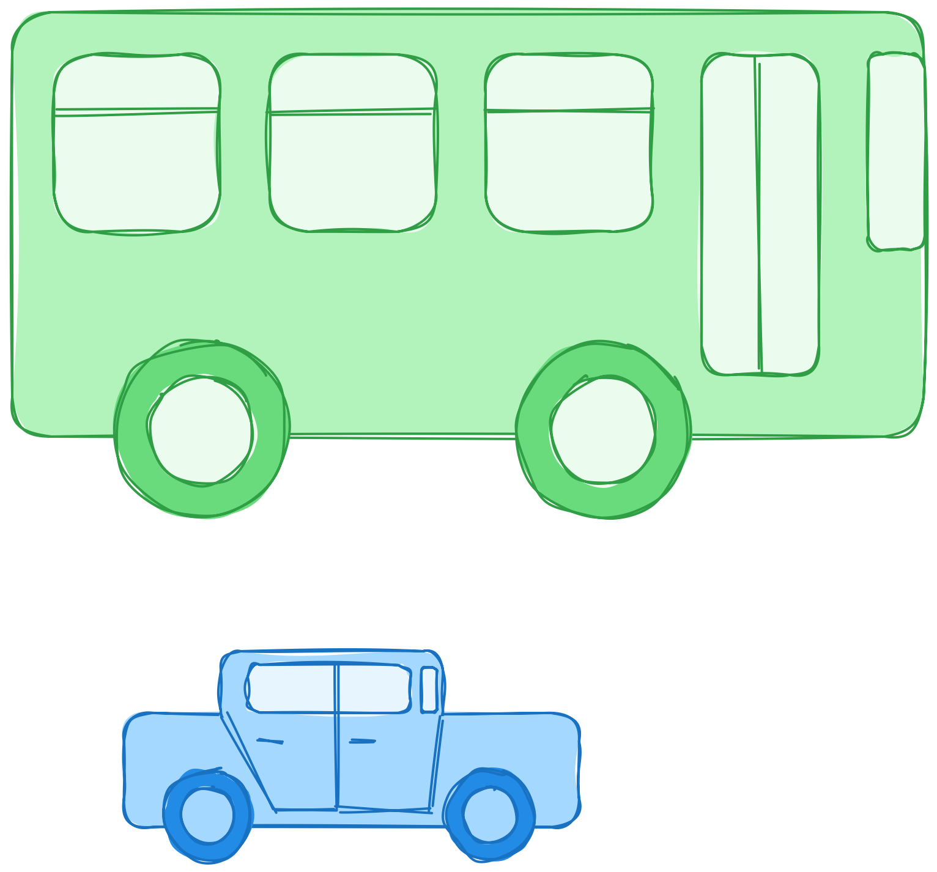
GPU Architecture at a Glance
What’s faster? Bus or car?
The question is not precise enough
Faster in doing what?
Bus will take longer to move a few people
Bus is optimized for moving many people
Car is optimized for moving a few people
Car will take longer to move many people
Notes:
And we’ll start by understanding why GPUs are so powerful.
Picture a bus and a car. Which one is faster?
This question is not precise enough. Faster in doing what?
If you only have a few people to transport, a car is quicker and more efficient.
But if you need to move a big crowd, a car will have to make multiple trips, taking more time overall.
A bus, on the other hand, might be slower for a handful of passengers, but it’s faster in carrying a large group all at once.
That’s exactly how CPUs and GPUs differ.
CPUs are very fast and flexible when handling a small number of tasks.
GPUs, on the other hand, can handle huge numbers of tasks in parallel, making them perfect for large datasets.
CUDA is the tool that lets us leverage GPUs for the right kinds of problems.

Slide 3
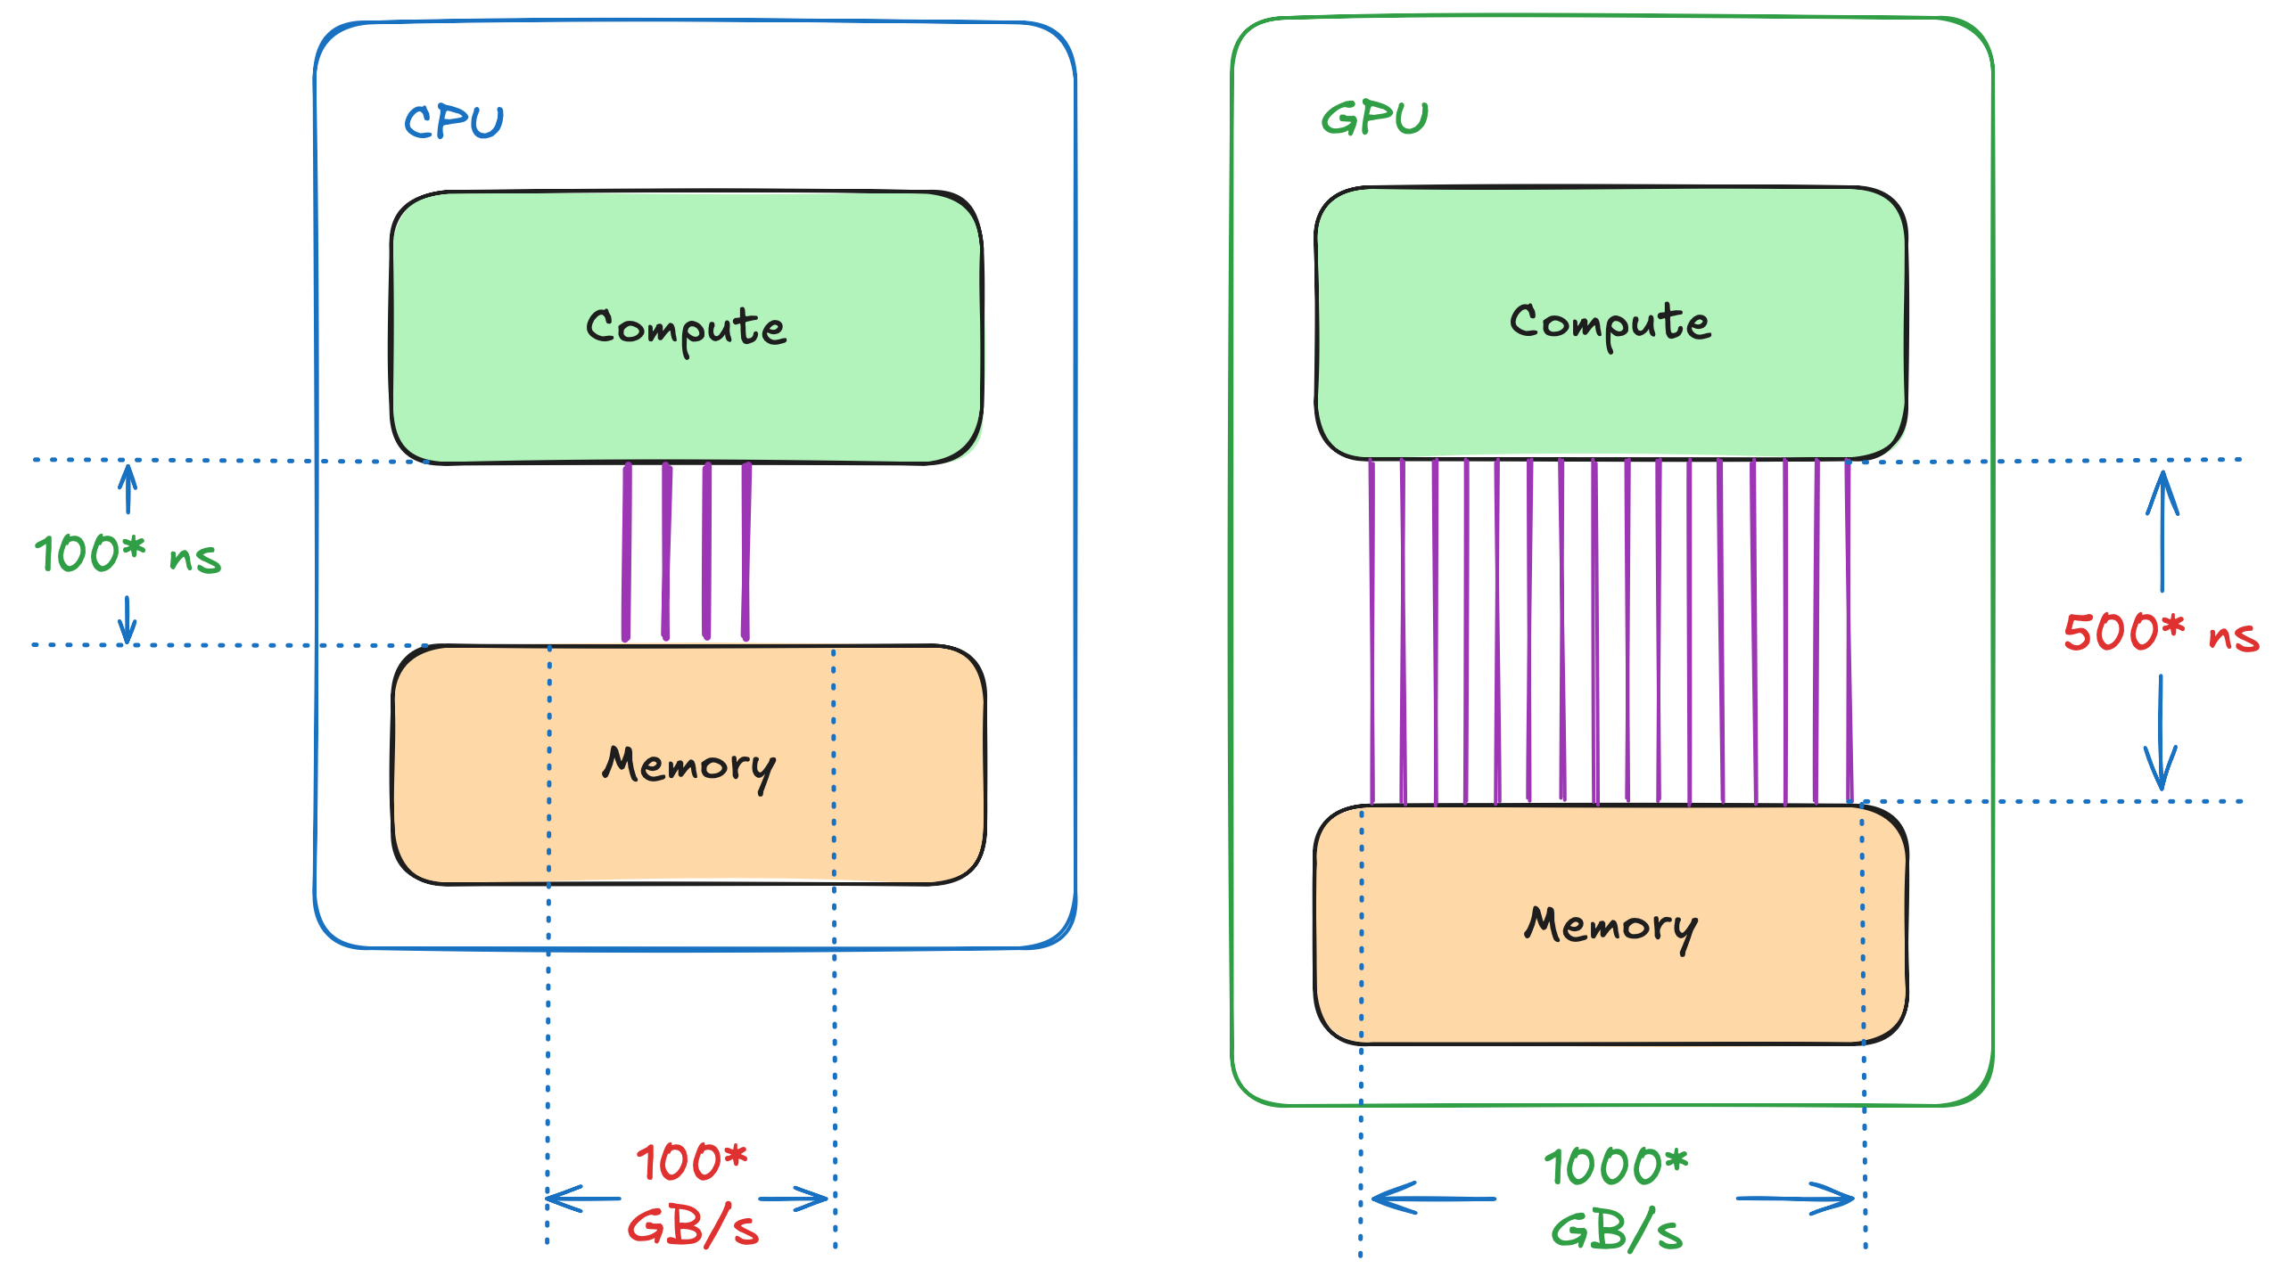
GPU Architecture at a Glance
*numbers are made up
Notes:
Next, let’s see how this bus-and-car analogy applies to real world.
On this slide, you can see two key parameters: bandwidth and latency.
• Bandwidth is how much data you can move at once.
• Latency, on the other hand, is how long it takes to move a single piece of data.
In our simplified example, the CPU (on the left) has lower latency: it can quickly access a single byte (say, in 100 ns).
The GPU (on the right) takes longer (about 500 ns), so it’s slower in loading a single byte.
But the GPU makes up for it with much higher bandwidth - up to 10 times more in this case.
It’s like a bus that may not be as fast as a car for one or two passenger but can carry far more people in a single trip.
Real hardware will have different numbers, but the key idea remains.
GPUs excel when you need to process lots of data in parallel.

Slide 4
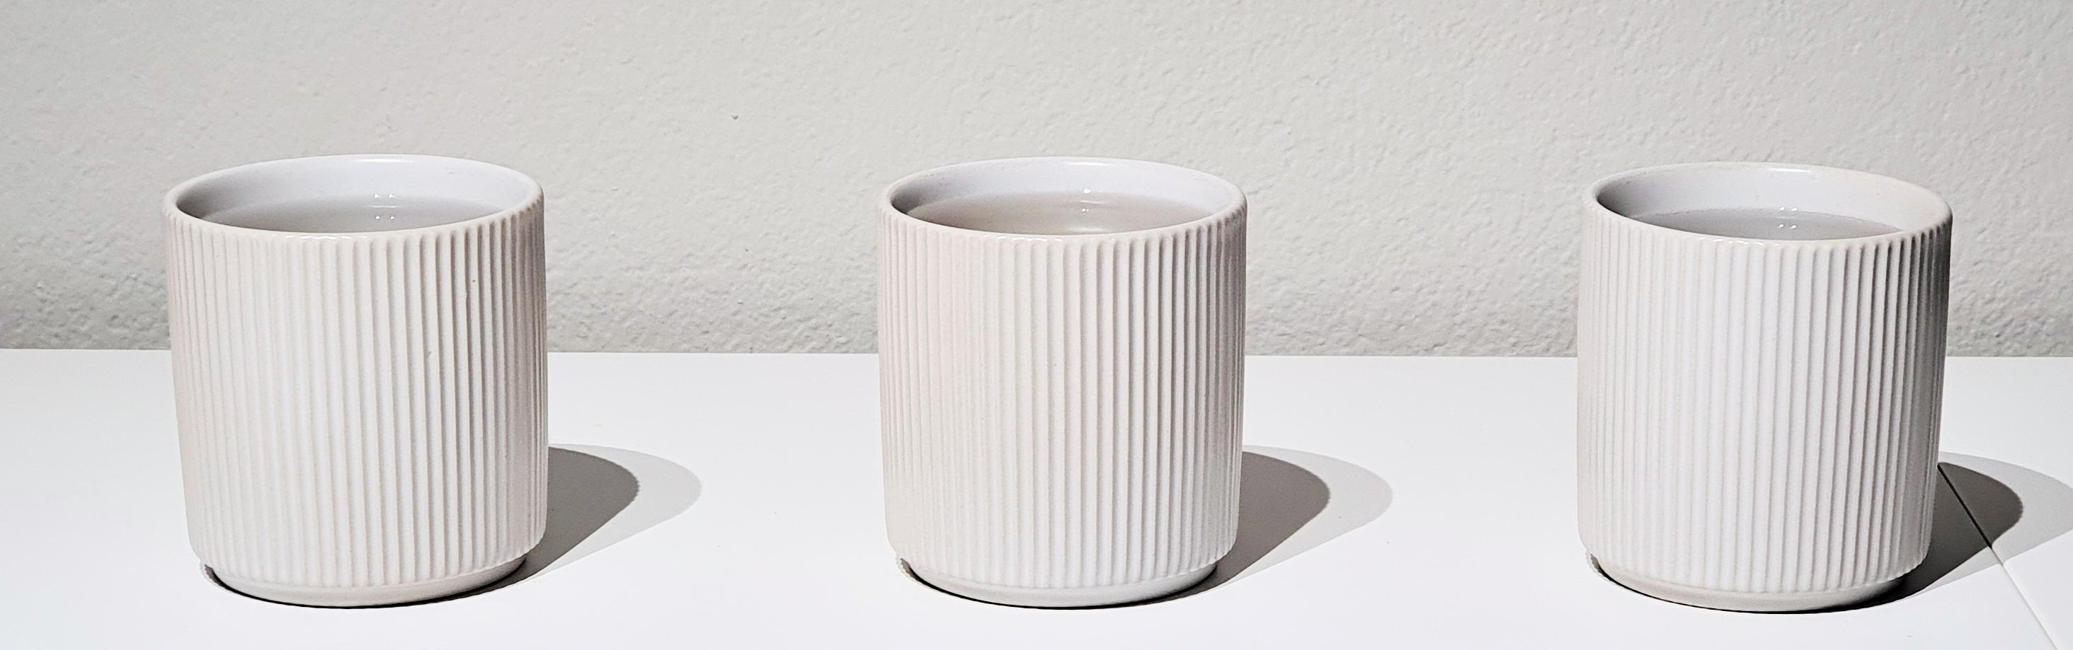

Which Problems Benefit from Bandwidth?
Let’s say we want to simulate 3 cups cooling down to a room temperature
We can abstract this problem a bit, by emulating a “sensor” in each cup
42℃
24℃
50℃
Notes:
So, how do you know if your problem will benefit from GPU’s higher bandwidth?
To build some intuition, imagine you have three cups of water at different temperatures: 42°, 24°, and 50°.
You want to simulate how they cool down over time.
But simulating every tiny detail - like shape or material - would be too complex.
Instead, you can simply represent each cup with just one number: its temperature.
Think of it like placing a temperature sensor in each cup.

Slide 5
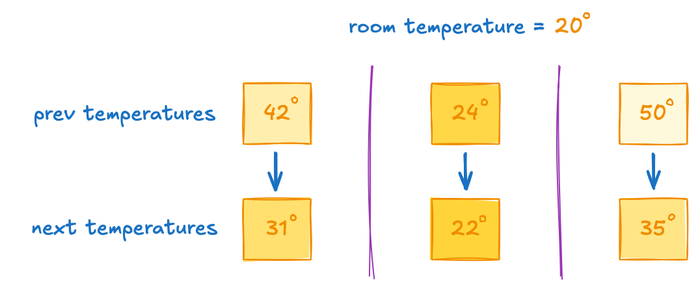
Which Problems Benefit from Bandwidth?
Let’s say we want to simulate N objects cooling down to a room temperature
Can this problem benefit from immense bandwidth provided by GPUs?
Just like before, the question is not precise enough
How large is N?
Notes:
Now the problem is much simpler: we have objects, each with its temperature.
And we want to simulate how these objects cool to the room temperature.
The question is: will this problem benefit from a GPU?
Just like with the bus-and-car analogy, this question is not precise enough.
It depends on how many objects you’re dealing with.
In other words, the answer depends on `N`.

Slide 6
Why GPU Programming?
Single-threaded CPU code is 150x faster than multi-threaded one (and 200x faster than GPU) when simulating 512 objects
Notes:
Let’s start small and see what happens when N is equal to 512.
While this may be a lot of cups for a kitchen, it’s actually too little data to take advantage of parallelism on either the GPU or the CPU to that matter.
On this slide you can see the time it take to solve the problem.
So, the lower the bar the better.
In this scenario, single-threaded CPU code runs so quickly that we can’t even see the bar representing it.
In fact, here single-threaded CPU code is 150 times faster than multi-threaded code and 200 times faster than the GPU.
This happens because the overhead of launching threads and managing parallelism outweighs the benefits of increased throughput.
For such small workloads, a single-threaded CPU approach is usually the most efficient.

Slide 7
Why GPU Programming?
Single-threaded CPU code is 150x faster than multi-threaded one (and 200x faster than GPU) when simulating 512 objects
But as problem size grows, multi-threaded code overcomes limitations of a single thread, making it a better option when simulating 64k elements
Notes:
Now let’s scale up to 65,000 objects.
At this size, the multi-threaded CPU code finally overtakes the single-threaded approach.
Increased memory and arithmetic throughput of multi-threaded CPU code finally overcomes mentioned overheads.
But we can’t say this about GPU yet.
At this problem size, it performs similar to the single-threaded code.

Slide 8
Why GPU Programming?
Single-threaded CPU code is 150x faster than multi-threaded one (and 200x faster than GPU) when simulating 512 objects
But as problem size grows, multi-threaded code overcomes limitations of a single thread, making it a better option when simulating 64k elements
Finally, GPU achieves 10x of multi-threaded CPU bandwidth, hence it’s the fasted on 268M elements
Notes:
Finally, if we jump to 200 million objects, the GPU takes the lead, performing roughly ten times faster than the multi-threaded CPU code.
That ten-fold improvement directly reflects the difference in bandwidth between CPU and GPU.
But, as you can see, you need a large enough problem to take advantage of this increased bandwidth.

Slide 9
Agenda
• | CUDA Made Easy: Accelerating Applications with Parallel Algorithms
• | Break (35 mins)
• | Unlocking the GPU’s Full Potential: Asynchrony and CUDA Streams
• | Break (15 mins)
• | Implementing New Algorithms with CUDA Kernels
• | Final Assessment (45 minutes)
Notes:
With that in mind, let’s take a look at our agenda for today.
First, we’ll begin with “CUDA Made Easy” section.
Here, you’ll learn the basics of writing CUDA code.
You’ll get hands-on practice by porting the cooling simulator we mentioned from the CPU to the GPU.
After a 35 minutes lunch break, we’ll move on to the next section, called ”Unlocking the GPU’s Full Potential”.
Here, you’ll learn a few optimization techniques allowing you to take full advantage of the GPU’s.
Then, we’ll take a quick 15-minute break before diving into “Implementing New Algorithms with CUDA Kernels”.
In this section, you’ll explore designing and building custom GPU algorithms for problems not covered by existing libraries.
Finally, we’ll wrap up with a final assessment that ties everything together, giving you a chance to apply what you’ve learned in a real-world context.
By the end of the day, you’ll have a solid foundation to start writing your own GPU-accelerated programs and to continue your journey into CUDA.

Slide 10
CUDA Made Easy:
Accelerating Applications with Parallel Algorithms
Notes:
Let’s get started with the first section!
Here, we’ll focus on the fundamentals of CUDA programming.
Our goal is to demystify the process of writing programs that run on GPUs and show you how to think in terms of parallel algorithms.

Slide 11
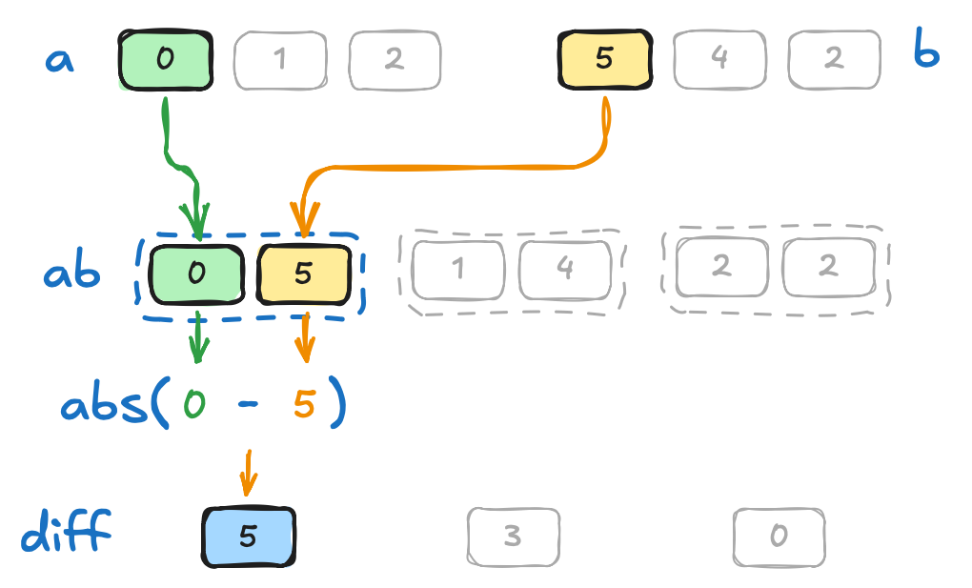
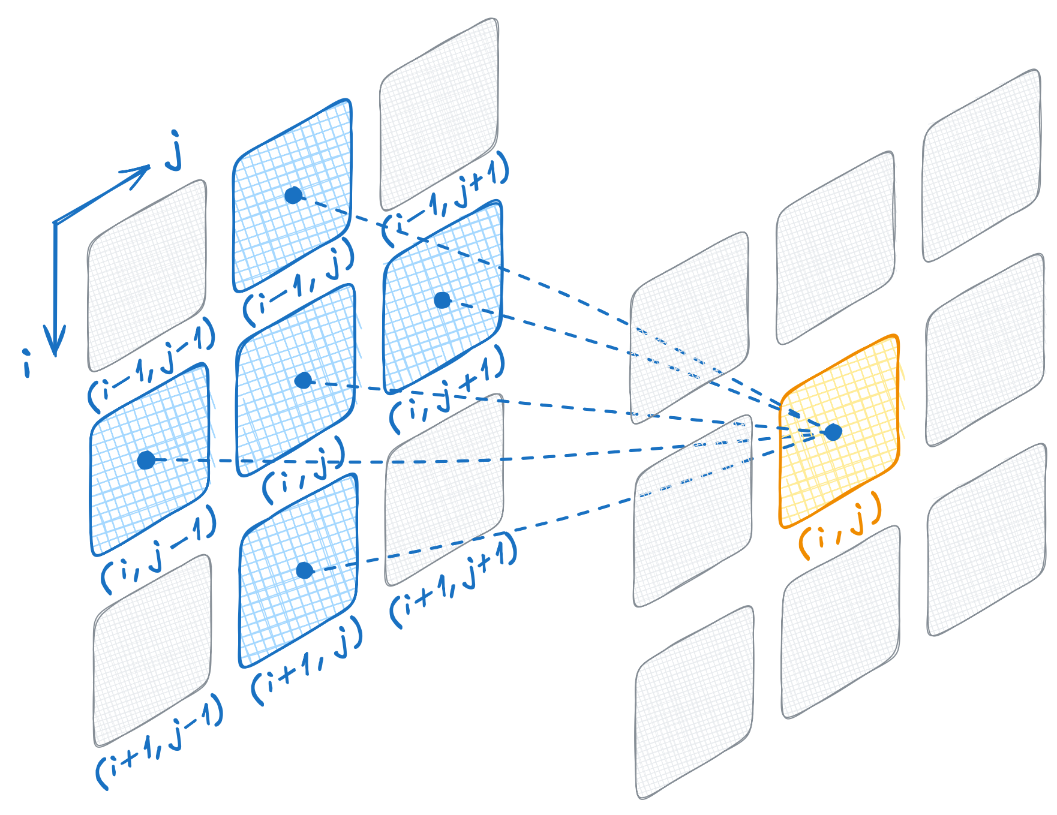
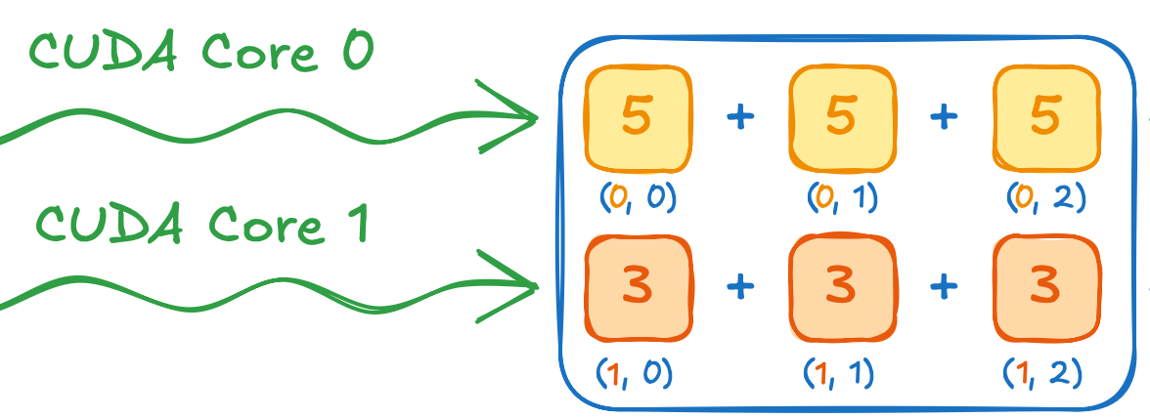
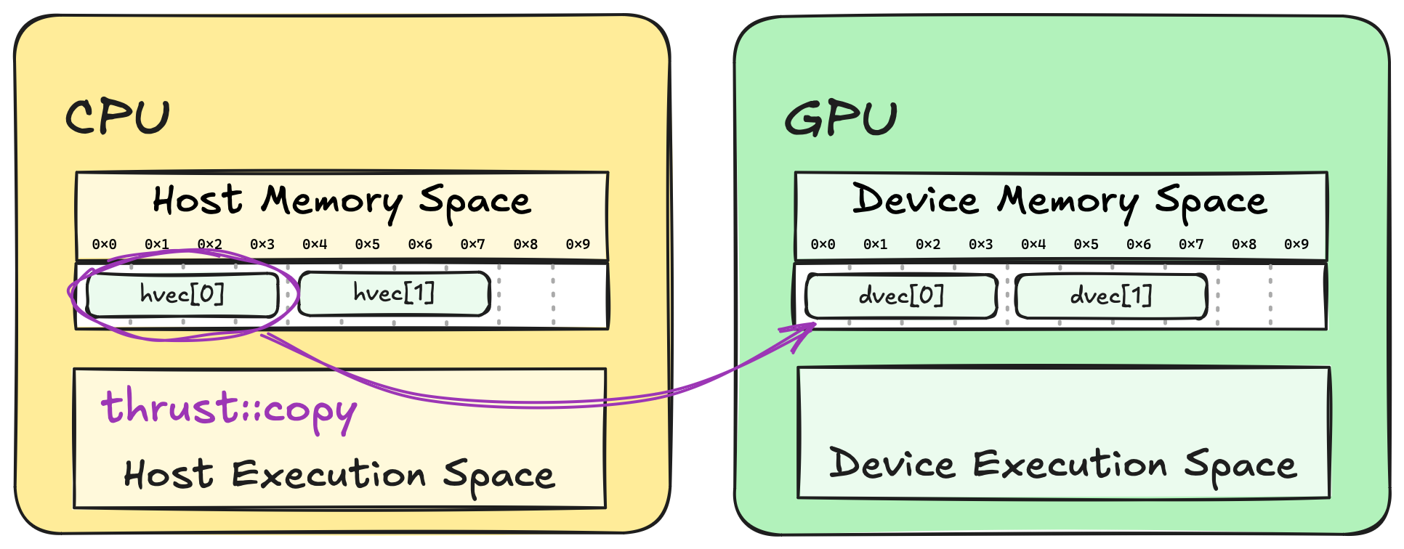
Section at a Glance
Learn 1.2 Execution Spaces as we accelerate naïve cooling simulator and achieve 16x speedup
Learn 1.3 Extending Algorithms with fancy iterators to achieve 2x speedup
Learn 1.4 Vocabulary Types as we transition from naive cooling to stencil-based simulation
Learn concept of 1.5 Parallelism as we accelerate one of the algorithms by 300x
Learn concept of 1.6 Memory Spaces as we accelerate one of the algorithms by 100x
Notes:
Let’s take a look at what we’ll cover in this section.
We’ll begin with the essential concept of execution spaces, which will enable us to GPU-accelerate our simple cooling simulator using parallel algorithms.
Next, we’ll explore how to extend these parallel algorithms when they don’t precisely fit your needs.
Along the way, we’ll introduce the concept of vocabulary types to boost developer productivity.
We’ll apply these vocabulary types to convert our basic cooling simulator into a full 2D heat equation simulator.
As we do that, we’ll build a clear understanding of how serialization impacts performance.
Finally, we’ll discuss memory spaces and see how they can help us further optimize the simulator.
By the end of this section, you’ll have a solid grasp of how to GPU-accelerate your code with parallel algorithms.

Slide 12
Independent Cooling
Problem statement
$$T_{n}=T_{n−1}+k(T_{room}−T_{n−1})$$
Notes:
Let’s revisit the problem of N objects cooling down to room temperature.
Our goal is to simulate how these objects gradually approach the ambient temperature, using the equation shown below.
At each step, the equation adjusts an object’s temperature based on the difference between its current temperature and the room temperature.
Crucially, each object cools down independently.
They all follow the same rule, but one object’s temperature doesn’t affect another’s.
This independence makes it a perfect candidate for parallel computing, because we can update every object’s temperature at the same time.
Below, you can see how each object’s temperature changes at the next step. Over time, they all move closer to the ambient temperature of 20 degrees.

Slide 13
Transform
Simple C++ simulation
float k = 0.5;
float ambient_temp = 20;
std::vector<float> temp{42, 24, 50};
auto op = [=](float temp) {
float diff = ambient_temp - temp;
return temp + k * diff;
};
for (int step = 0; step < 3; step++)
{
print(step, temp);
std::transform(temp.begin(), temp.end(),
temp.begin(), op);
}
Multiple objects cool down independently
Iterative change of state
Computed on CPU (for now)
step | temp[0] | temp[1] | temp[2]
0 | 42.0 | 24.0 | 50.0
1 | 31.0 | 22.0 | 35.0
2 | 25.5 | 21.0 | 27.5
Notes:
Let’s see how we can implement this simulation in C++.
We start by defining a cooling coefficient, k, and setting ambient temperature of 20 degrees.
The temp vector holds initial temperatures for three objects.
We then define a lambda function that calculates the new temperatures based on the old ones.
Next, we apply this function to each temperature using std::transform, which updates the values in-place.
By running this transformation for several steps, each object’s temperature gradually shifts closer to ambient.
This can be seen in the table on the right.
Initially, on the step zero, we have temperatures we started with, 42, 24, and 50 degrees.
Towards the second step, these temperatures turn into 25, 21, and 27 degrees.

Slide 14
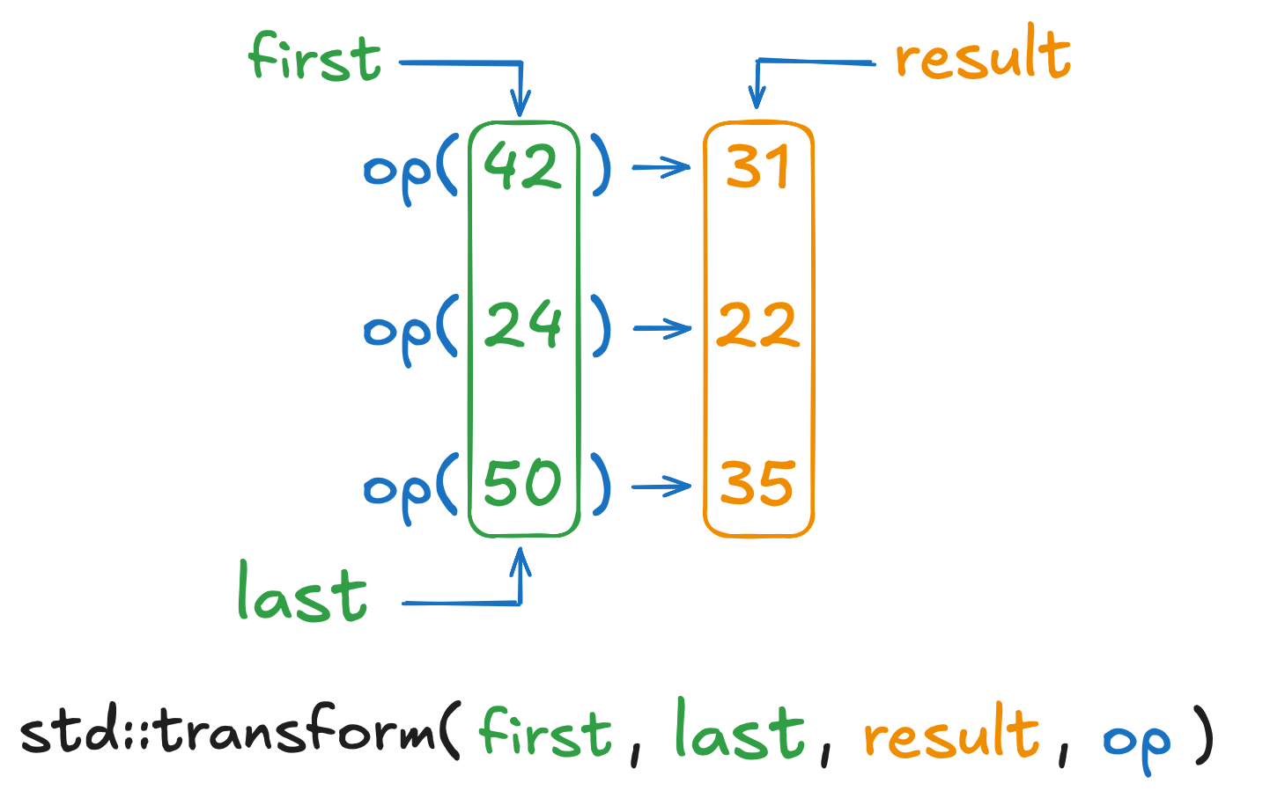
Transform
For execution on GPU
auto op = [=](float temp) {
float diff = ambient_temp - temp;
return temp + k * diff;
};
std::transform(temp.begin(), temp.end(),
temp.begin(), op);
applies a given function to the elements of the input range, and
stores the result in the output range
Notes:
Just in case you’re not familiar with std::transform, here’s a quick overview.
It’s a standard library algorithm that takes a range of input elements, applies an operation to each one, and stores the result in a given output range.
Think of it as a conveyor belt: each item goes in, gets transformed, and then the output is placed somewhere.
In our case:
• We provide the start and the end of the temp vector to specify the input range.
• We then specify temp.begin() again as the output, so we overwrite the original values in-place.
• Finally, we pass our lambda function, which calculates the new temperature.
Visually, each old temperature is fed into the operation:
• 42 becomes 31
• 24 becomes 22
• 50 becomes 35

Slide 15
Transform
For execution on GPU
auto op = [=](float temp) {
float diff = ambient_temp - temp;
return temp + k * diff;
};
std::transform(temp.begin(), temp.end(),
temp.begin(), op);
for (int i = 0; i < temp.size(); i++) {
temp[i] = op(temp[i]);
}
Notes:
In C++, std::transform can be implemented as a simple for loop, like the one you see on the screen.
But let’s take a step back and see what must happen to run this code on the CPU.

Slide 16
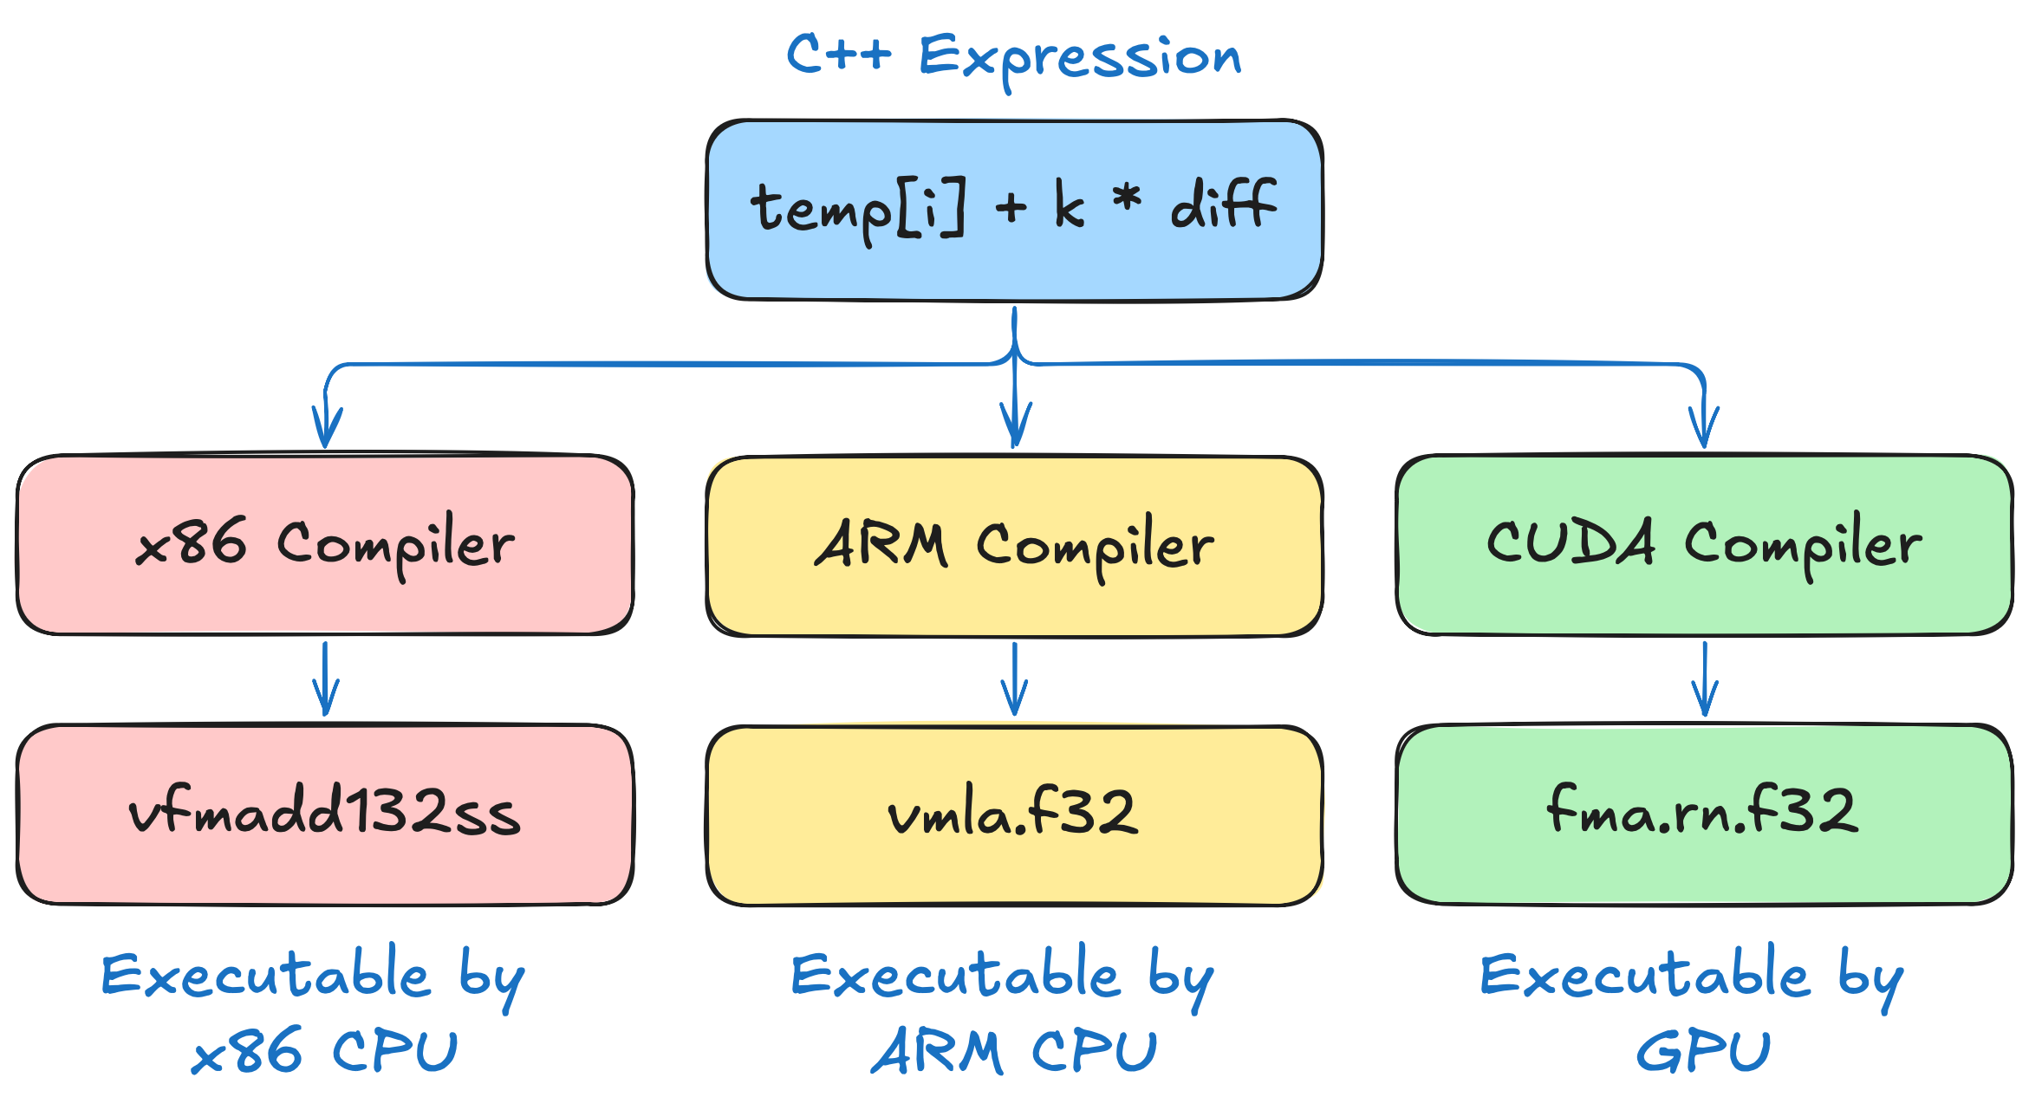
Compilation
Of a simple C++ simulation
Notes:
The problem is, CPUs do not run C++ code!
They only understand machine instructions.
That’s why we need a compiler to translate our C++ code into CPU instructions.
For instance, C++ expression on the slide will likely be compiled into fused multiply-add instruction like vfmadd.
However, different CPUs have different instruction sets.
For example, vfmadd instruction only works on x86 CPUs.
Other CPU architectures, say ARM, have different instructions.
This means that by default, the code you compile for one CPU architecture like x86, won’t run on another architecture, like ARM, and vice versa.
And GPUs are no different.
They’re just another processor type with their own set of instructions.
This means we need a specialized compiler that can emit GPU instructions.

Slide 17
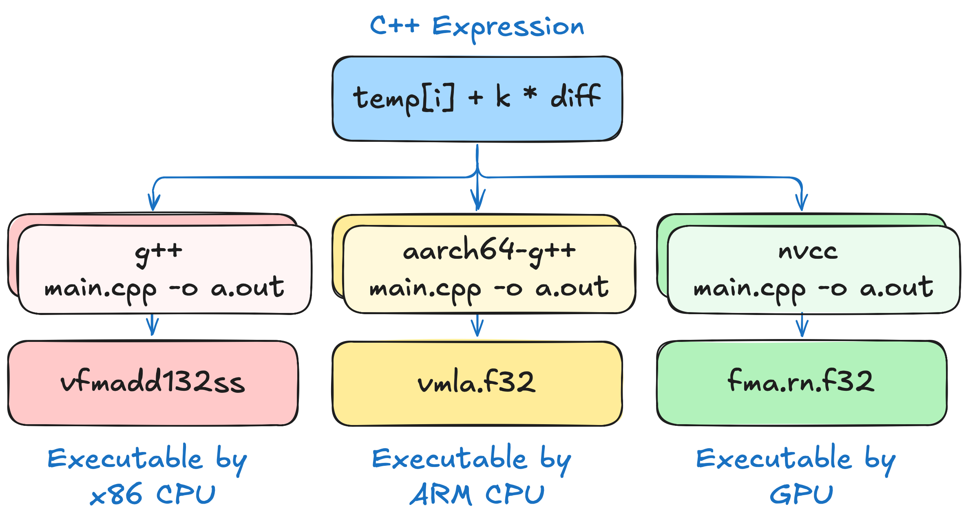
Compilation
Of a simple C++ simulation
NVCC (NVIDIA CUDA Compiler Driver) knows how to turn C++ code into GPU instructions
Notes:
That’s where the NVIDIA CUDA Compiler, or NVCC, comes in.
NVCC is a tool that lets us compile CUDA C++ code specifically for NVIDIA GPUs.
Congratulations, you've just compiled your first CUDA program!
But there’s one issue.
The program you’ve just compiled is not using GPUs at all.
That might be surprising because when we compiled out code for CPU, the entire program was executed on a CPU.
But now we compile our program for GPU, and nothing runs on GPU.
This confusion is an indicator that we are missing an important piece of CUDA programming model.

Slide 18
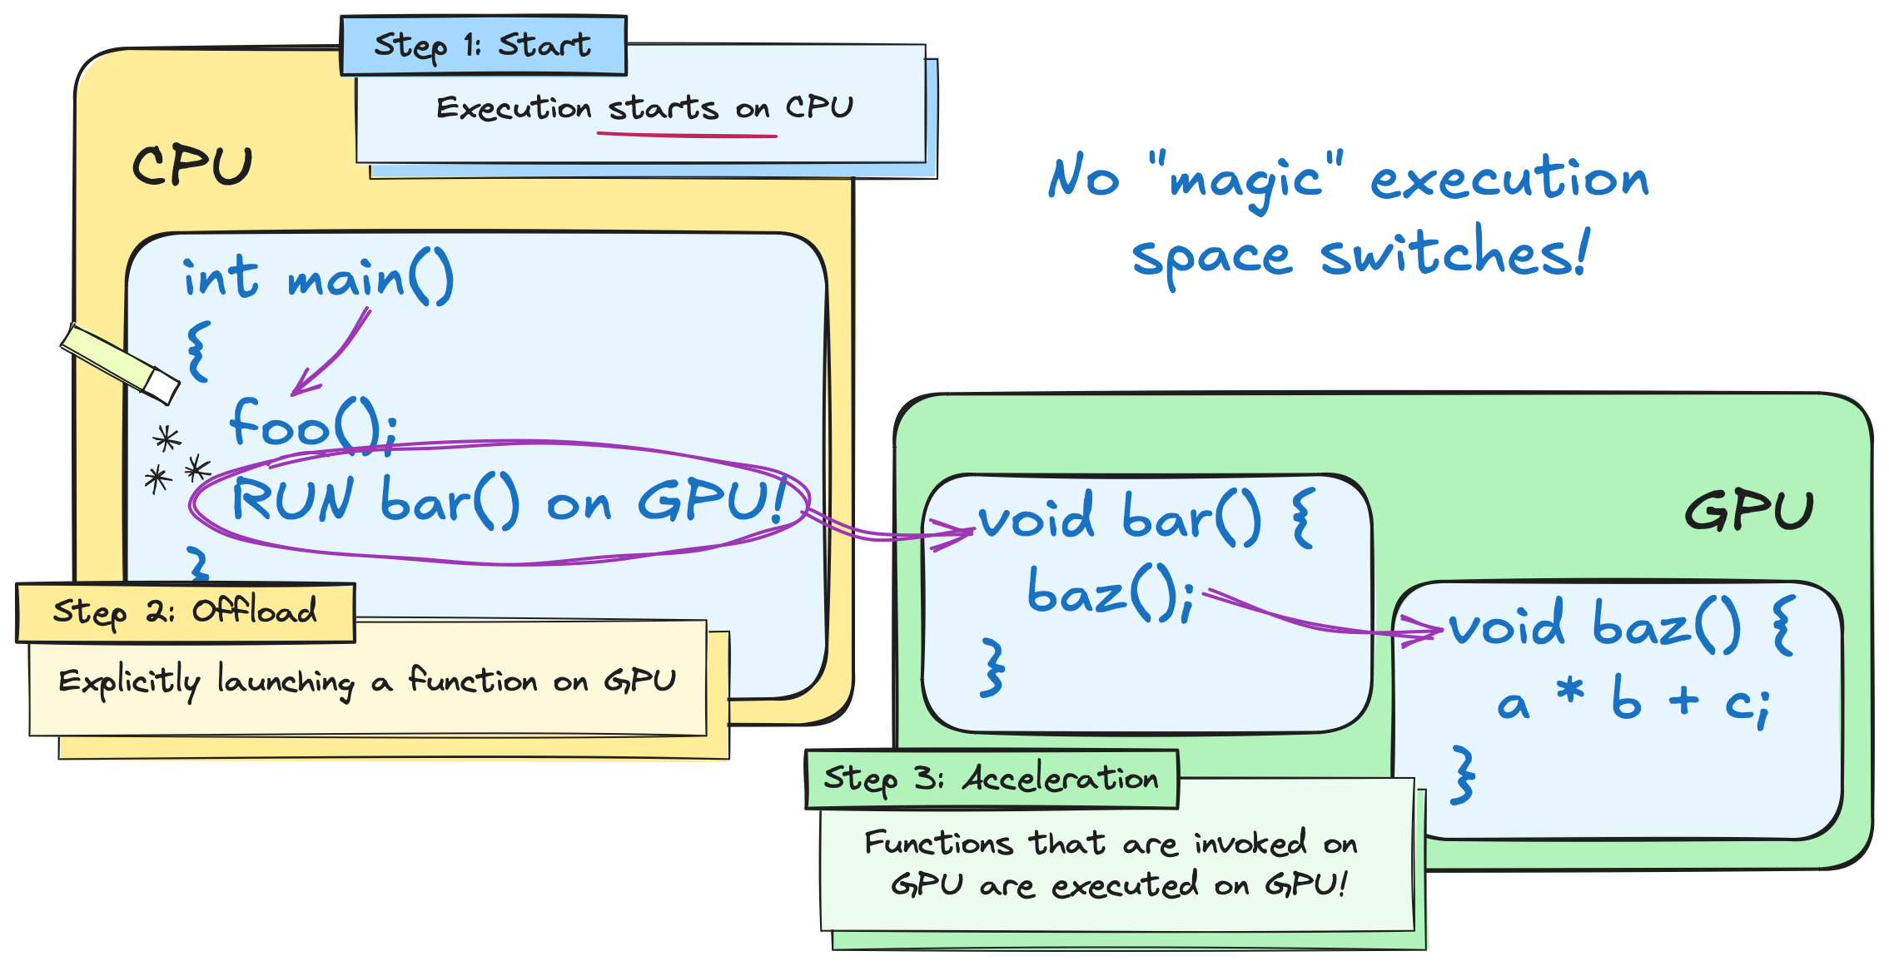
Heterogeneous Programming Model
Notes:
GPUs are accelerators rather than standalone processors.
A lot of work, like interactions with network and file system, can only be done on CPU.
So, a CUDA program always starts on the CPU.
You are responsible for explicitly specifying which code has to run on the GPU.
In other words, you are responsible for specifying which code runs where.
The established terminology for where code is executed is execution space.
At a high level, these execution spaces are partitioned into host (CPU) and device (GPU).
These terms are used to generalize programming model.
Something other than a CPU could host a GPU, and something else than a GPU could accelerate a CPU.
By default, code runs on the host side.
You are responsible for specifying which code should run on the device.
This should explain why using NVCC alone was insufficient.
We haven't marked any code for execution on the GPU.

Slide 19
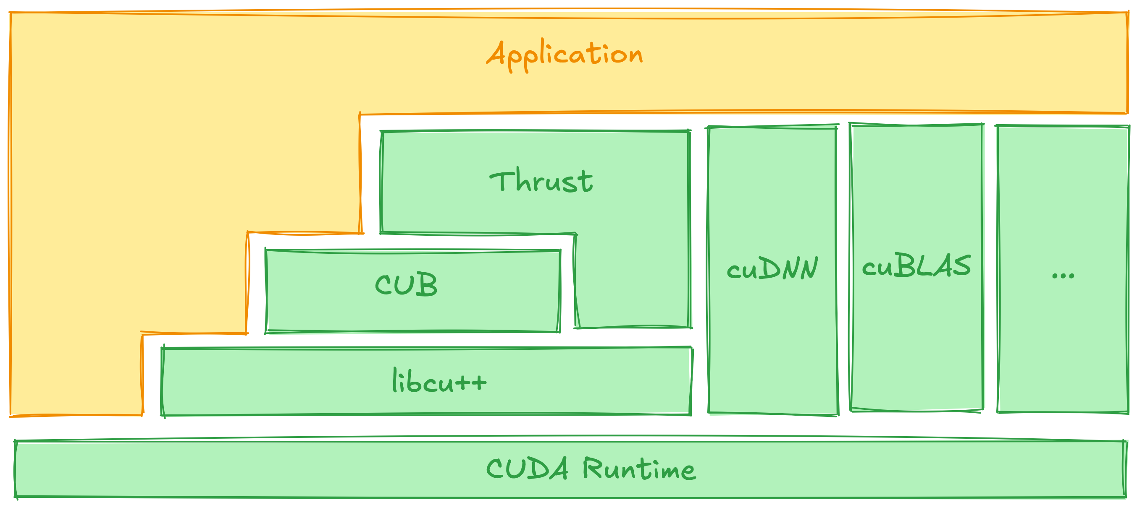
Software Stack
Applications utilize libraries to:
simplify development
maximize performance
CUDA Runtime
Underpins the entire stack
Provides interface to GPU
Notes:
So, how do we actually run any code on the GPU?
In C++, we often rely on libraries rather than re-implementing every feature from scratch.
For instance, it’s likely that you’ve used printf or std::sort instead of implementing them.
And CUDA is no different.
Along with NVCC, CUDA provides a wealth of GPU-accelerated libraries.
Some libraries are generic, like Thrust, which offers high-level algorithms similar to the C++ Standard Library.
There are also domain-specific libraries, such as cuDNN for deep neural networks and cuBLAS for linear algebra.
Most of these build on the CUDA Runtime - the core set of APIs for managing and communicating with the GPU.
Since this course is not domain-specific, we’ll focus on one of the generic libraries – Thrust.
Let’s dive in!

Slide 20
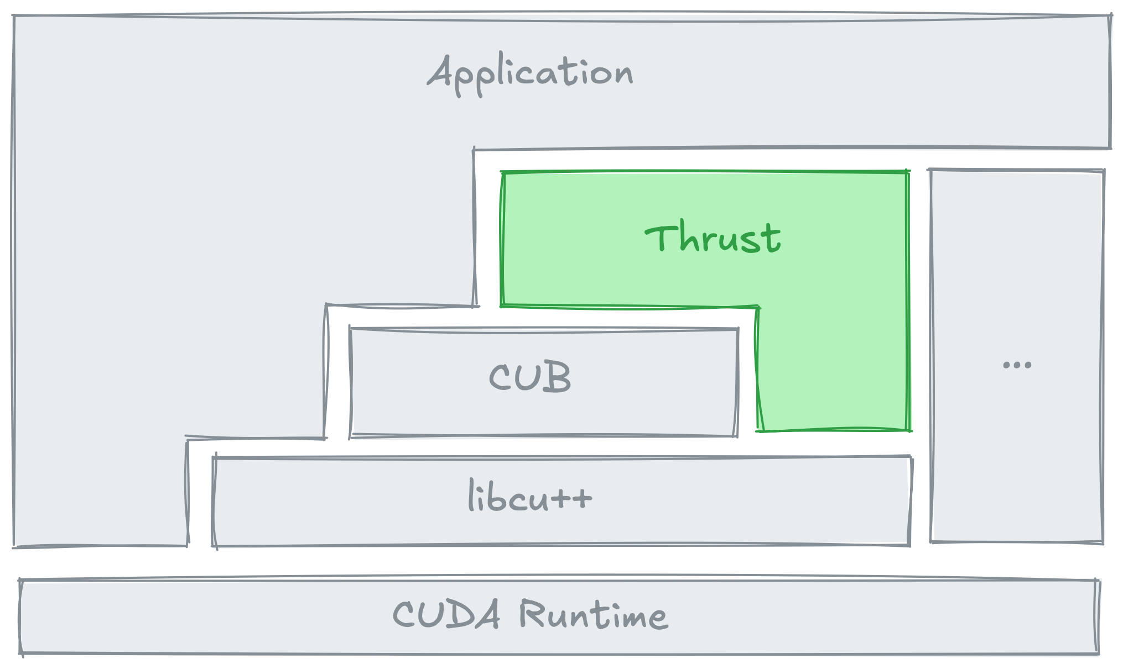
Thrust Overview
Standard Algorithms
thrust::copy
thrust::sort
thrust::find
...
Containers
thrust::host_vector
thrust::device_vector
thrust::universal_vector
...
Function Objects
thrust::plus
thrust::less
thrust::multiplies
...
Extended Algorithms
thrust::tabulate
thrust::sort_by_key
thrust::reduce_by_key
...
Iterators
thrust::constant_iterator
thrust::counting_iterator
thrust::transform_iterator
...
https://nvidia.github.io/cccl/thrust/api.html
Notes:
Thrust is a library that helps you write GPU-accelerated programs using tools that feel very similar to the C++ Standard Library.
It simplifies working with GPUs by offering prebuilt components for common tasks:
Thrust containers give you GPU-friendly alternatives to things like std::vector.
And Thrust algorithms, like thrust::copy, thrust::sort, etc., provide GPU-accelerated alternatives to standard algorithms.
Long story short, Thrust makes it easier to write clean, efficient code for GPUs without worrying too much about the low-level details.
We’ll start simple and explore how Thrust can help accelerate our cooling simulator.

Slide 21

Porting Algorithms to GPU
Using parallel algorithms
std::vector<float> temp{ 42, 24, 50 };
auto op = [=] (float temp) {
float diff = ambient_temp - temp;
return temp + k * diff;
};
std::transform(temp.begin(), temp.end(),
temp.begin(), op);
thrust::universal_vector<float> temp{ 42, 24, 50 };
auto op = [=] __host__ __device__ (float temp) {
float diff = ambient_temp - temp;
return temp + k * diff;
};
thrust::transform(thrust::device,
temp.begin(), temp.end(),
temp.begin(), op);
Notes:
On the left, you can see our CPU version, where we use std::vector to store data and std::transform to apply the cooling operation.
On the right, we’ve adapted it for GPU execution with Thrust:
• We replaced std::vector with thrust::universal_vector
• We also added __host__ __device__ specifiers to the lambda
• And lastly, we swapped std::transform for thrust::transform, and provided the thrust::device execution
With these small changes, our code is now set up to run efficiently on the GPU.
Thrust keeps the style of the C++ standard library but makes GPU acceleration much more straightforward.
Next, let’s take a closer look at each of these adjustments, starting with the execution space specifiers.

Slide 22
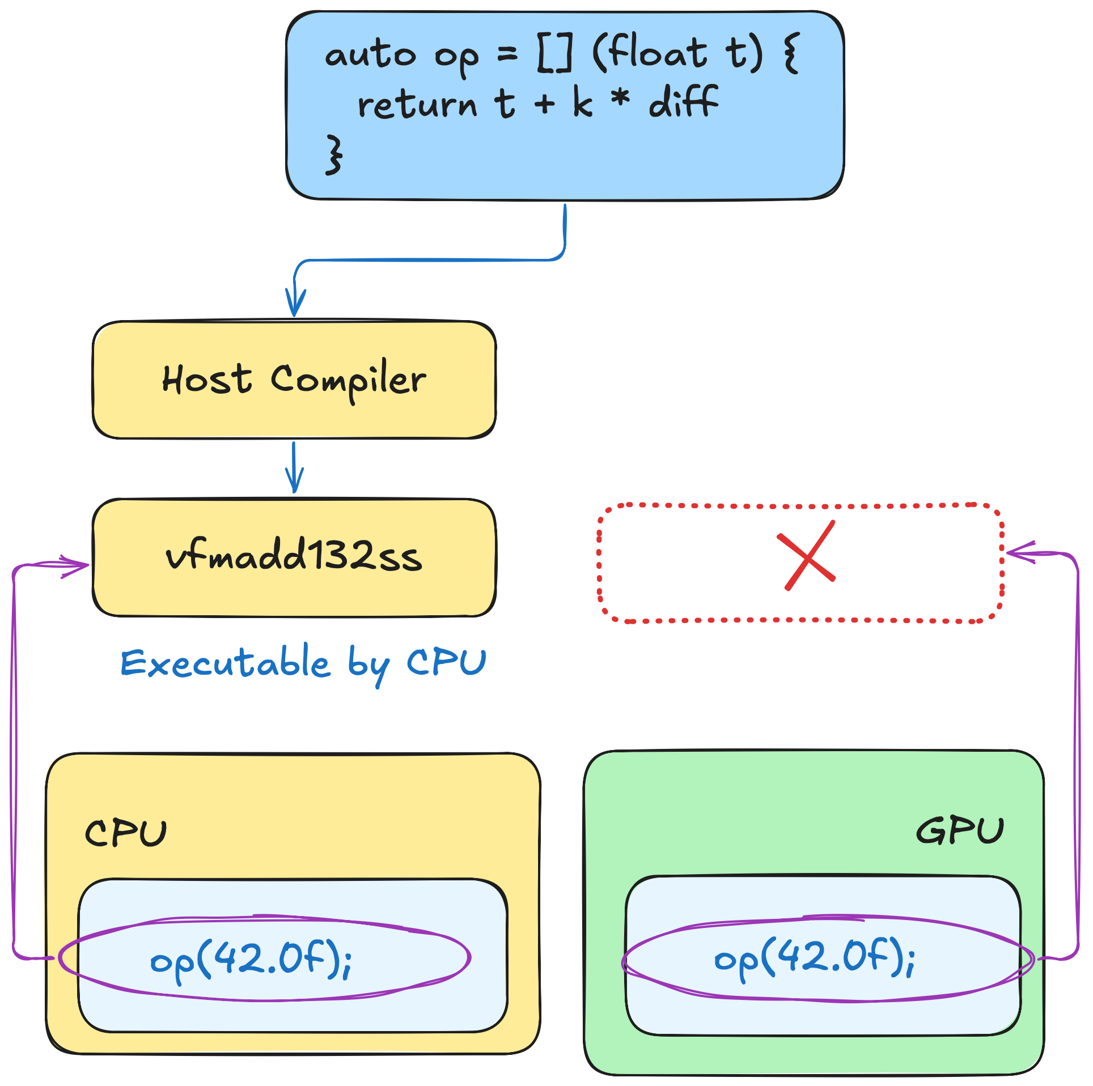
Porting Algorithms to GPU
Execution space specifier
By default, all functions are compiled for CPU
If you attempt to invoke this function on GPU, there’ll be no code for it to execute
Notes:
As we discussed, you must specify which hardware each function is compiled for.
That’s where execution space specifiers come into play.
If you remember, all code is compiled for CPUs by default.
That means that if you don’t annotate the function in any way, there’ll be no instructions for GPU to execute!

Slide 23
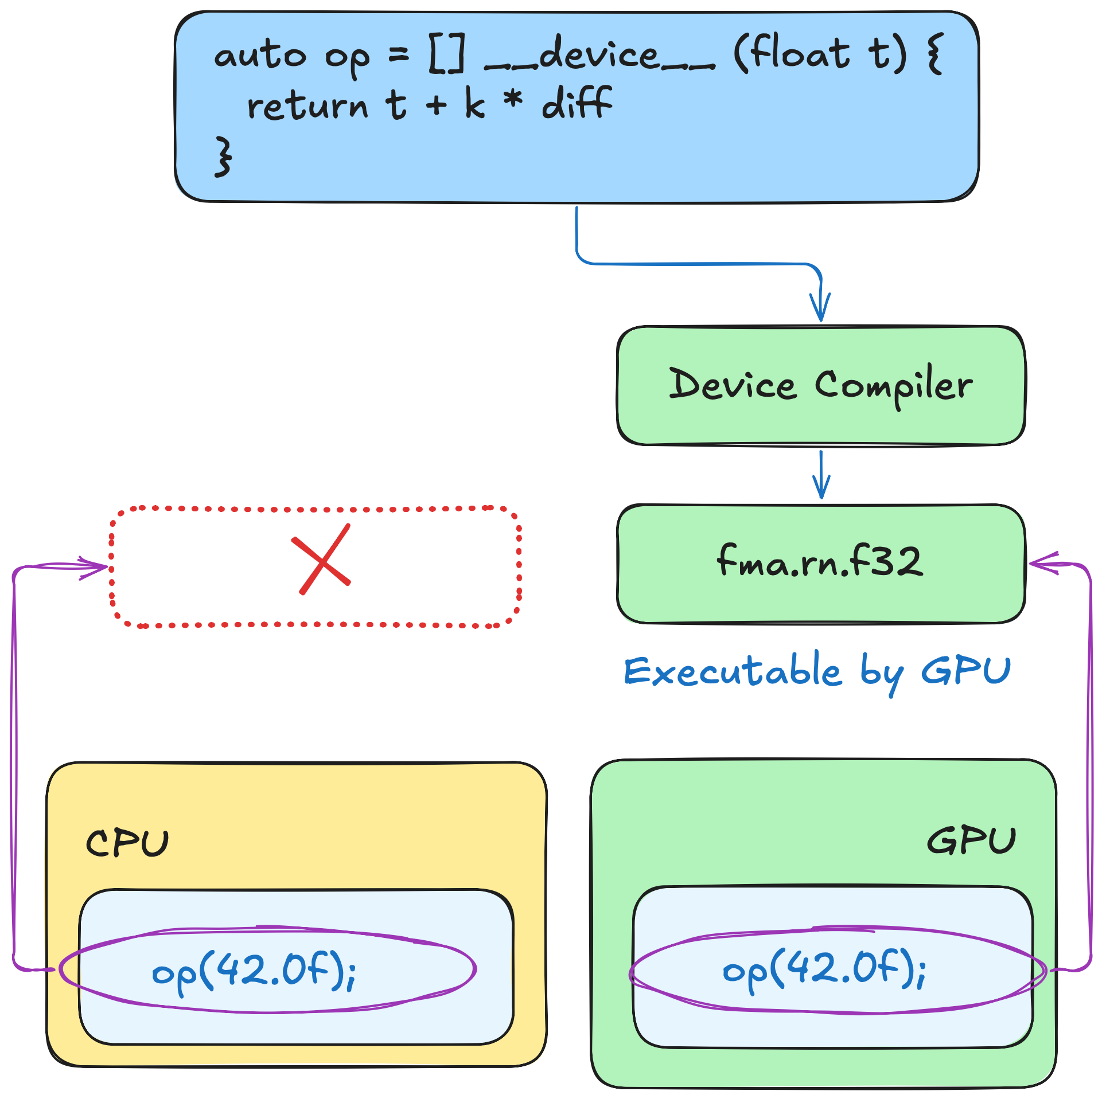
Porting Algorithms to GPU
Execution space: host & device
Notes:
To fix that, you can annotate lambda function with `__device__` execution space specifier
In this case, nvcc will generate instructions only for the GPU.
But now, there are no instructions for the CPU to execute.

Slide 24
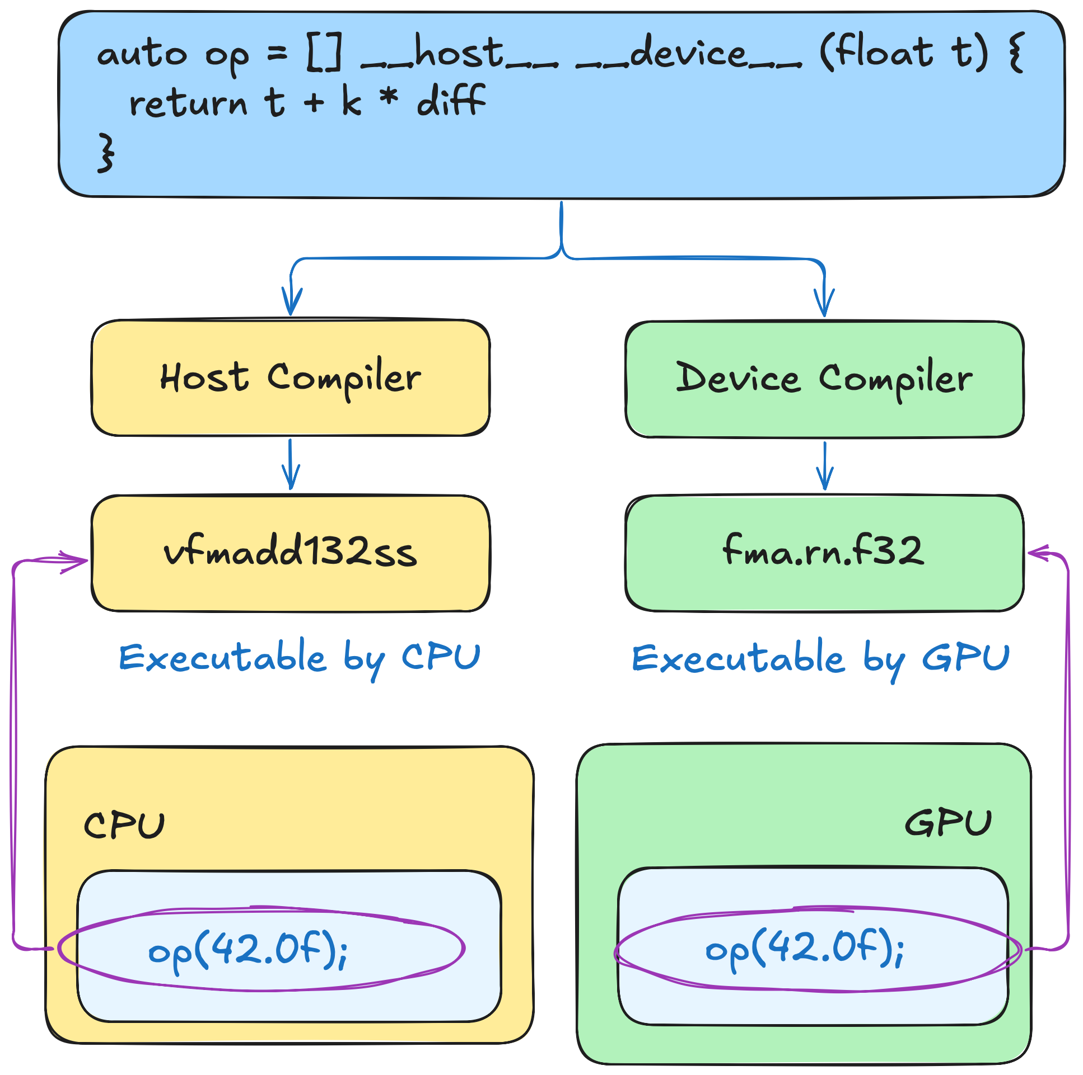
Porting Algorithms to GPU
Execution space: host-device
thrust::universal_vector<float> temp{ 42, 24, 50 };
auto op = [=] __host__ __device__ (float temp) {
float diff = ambient_temp - temp;
return temp + k * diff;
};
thrust::transform(thrust::device,
temp.begin(), temp.end(),
temp.begin(), op);
Notes:
If you want the function to get compiled for both CPU and GPU, you can add __host__ and __device__ specifiers at the same time.
And that’s exactly what we’ll do for the rest of this course.

Slide 25
Execution Policy
C++
CUDA C++
std::transform(temp.begin(), temp.end(),
temp.begin(), op);
thrust::transform(thrust::device,
temp.begin(), temp.end(),
temp.begin(), op);
What is an execution policy for?
It tells Thrust where to run the algorithm
thrust::host
Executes algorithms on the CPU (host)
Consistent interface
Allows code reuse between CPU and GPU
thrust::device
Executes algorithms on the GPU (device).
Notes:
Besides the execution specifiers, we’ve made another change.
In the original code, we used std::transform, and in the GPU version, we use thrust::transform.
Aside from the difference in the namespaces, the main change is that we added thrust::device as the first parameter.
This parameter is called execution policy.
It tells Thrust where to run the algorithm. For example:
• thrust::host runs the algorithm on the CPU, behaving much like std::transform.
• thrust::device, on the other hand, runs the algorithm on the GPU.
Thanks to this consistent interface, you can write your algorithm once and then decide whether it runs on the CPU or GPU.
This eliminates the need to maintain two separate code paths and makes switching between CPU and GPU as easy as changing the execution policy.

Slide 26
Execution Policy is Not New
C++
CUDA C++
std::transform(temp.begin(), temp.end(),
temp.begin(), op);
thrust::transform(thrust::device,
temp.begin(), temp.end(),
temp.begin(), op);
std::transform(std::execution::par,
temp.begin(), temp.end(),
temp.begin(), op);
Execution policy is not a Thrust-specific concept
If you are familiar with C++ 17 parallel algorithms, Thrust execution policies are like std::execution
Notes:
To be on the same page, execution policies aren’t unique to Thrust.
Instead, they’re a broader idea that even inspired the parallel algorithms introduced in C++17.
In both Thrust and C++17, execution policies are provided as first parameter and modify how the code runs.
But Thrust goes a step further by also specifying where the computation happens — on the CPU or GPU.

Slide 27
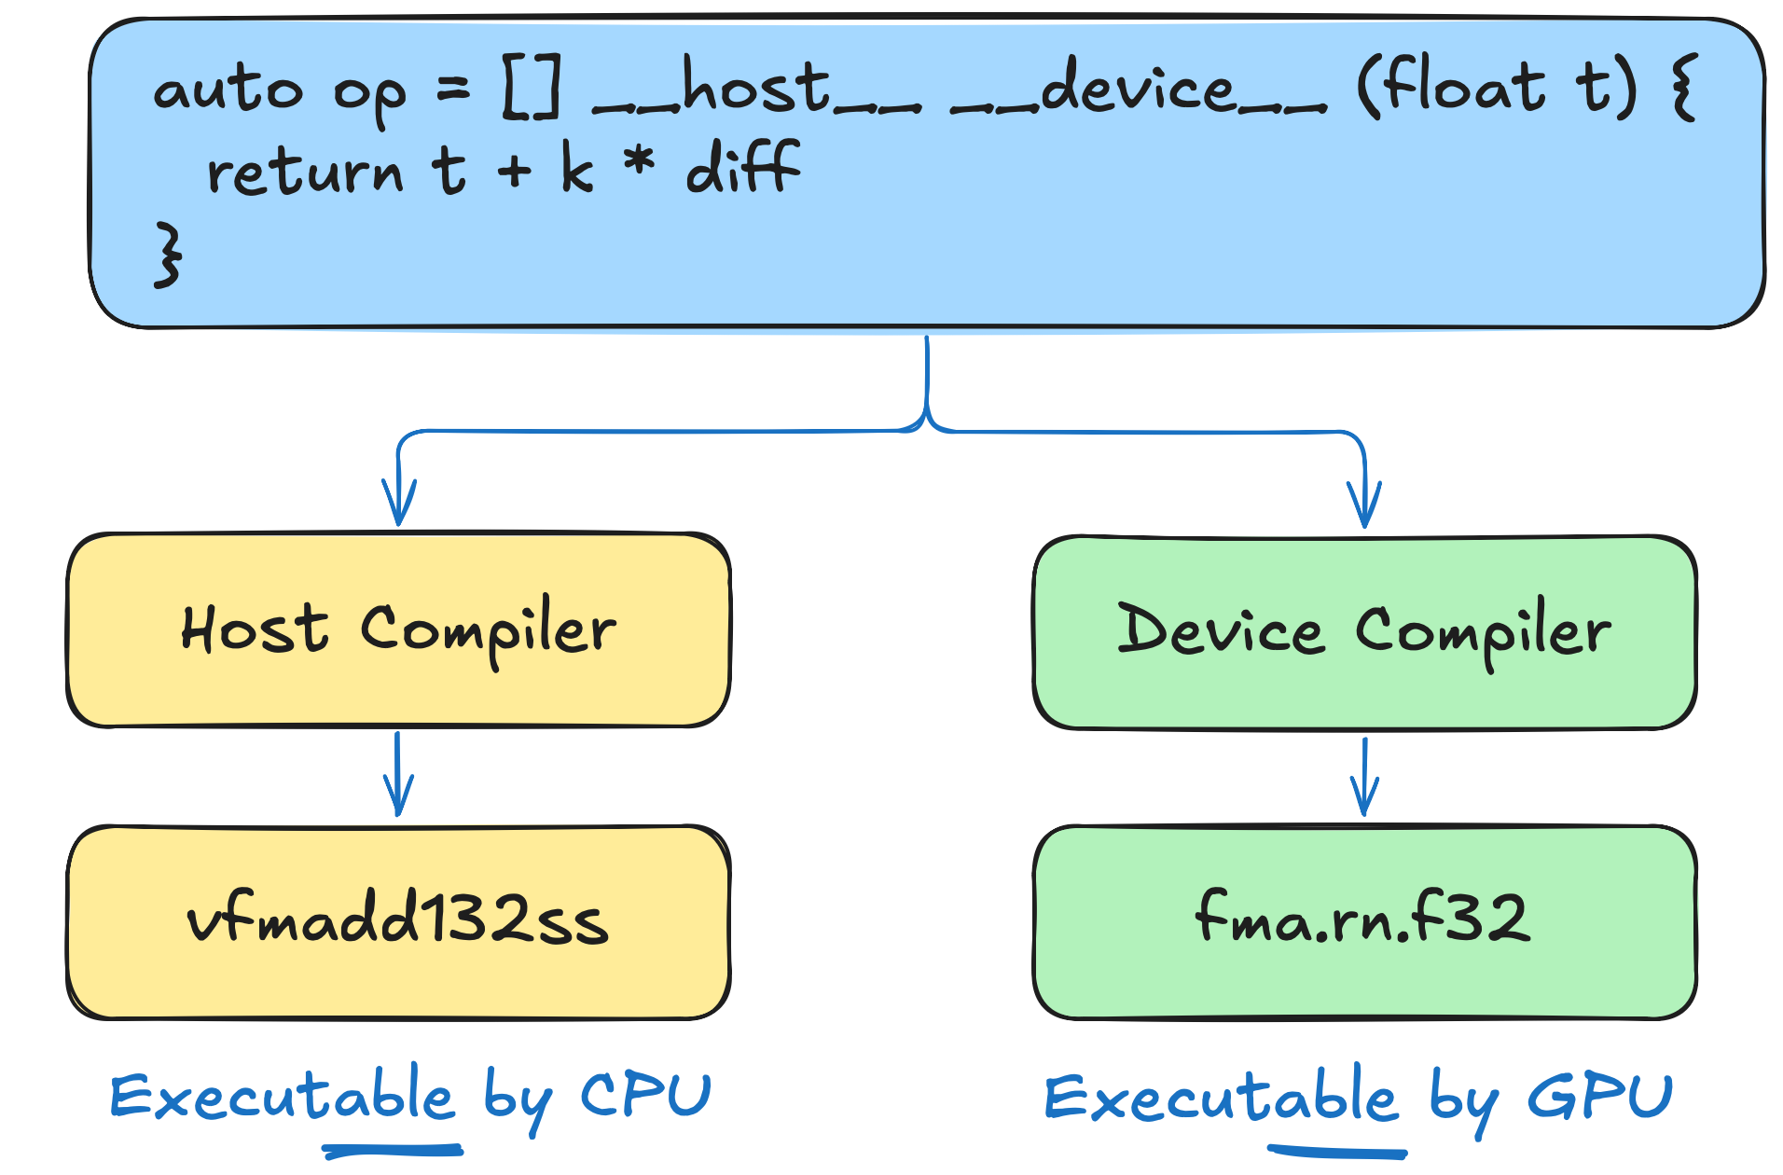
Execution Policy vs Specifier
execution space specifier (__host__, __device__):
works at compile time
indicates where code can run
doesn’t automatically run code there
Notes:
It’s important that you understand the difference between the execution specifiers and execution policies, so let’s contrast them.
When you mark a function with something like __host__ or __device__, you’re telling the compiler to generate instructions for CPU, GPU, or both.
It doesn’t automatically make the function runs there - it just prepares the code for that execution space.
So, if you annotate a function with __device__ and call it from CPU, it’ll just fail.

Slide 28
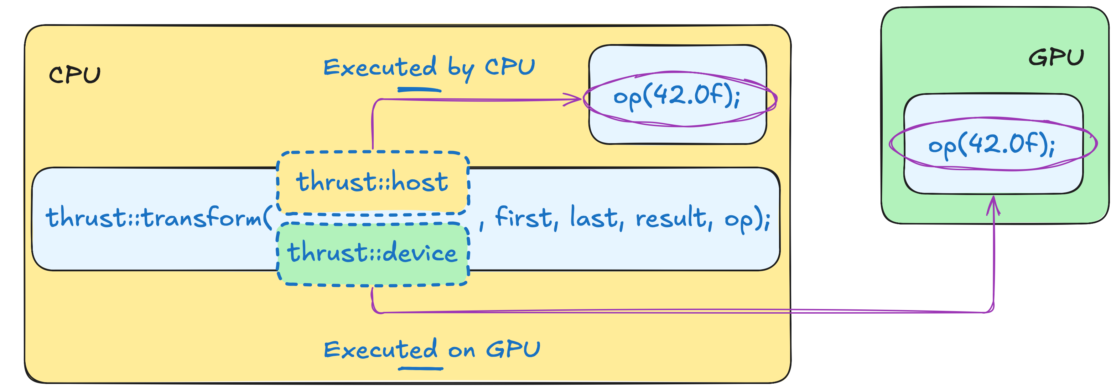
Execution Policy vs Specifier
execution policy (thrust::host, thrust::device):
works at runtime
indicates where code will run
doesn’t automatically compile code for that location.
Notes:
On another hand, an execution policy (like thrust::device or thrust::host).
If you pass `thrust::device`, it’s equivalent to saying: “Now run this algorithm on the GPU”.
But this does not generate any new CPU or GPU instructions.
It simply picks already-compiled version should be executed.

Slide 29
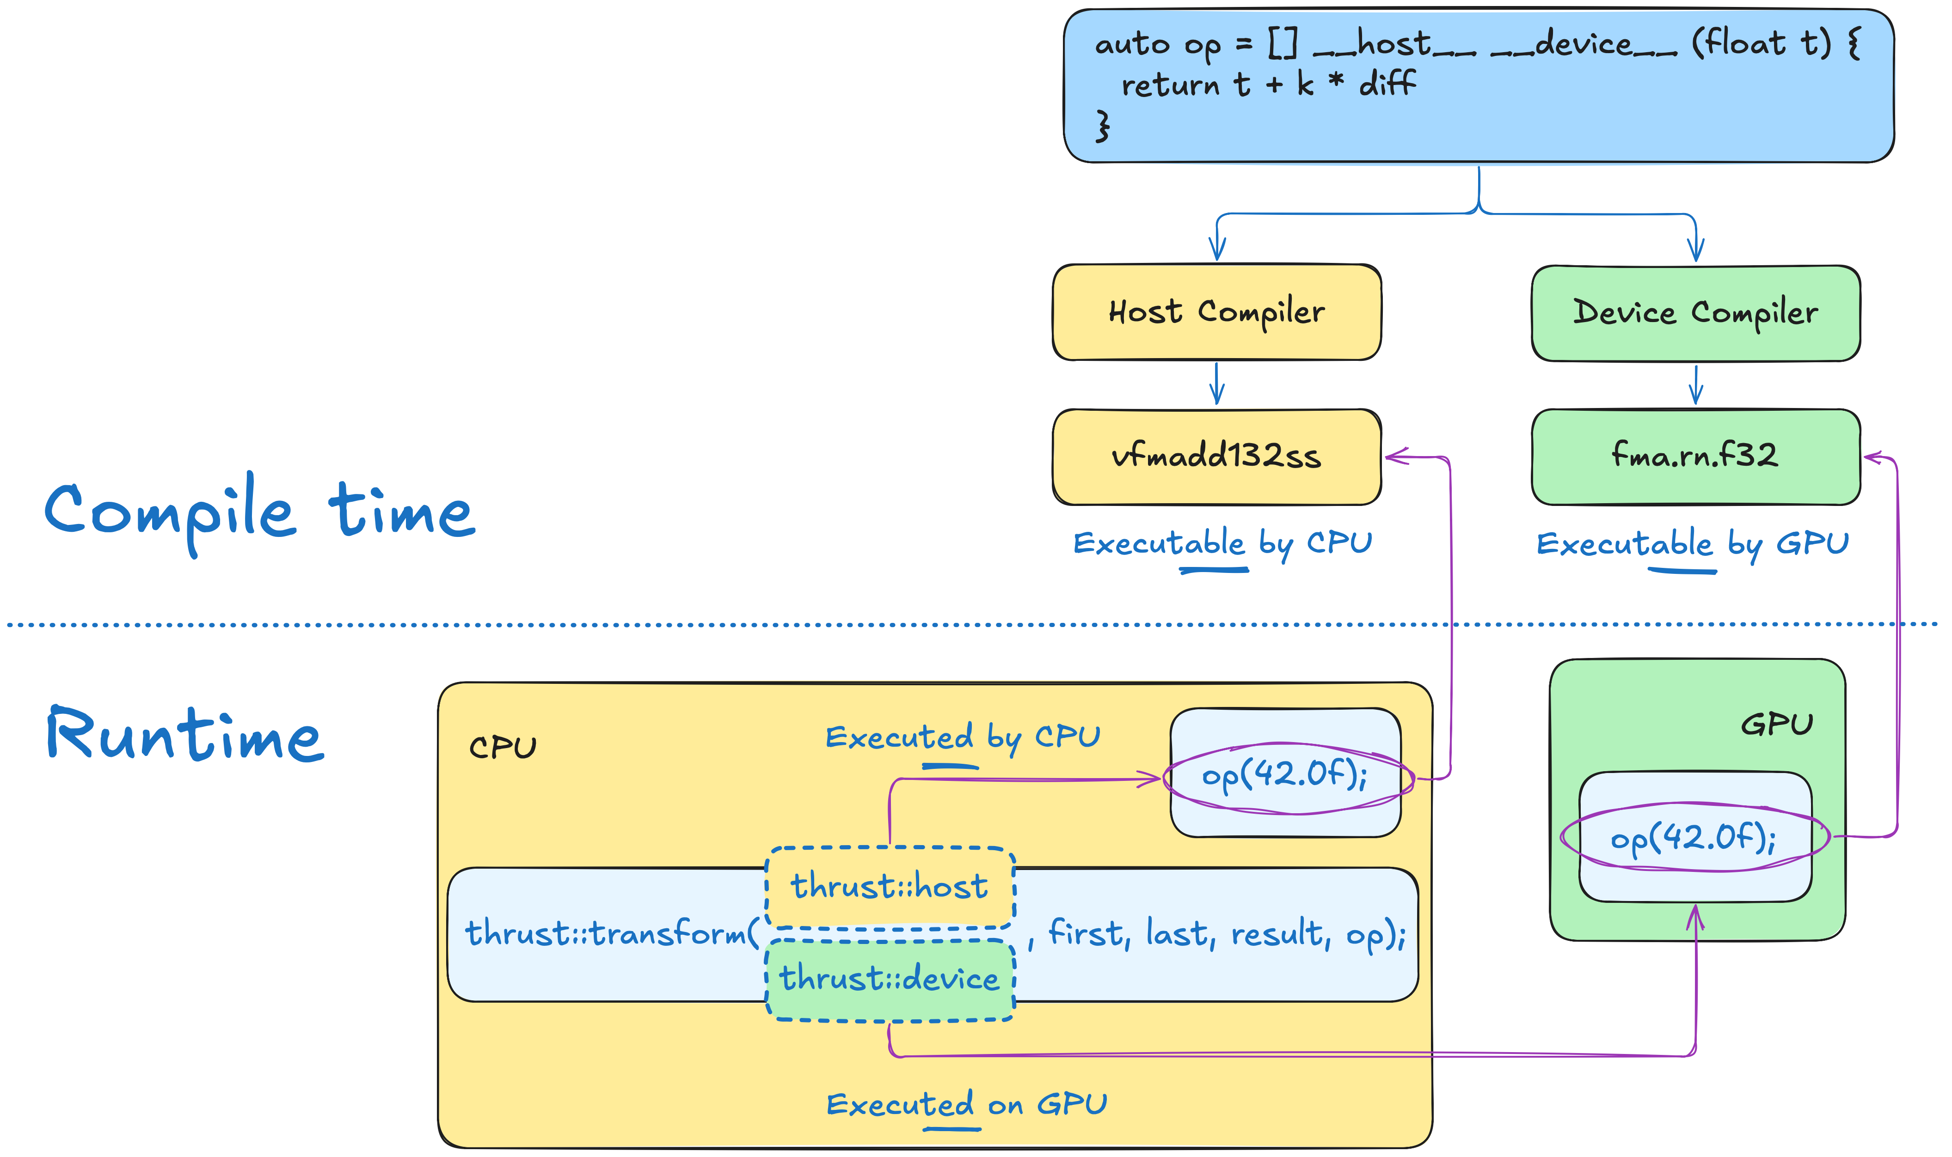
Execution Policy vs Specifier
execution space specifier (__host__, __device__) indicates where code can run. It doesn’t automatically run code there.
execution policy (thrust::host, thrust::device) indicates where code will run. It doesn’t automatically compile code for that location.
Notes:
In short, you need both pieces:
1. Execution space specifiers (like __host__ __device__) tell the compiler to generate the required CPU and/or GPU code.
2. Execution policies (like thrust::host or thrust::device) decide where that code actually runs.
If you don’t use the specifier, there’s no GPU version compiled.
And if you don’t use the execution policy, there’s no instruction to run on the GPU. They work hand in hand to enable GPU acceleration.

Slide 30
Execution Policy vs Specifier
 |  | Specifier
 |  | __host__ | __device__ | __host__ __device__
Policy | thrust::host | runs on CPU | error | runs on CPU
 | thrust::device | error | runs on GPU | runs on GPU
Notes:
This table shows how the specifier (__host__ and __device__) combines with the policy (thrust::host or thrust::device) to determine where code runs.
__host__ functions are CPU-only, so Thrust fails if you try to run them on the GPU.
__device__ function are GPU-only, so Thrust fails if you try to run them on the CPU.
Finally, __host__ __device__ functions are compiles for both, and the policy decides whether it actually runs on CPU or GPU.

Slide 31
Exercise: Annotate Execution Spaces
5 minutes
Replace ??? with CPU or GPU
dli::where_am_I("???");
thrust::universal_vector<int> vec{1};
thrust::for_each(thrust::device, vec.begin(), vec.end(),
[] __host__ __device__(int) { dli::where_am_I("???"); });
thrust::for_each(thrust::host, vec.begin(), vec.end(),
[] __host__ __device__(int) { dli::where_am_I("???"); });
dli::where_am_I("???");
01.02-Execution-Spaces/01.02.02-Exercise-Annotate-Execution-Spaces.ipynb
Notes:
Understanding where your code is executed is fundamental to harnessing the power of accelerated computing.
In this exercise, you will confirm your understanding of the execution spaces.
In the file you see on the slide, you’ll have to replace all question marks (?) with either CPU or GPU.

Slide 32
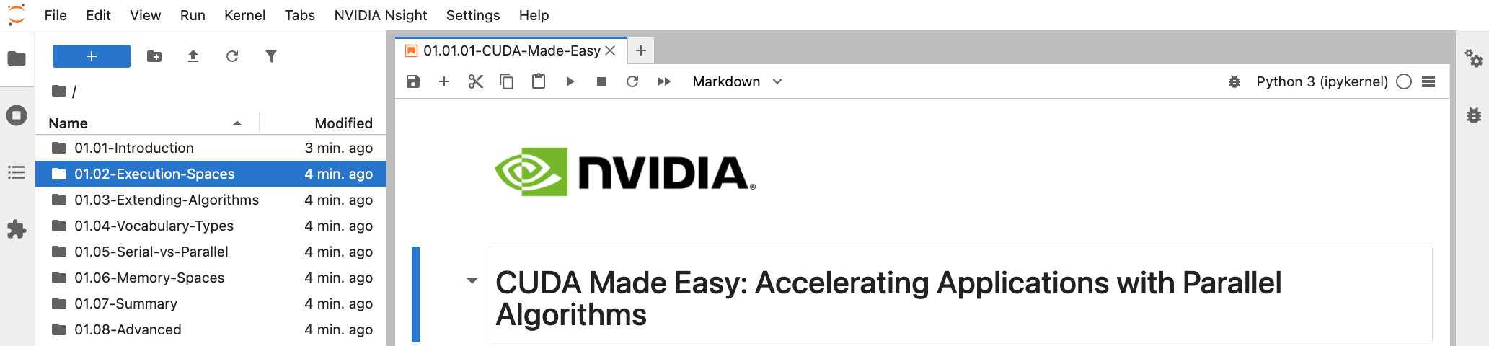
How to Run Exercises
Locate the exercise folder
Replace ??? with CPU or GPU
dli::where_am_I("???");
thrust::universal_vector<int> vec{1};
thrust::for_each(thrust::device, vec.begin(), vec.end(),
[] __host__ __device__(int) { dli::where_am_I("???"); });
thrust::for_each(thrust::host, vec.begin(), vec.end(),
[] __host__ __device__(int) { dli::where_am_I("???"); });
dli::where_am_I("???");
01.02-Execution-Spaces/01.02.02-Exercise-Annotate-Execution-Spaces.ipynb
Notes:
To locate the file, first open the folder that contains it.
On the left, you should find 01.02-Execution-Spaces folder.

Slide 33
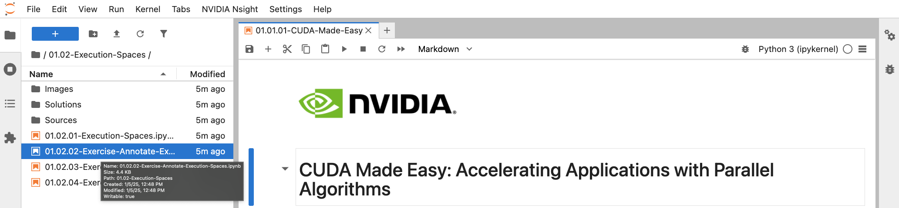
How to Run Exercises
Locate the notebook
Replace ??? with CPU or GPU
dli::where_am_I("???");
thrust::universal_vector<int> vec{1};
thrust::for_each(thrust::device, vec.begin(), vec.end(),
[] __host__ __device__(int) { dli::where_am_I("???"); });
thrust::for_each(thrust::host, vec.begin(), vec.end(),
[] __host__ __device__(int) { dli::where_am_I("???"); });
dli::where_am_I("???");
01.02-Execution-Spaces/01.02.02-Exercise-Annotate-Execution-Spaces.ipynb
Notes:
When you click on it, you’ll see 01.02.02-Exercise-Annotate-Execution-Spaces.
Click on it to proceed to the exercise lab.

Slide 34
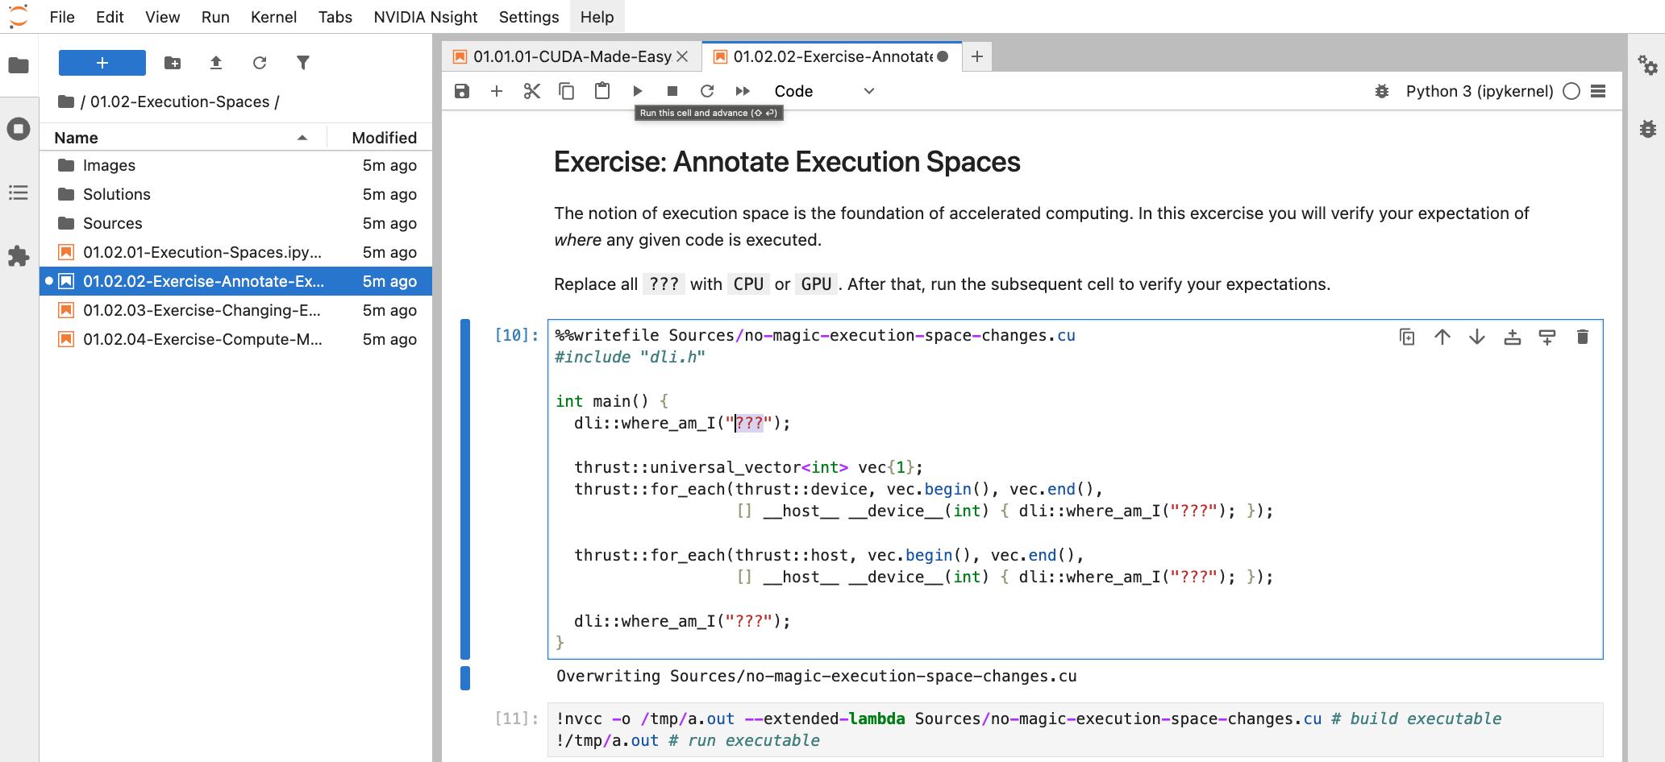
How to Run Exercises
Saving code changes
Run the cell to save changes
Notes:
Inside the exercise lab, you can just start editing the code.
When you are comfortable with the changes, you can run the cell as shown on the slide to save them.

Slide 35
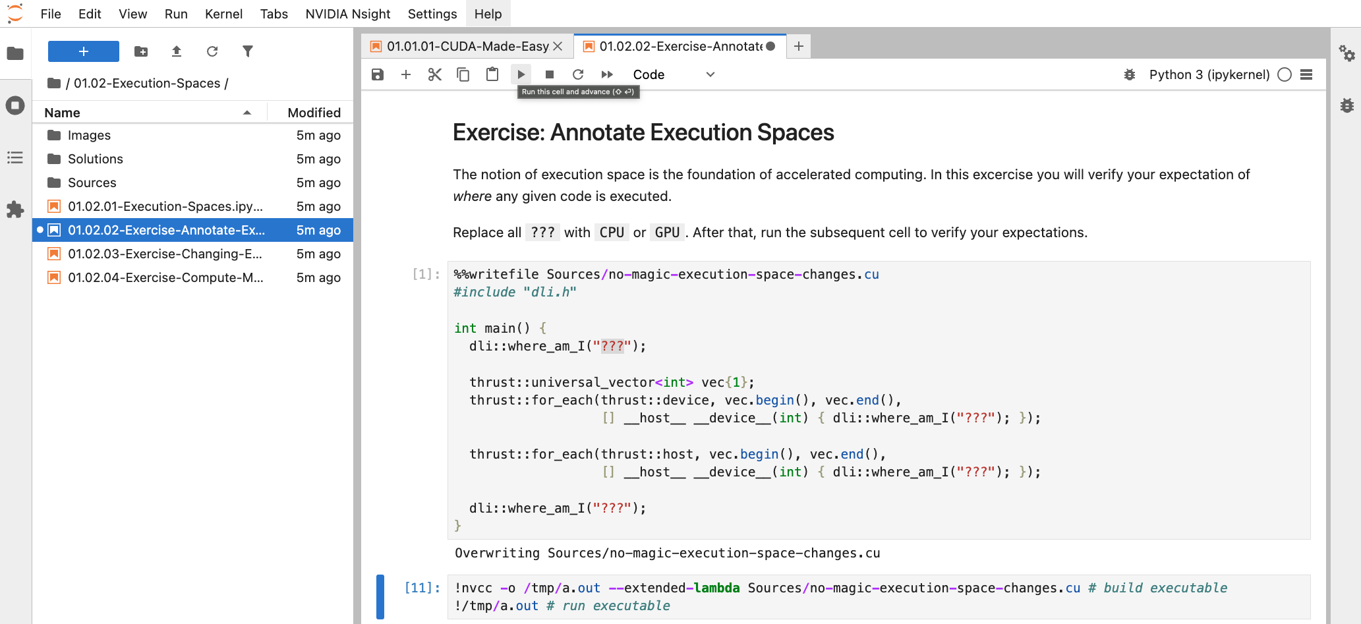
How to Run Exercises
Run the code
Run the cell to execute the code
Notes:
After that, run the following code cell with nvcc invocation to compile and execute your program.
You have 5 minutes to complete this exercise.

Slide 36
Exercise: Annotate Execution Spaces
Solution
dli::where_am_I("CPU");
Program always starts on CPU
01.02-Execution-Spaces/01.02.02-Exercise-Annotate-Execution-Spaces.ipynb
Notes:
Time’s up!
Let’s revisit the correct solution.
As discussed previously, program always starts on CPU.

Slide 37
Exercise: Annotate Execution Spaces
Solution
dli::where_am_I("CPU");
thrust::universal_vector<int> vec{1};
thrust::for_each(thrust::device, vec.begin(), vec.end(),
[] __host__ __device__(int) { dli::where_am_I("GPU"); });
thrust::device execution policy leads to execution on GPU
01.02-Execution-Spaces/01.02.02-Exercise-Annotate-Execution-Spaces.ipynb
Notes:
And device execution policy leads to the first lambda being executed on the GPU.

Slide 38
Exercise: Annotate Execution Spaces
Solution
dli::where_am_I("CPU");
thrust::universal_vector<int> vec{1};
thrust::for_each(thrust::device, vec.begin(), vec.end(),
[] __host__ __device__(int) { dli::where_am_I("GPU"); });
thrust::for_each(thrust::host, vec.begin(), vec.end(),
[] __host__ __device__(int) { dli::where_am_I("CPU"); });
thrust::host execution policy leads to execution on CPU
01.02-Execution-Spaces/01.02.02-Exercise-Annotate-Execution-Spaces.ipynb
Notes:
Host execution policy leads to algorithm execution on the CPU.

Slide 39
Exercise: Annotate Execution Spaces
Solution
dli::where_am_I("CPU");
thrust::universal_vector<int> vec{1};
thrust::for_each(thrust::device, vec.begin(), vec.end(),
[] __host__ __device__(int) { dli::where_am_I("GPU"); });
thrust::for_each(thrust::host, vec.begin(), vec.end(),
[] __host__ __device__(int) { dli::where_am_I("CPU"); });
dli::where_am_I("CPU");
Device execution space doesn’t “leak” out of algorithms
01.02-Execution-Spaces/01.02.02-Exercise-Annotate-Execution-Spaces.ipynb
Notes:
And finally, program ends on CPU.
I hope this example manages to help you understand that there are no magical execution space changes.

Slide 40
Exercise: Change Execution Space
5 minutes
Modify Thrust algorithm to run on GPU
thrust::for_each(thrust::host, vec.begin(), vec.end(), [] __host__ (int val) {
std::printf("printing %d on %s\n", val, dli::execution_space());
});
01.02-Execution-Spaces/01.02.03-Exercise-Changing-Execution-Space.ipynb
Notes:
Now, let’s verify your understanding of execution specifier and policies.
Modify the code on the screen so that lambda is executed on GPU.
For this exercise, you have 5 minutes as well.

Slide 41
Exercise: Change Execution Space
Solution
thrust::for_each(thrust::host, vec.begin(), vec.end(), [] __host__ (int val) {
std::printf("printing %d on %s\n", val, dli::execution_space());
});
Use thrust::device to tell Thrust that you want algorithm to run on GPU
thrust::for_each(thrust::device, vec.begin(), vec.end(), [] __device__(int val) {
std::printf("printing %d on %s\n", val, dli::execution_space());
});
Notes:
Time’s up!
To make this for each algorithm run on the GPU, we have to use thrust::device execution policy instead of thrust::host.

Slide 42
Exercise: Change Execution Space
Solution
thrust::for_each(thrust::host, vec.begin(), vec.end(), [] __host__ (int val) {
std::printf("printing %d on %s\n", val, dli::execution_space());
});
Use __device__ to tell NVCC that you need a function to be compiled for GPU
thrust::for_each(thrust::device, vec.begin(), vec.end(), [] __device__(int val) {
std::printf("printing %d on %s\n", val, dli::execution_space());
});
Notes:
Besides that, we have to change the execution space specifier to `__device__`, so that our lambda function is compiled for the GPU.

Slide 43
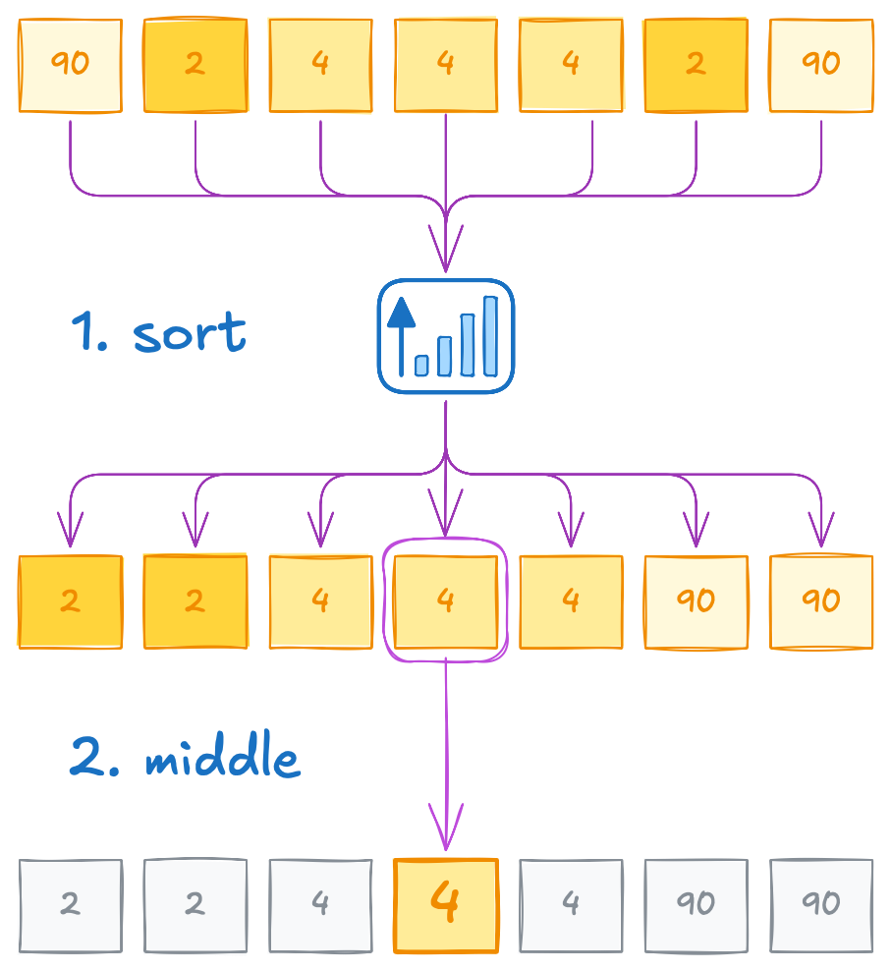
Median
CPU version
Median is a number which is larger and less than half of elements
To compute median, we can sort the data and then return the middle element
For simplicity, we’ll only cover odd number of elements
float median(thrust::universal_vector<float> vec)
{
std::sort(vec.begin(), vec.end());
return vec[vec.size() / 2];
}
Notes:
Before moving on, let’s confirm you understand how to port standard C++ algorithms to the GPU.
Suppose we need to track the median temperature in our simulator.
To compute median, we can sort the data and then return the middle element.
For simplicity, we’ll only cover cases when number of elements is odd.
And to implement this in C++, it’s sufficient to call std::sort and return middle element of the sorted vector.

Slide 44
Exercise: Port to GPU
5 minutes
Modify code to GPU-accelerate median computation
float median(thrust::universal_vector<float> vec)
{
std::sort(vec.begin(), vec.end());
return vec[vec.size() / 2];
}
int main()
{
for (int step = 0; step < 3; step++)
{
float median_temp = median(temp);
...
}
}
01.02-Execution-Spaces/01.02.04-Exercise-Compute-Median-Temperature.ipynb
Notes:
In this exercise, you’ll have to GPU-accelerate the `median` function that you see on the screen.
For that, you have 5 minutes starting now.

Slide 45
Exercise: Port to GPU
Wrong solution
__device__
float median(thrust::universal_vector<float> vec)
{
std::sort(vec.begin(), vec.end());
return vec[vec.size() / 2];
}
int main()
{
for (int step = 0; step < 3; step++)
{
float median_temp = median(temp);
...
}
}
Execution specifier doesn’t make the function run on GPU, only compile code for it
No reason to GPU-accelerate a single division
Parallel algorithms are invoked from CPU
Notes:
Time’s up!
Before showing the correct solution, let’s highlight a common mistake: trying to mark the median function with __device__.
Because `std::sort` is not annotated as device function, this approach won’t compile.
But even if it did, median is called from the CPU in main, so you can’t call a device function directly from host code.
Besides that, `std::sort` is serial algorithm, it won’t be able to leverage massive parallelism provided by GPUs.
What we need is a parallel algorithm, and parallel algorithms are invoked on the CPU.

Slide 46
Exercise: Port to GPU
Solution
float median(...)
{
std::sort(vec.begin(), vec.end());
return vec[vec.size() / 2];
}
float median(...)
{
thrust::sort(thrust::device, vec.begin(), vec.end());
return vec[vec.size() / 2];
}
GPU-accelerating standard algorithms should be as easy as:
switching std:: to thrust::, and
adding an execution policy
Notes:
That’s why the correct solution is to replace std::sort with thrust::sort and use thrust::device as the execution policy.
If you completed this exercise correctly, you now know how to adapt many standard C++ algorithms to run on GPUs using Thrust.

Slide 47
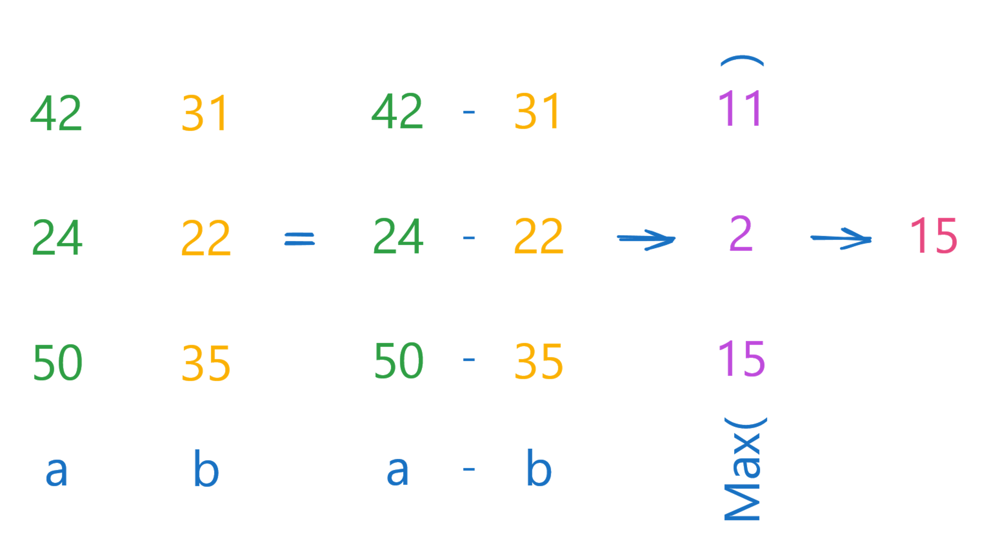
Extending Standard Algorithms
Compute max difference between two vectors
There’s no standard algorithm for every use case
Notes:
But what if your problem is not a standard one?
For instance, let’s say we want to compute maximal difference between old and new temperatures.
For instance, first object cooled from 42 to 31 degrees, which is an 11 degrees change.
But the last one cooled from 50 to 35, which is a difference of 15 degrees.
So, the maximal difference is 15 degrees.
There’s no standard algorithm for computing maximal difference, though.
A naïve approach would be to compute each stage of this algorithm as illustrated.

Slide 48
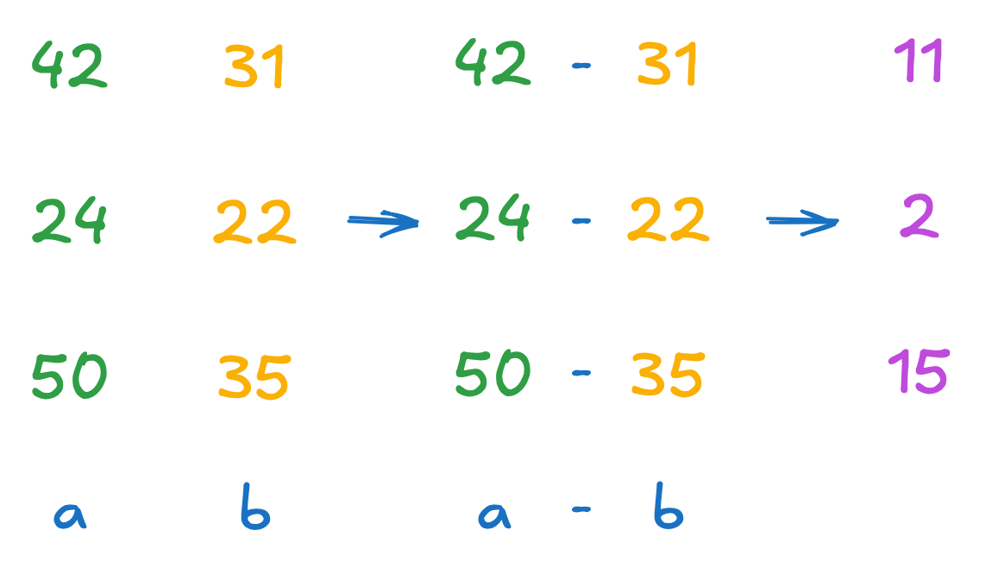
Extending Standard Algorithms
Compute max difference between two vectors
thrust::universal_vector<float>
unnecessarily_materialized_diff(a.size());
// compute abs differences
thrust::transform(
thrust::device,
a.begin(), a.end(), // first input sequence
b.begin(), // second input sequence
unnecessarily_materialized_diff.begin(),
[]__host__ __device__(float x, float y) {
return abs(x - y);
});
Notes:
To do this, we start by creating a vector for differences.
Then we use the version of thrust::transform that takes two input ranges - one for the old temperatures and one for the new temperatures.
Our operation (a lambda or function object) now receives two parameters (one from each range), computes the absolute difference between them, and writes the result into the differences vector.

Slide 49
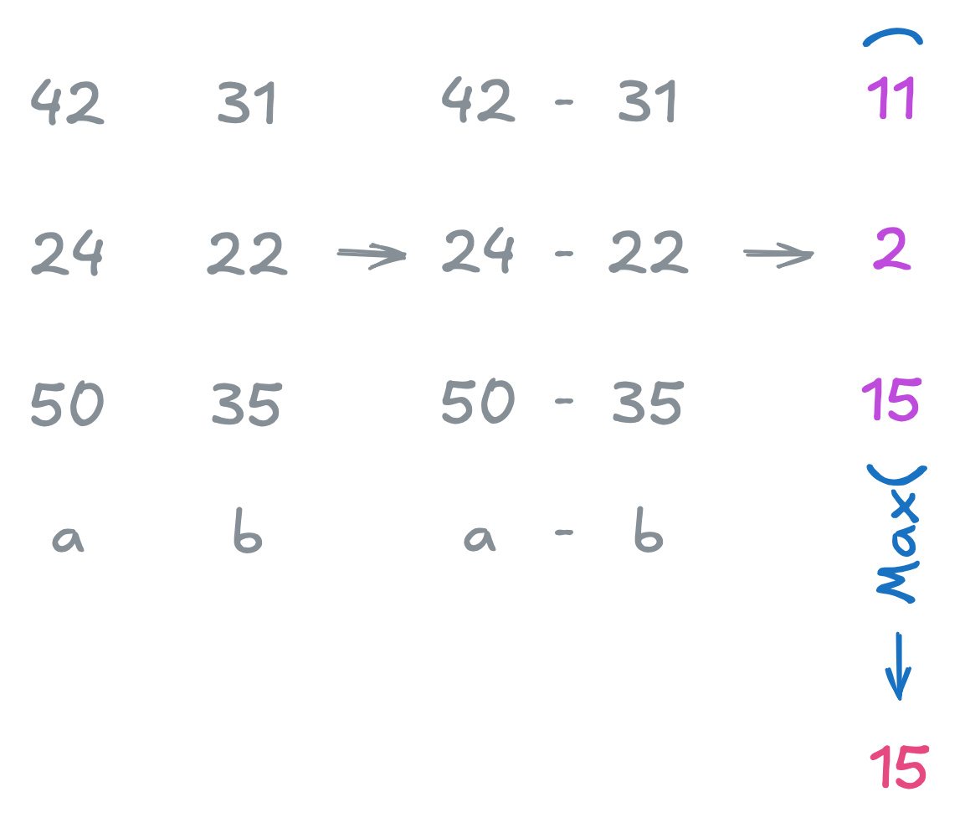
Extending Standard Algorithms
Compute max difference between two vectors
thrust::universal_vector<float>
unnecessarily_materialized_diff(a.size());
// compute abs differences
thrust::transform(
thrust::device,
a.begin(), a.end(), // first input sequence
b.begin(), // second input sequence
unnecessarily_materialized_diff.begin(),
[]__host__ __device__(float x, float y) {
return abs(x - y);
});
// compute max difference
return thrust::reduce(
thrust::device,
unnecessarily_materialized_diff.begin(),
unnecessarily_materialized_diff.end(),
0.0f, thrust::maximum<float>{});
Notes:
Lastly, we run a max reduction on the differences vector to find the maximum absolute difference.
This code will produce the correct result, but is it efficient?

Slide 50
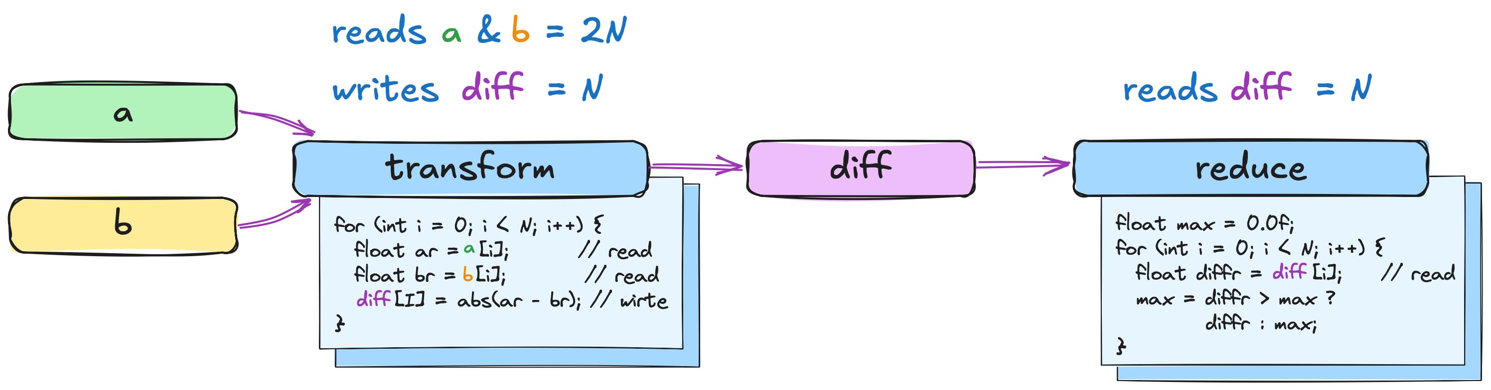
Counting Memory Accesses
Algorithm starts with allocation, which is already suboptimal
After that, transform reads 2N elements and writes N diffs
After that, reduction has to read N differences and return max
If you had to implement this algorithm, would you write it this way?
Notes:
To answer this question, let’s recap the key steps of this algorithm.
It starts with an allocation, which is already suboptimal.
After that, it transforms two input ranges into differences.
To build an intuition for this step, you can consider the transformation as a for-loop on the screen.
Inside this loop, we read two elements, one from a, and one from b.
We then compute the difference and write it back into memory.
Overall, this step reads 2N elements and writes N elements back.
The subsequent reduction step, can be represented as another for loop.
Here it reads one element from difference array, checks if the newly read value is larger than the current max value, and updates the current max value if it’s the case.

Slide 51
Counting Memory Accesses
📖 | ✏️
3N | 1N
Algorithm starts with allocation, which is already suboptimal
After that, transform reads 2N elements and writes N diffs
After that, reduction has to read N differences and return max
If you had to implement this algorithm, would you write it this way?
Notes:
Overall, this approach leads to 3N reads, where N is the size of the input sequence.
It also write back N elements.
The question is, if you had to implement this algorithm with just for loops, would you write it this way?

Slide 52
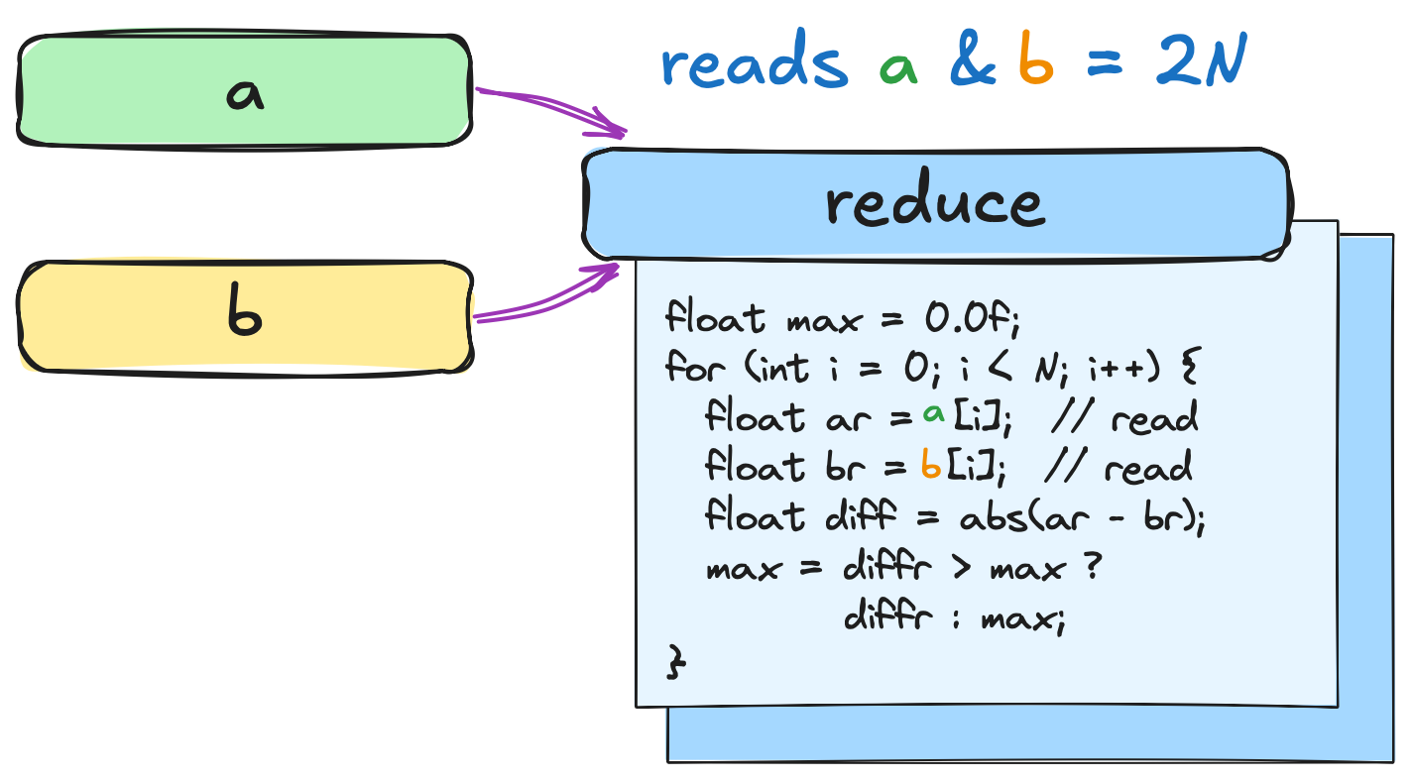
Preferred Implementation
📖 | ✏️
3N | 1N
In C++, we could write a simple loop
It’d read 2N elements and avoid writing temporaries back into memory
That’d give us 2x less memory accesses
Which should result in better performance
How can we achieve this with algorithms?
📖 | ✏️
2N | 1
Notes:
Personally, I’d implement this with a single reduction loop: for each element in a and b, compute the absolute difference on the fly and compare it to the current maximum.
This way, we only read 2N elements once, and we avoid any extra memory allocations.
Since this approach leads to 2x less memory accesses, I’d expect it to be much faster.
The next question is: how do we get a parallel algorithm to implement this on-the-fly computation of absolute differences?
And which parallel algorithm should we start with?
Well, at least this part is straightforward - our loop already looks just like a standard reduction, except that it’s reducing absolute differences instead of the raw values.
So, it has to be `thrust::reduce`. But how do we embed this logic of computing absolute differences in it?
The answer is iterators.
If you’re not familiar with the concept, don’t worry - we’ll quickly recap it now.

Slide 53
Pointers
std::array<int, 3> a{0, 1, 2};
int *ptr = a.data(); // points to a[0]
std::printf("pointer[0]: %d\n", ptr[0]); // prints 0
std::printf("pointer[1]: %d\n", ptr[1]); // prints 1
📖
N
Notes:
And it’s easiest to understand iterators by looking at their simplest form - pointers.
On the slide you can see a simple program that allocates an array with 3 elements.
Then we initialize a pointer with address of the first element.
We can then use square brackets, also called subscript operator, to reference underlying integer sequence.

Slide 54
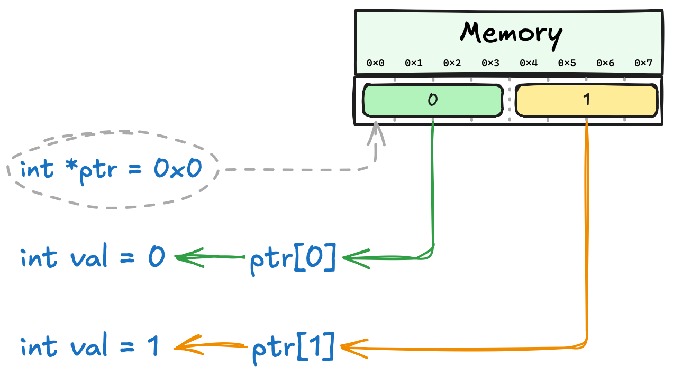
Pointers
A very simple mental model for pointers is something that:
Stores a physical memory address
Enables array-style access to the pointed elements through the subscript operator
📖
N
Notes:
Here’s a very simple mental model for pointers - they store a physical memory address.
Besides that, pointers provide an array-style interface for accessing the data they point to.
So, if I write pointer at index zero, I get the first element of the sequence; if I write pointer at index one, that moves me to the second element in memory, and so on.

Slide 55
Pointers Interface
std::printf("pointer[0]: %d\n", ptr[0]); std::printf("pointer[1]: %d\n", ptr[1]);
Subscript operator[]
Provides array-style element access
C++ allows overloading of subscript operator[]
That’s how indexing works in vectors vec[42]
struct vector
{
int operator[](int i = 42)
{
return *(data() + i);
}
};
Notes:
But the subscript operator isn’t limited to pointers and arrays.
If you think about how we access elements in thrust::vector or std::vector, we use the same square bracket notation.
Why does that work? Because in C++, we can define the subscript operator just like any other function.
In other words, when you write ‘vector at index 42’, 42 is passed as a parameter to the operator[] function inside the vector class.
If it’s hard to treat subscript operator as normal function, try replacing square brackets with parenthesis to recognize it as a normal function call.
Anyways, this flexibility allows us to give many objects pointer-like behavior, which brings us to iterators.

Slide 56
Simple Counting Iterator
counting_iterator it;
std::printf("it[0]: %d\n", it[42]);
We can overload subscript operator[]
But instead of accessing physical memory, we can, say, return the incoming index
Mental Model
struct counting_iterator
{
int operator[](int i = 42)
{
return i;
}
};
Notes:
Since we can put any code in the subscript operator, we don’t have to limit ourselves to the concept of physical memory at all.
For example, imagine a type whose subscript operator just returns whatever index you pass in. Pass it 42, you get 42.
That might seem pointless at first but trust me - by the end of this course, this little trick will become one of your best friends!

Slide 57
Simple Counting Iterator
Pointers
Iterators
struct counting_iterator
{
int operator[](int i)
{
return i;
}
};
Subscript operator leads to memory accesses
📖
N
📖
0
std::array<int, 3> a{0, 1, 2};
int *ptr = a.data();
std::printf("pointer[0]: %d\n", ptr[0]); // prints 0
std::printf("pointer[1]: %d\n", ptr[1]); // prints 1
counting_iterator it;
std::printf("it[0]: %d\n", it[0]); std::printf("it[1]: %d\n", it[1]);
Notes:
So now let’s compare the pointer-based code on the left with our custom type on the right.
When we pass in an index of zero, both print zero.
When we pass in an index of one, both print one, and so on.
Functionally, there’s no difference.
But because a pointer is tied to actual physical memory, every time you use the subscript operator, you’re performing a memory access.
That means if you read N elements, you’ll have N memory accesses.
Our custom type, on the other hand, simply returns the index you pass in, with no memory access at all.
In theory, that can give much better performance.
And from the algorithm’s point of view, notice how both interfaces look exactly the same: we just use square brackets.
Whether those brackets trigger a memory read or simply return the index doesn’t matter for the rest of the code - and that’s a key concept behind how iterators work.

Slide 58
Simple Counting Iterator
Iterators:
Provide pointer-like interface
Generalize pointers by overloading operators
Not restricted to raw memory addresses
Let’s implement integer sequence as an iterator
Mental Model:
struct counting_iterator
{
int operator[](int i)
{
return i;
}
};
counting_iterator it;
std::printf("it[0]: %d\n", it[0]); // prints 0
std::printf("it[1]: %d\n", it[1]); // prints 1
Iterators:
Lead to same functional behavior
Reduce memory footprint
Reduce memory traffic which improves performance
📖
0
Notes:
You can think of iterators as a generalization of pointers.
They provide the same interface, think subscript operator, increment, etc., but they’re not limited to actual memory accesses.
The type we just explored is called a counting iterator: it presents an infinite sequence of integers without allocating a single byte.
I’m showing you its code just to help build a mental model, but you won’t ever need to write one yourself. It’s the concept that’s important.

Slide 59
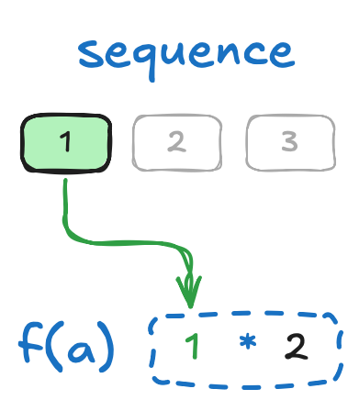
Simple Transform Iterator
Mental Model:
struct transform_iterator
{
int *a;
int operator[](int i)
{
return a[i] * 2;
}
};
Transform iterator applies a function before returning a value
std::array<int, 3> a{ 0, 1, 2 };
transform_iterator it{a.data()};
std::printf("it[0]: %d\n", it[0]); // prints 0 std::printf("it[1]: %d\n", it[1]); // prints 2
📖
N
Notes:
The counting iterator we just saw doesn’t make any memory accesses, but not every iterator works that way.
For example, imagine a ‘transform iterator’ that references an underlying pointer.
Every time you call its subscript operator, instead of returning the original element directly, it might multiply that element by two before giving it back.
From the outside, it looks like the entire sequence was scaled - if you look at index one, you get two, even though the underlying data still stores one.
Notice that the result of the multiplication isn’t stored anywhere; it’s computed on the fly each time you access an element.

Slide 60
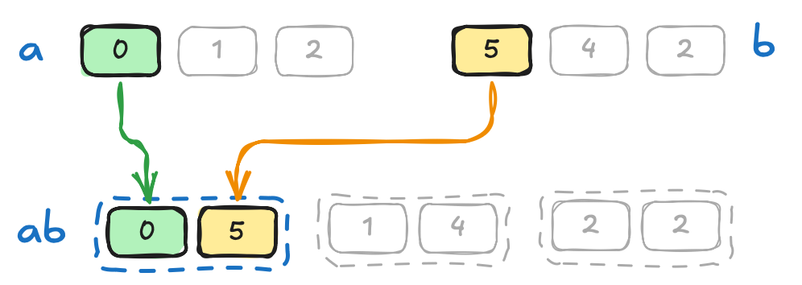
Simple Zip Iterator
Mental Model:
struct zip_iterator
{
int *a;
int *b;
std::tuple<int, int> operator[](int i)
{
return {a[i], b[i]};
}
};
std::array<int, 3> a{ 0, 1, 2 };
std::array<int, 3> b{ 5, 4, 2 };
zip_iterator it{a.data(), b.data()};
std::printf("it[0]: (%d, %d)\n", std::get<0>(it[0]), std::get<1>(it[0])); // prints (0, 5)
📖
2N
Zip iterator allows you to combine multiple sequences
Notes:
We can take this even further by implementing a ‘zip iterator’ that references two sequences at once.
Its subscript operator returns a tuple containing one element from each sequence.
So, if we access the iterator at index zero, we might get (0, 5), which corresponds exactly to a[0] and b[0], as shown on the slide.

Slide 61
Combining Input Iterators
Mental Model:
struct transform_iterator
{
zip_iterator zip;
int operator[](int i)
{
auto [a, b] = zip[i];
return abs(a - b);
}
};
std::array<int, 3> a{ 0, 1, 2 };
std::array<int, 3> b{ 5, 4, 2 };
zip_iterator zip{a.data(), b.data()};
transform_iterator it{zip};
std::printf("it[0]: %d\n", it[0]);
You can nest iterators!
📖
2N
Notes:
The real power of iterators shows up when we start combining them.
For example, imagine a transform iterator that uses a zip iterator inside.
Each time you call its subscript operator with index `i`, it first fetches two values - one from sequence a, one from sequence b - then computes their absolute difference and returns it.
That’s exactly what we needed for our maximum difference algorithm!
If we pass this ‘transformed zip iterator’ to a reduction algorithm, it’ll treat it just like a regular pointer and read values as usual, but under the hood, every access fetches two elements, computes the absolute difference, and hands it over.
All of that without ever writing those intermediate differences back to memory.

Slide 62
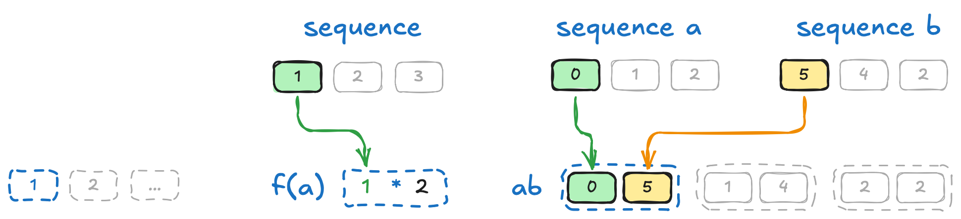
Thrust Fancy Iterators
thrust::make_zip_iterator(a.begin(), b.begin())
thrust::make_transform_iterator(
a.begin(),
[]__host__ __device__(int a) {
return a * 2;
})
thrust::make_counting_iterator(1)
Notes:
In reality, production-grade iterator implementations are much more complex than the simplified examples we’ve shown on these slides.
Luckily, you don’t have to build them yourself.
Thrust already provides a variety of ready-to-use iterators, including counting, zip, and transform iterators.
Let’s take a look at how to work with those in practice.

Slide 63
Thrust Fancy Iterators
auto begin = thrust::make_counting_iterator(1);
auto end = begin + 42;
thrust::for_each(thrust::device, begin, end, print);
// prints: 1 2 3 ... 42
Notes:
`thrust::make_counting_iterator` takes an integer that tells it where to start counting.
For example, in the code on the slide, we pass it into `thrust::for_each` to print out the first 42 elements.
If we create a counting iterator that starts at 1, the output will be 1, 2, 3, and so on, up to 42.

Slide 64
Thrust Fancy Iterators
thrust::universal_vector<int> vec = {1, 2, 3, ...};
auto begin =
thrust::make_transform_iterator(
vec.begin(),
[] __host__ __device__(int value) {
return value * 2;
});
auto end = begin + 42;
thrust::for_each(thrust::device, begin, end, print);
// prints: 2 4 6 8 ... 84
Notes:
`thrust::make_transform_iterator` takes two things:
- An iterator pointing to your underlying data, and
- A transformation function that does something to each element
For example, on the slide we have a Thrust vector containing a simple sequence like 1, 2, 3, and so on
We then pass the beginning of that vector as the first parameter to `make_transform_iterator`, and as the second parameter, we provide a function that doubles any value it receives
That means when we iterate over this transform iterator, each element is automatically multiplied by two on the fly.
If our underlying sequence was 1, 2, 3, 4…, then the transform iterator produces 2, 4, 6, 8, and so on.
Notice that we never actually store these doubled values in memory; they’re generated each time we access an element through the iterator.

Slide 65
Thrust Fancy Iterators
thrust::universal_vector<int> a = {0, 1, 2};
thrust::universal_vector<int> b = {5, 4, 2};
auto begin = thrust::make_zip_iterator(a.begin(), b.begin());
auto end = begin + 42;
thrust::for_each(thrust::device, begin, end, print);
// prints: (0, 5) (1, 4) (2, 2)
Notes:
Now let’s take a look at an example using `thrust::make_zip_iterator`.
We have two thrust vectors, a and b.
The first one holds {0, 1, 2}, and the second holds {5, 4, 2}.
We then call `thrust::make_zip_iterator(a.begin(), b.begin())` to create an iterator that pairs up elements from both vectors: the element at index 0 in a is zipped with the element at index 0 in b, and so on.
That gives us sequence of pairs like (0, 5), (1, 4), (2, 2).

Slide 66
Using Thrust Fancy Iterators
auto zip_it = thrust::make_zip_iterator(a.begin(), b.begin());
auto transform_it =
thrust::make_transform_iterator(zip_it, [] __host__ __device__(thrust::tuple<float, float> t) {
return abs(thrust::get<0>(t) - thrust::get<1>(t));
});
Now computation happens upon accessing transform iterator:
zip_it[i] returns tuple
transform_it[i] returns diff
Notes:
As we discussed, our plan for the maximum difference problem is to combine a zip iterator with a transform iterator.
In this code, we do exactly that.
First, we use `make_zip_iterator on a.begin() and b.begin()`.
That gives us an iterator which, at each index, returns a tuple of two floats - one from a and one from b.
Next, we pass that zip iterator into `make_transform_iterator`, along with a lambda function.
Because the zip iterator returns a tuple of floats, that’s exactly what the lambda function should have as a parameter.
For each tuple, we extract the two values using thrust::get, compute the absolute difference, and return that result.
So, for the first elements in a and b, if the tuple is (0, 5), the transform iterator returns abs(0 - 5), which is 5.

Slide 67
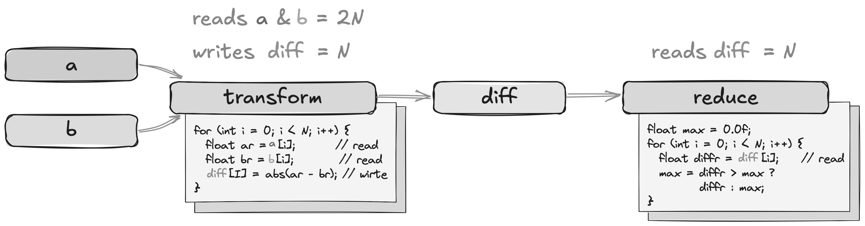
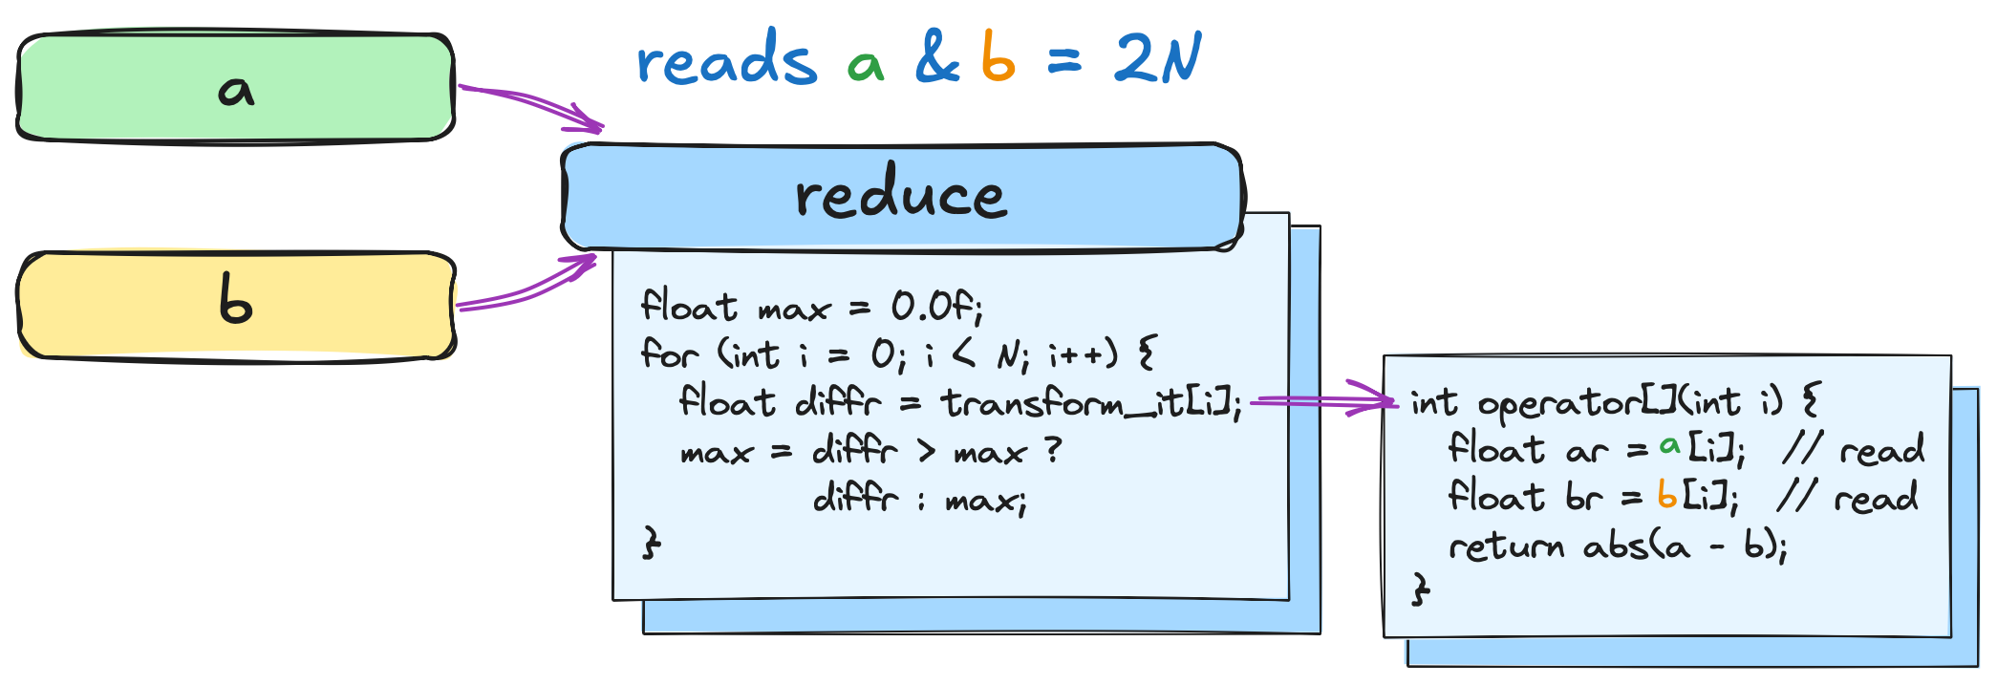
Counting Memory Accesses
Naïve solution
📖 | ✏️
3N | 1N
Version with iterators accesses 2x less memory
How does this affect performance?
Fancy Iterators
📖 | ✏️
2N | 1
Notes:
From the reduction’s perspective, it’s just reading a single float each time.
But behind the scenes, our transform iterator grabs two floats - one from a and one from b vectors - calculates the difference on the fly, and returns that result, without any extra reads or writes.
So, in total, we only need 2N memory accesses, which is exactly the improvement we aimed for.
Now let’s see if this reduced memory traffic actually improves performance.

Slide 68
Extending Standard Algorithms
Version with iterators takes 2x less time to execute
Version with iterators needs 30% less memory
Notes:
On this slide, we have normalized elapsed times for different vector sizes. Remember, lower is better.
You can see that using fancy iterators is about twice as fast as storing the temporary differences in memory.
And this comparison doesn’t even include the cost of allocating space for those temporary arrays.
If we factor in the allocation overhead, the speedup could climb to around 70 times!
But performance isn’t the only benefit.
Fancy iterators also drastically reduce memory usage.
For instance, if your GPU has 8GB of memory and each vector takes up 4GB, then you’ve essentially used up all available space by just storing a and b.
In that scenario, a materializing approach—which needs extra storage for the difference vector—would fail.
Meanwhile, the fancy-iterator-based version requires no extra space and would work just fine.

Slide 69
Exercise: Computing Variance
10 minutes
change the code below so that dereferencing squared_differences returns (x[i] - mean) * (x[i] - mean)
float variance(const thrust::universal_vector<float> &x, float mean)
{
auto squared_differences = ...
return thrust::reduce(
thrust::device, squared_differences, squared_differences + x.size()
) / x.size();
}
📖 | ✏️
2N | N
01.03-Extending-Algorithms/01.03.02-Exercise-Computing-Variance.ipynb
Notes:
Most of the parallel algorithms we’ve seen so far are very challenging to implement efficiently.
That’s why it’s crucial for you to understand how to adopt these accelerated libraries to your unique use cases without having to re-implement them.
Let’s pause and verify your understanding of how to extend parallel algorithms to your unique use cases.
This time we want to calculate the variance of a temperature dataset, which requires us to compute the squared difference of each element from the mean.
A naive approach would create a whole new buffer in memory to store these squared differences, which wastes both time and space.
Instead, you already know how to handle this using ‘fancy iterators’ - we’ll compute squared differences on the fly, feeding them straight into the reduction without ever creating a separate array.
In the code snippet, you’ll see a placeholder for squared_differences.
Your task is to replace that placeholder with a transform iterator that, when dereferenced, returns squared difference of incoming value with the mean.
For this exercise you have 10 minutes starting now.

Slide 70
Exercise: Computing Variance
Solution
float variance(const thrust::universal_vector<float> &x, float mean)
{
auto squared_differences = thrust::make_transform_iterator(
x.begin(), [mean] __host__ __device__(float value) {
return (value - mean) * (value - mean);
});
return thrust::reduce(
thrust::device, squared_differences, squared_differences + x.size()
) / x.size();
}
📖 | ✏️
N | 1
Notes:
The solution is straightforward: we use a Thrust transform iterator.
This time, we capture the mean in our lambda and compute each element’s squared difference on the fly.
By now, you should have a clear idea of how to apply fancy iterators and parallel algorithms in practice.
So, it’s a good time to complicate our simulator even further!

Slide 71
Heat Equation
Let’s implement an actual heat equation simulator
Neighbors now affect next state of a given cell
This pattern is called stencil
We’ll organize cells into a two-dimensional matrix
Notes:
So far, we’ve looked at simple temperature simulations where each cell or object evolved on its own, independent of the others.
Of course, that isn’t very realistic.
Now that we’re comfortable with fancy iterators, parallel algorithms, and execution spaces, let’s tackle a slightly more complex scenario: the 2D heat equation.
On the screen, you can see the computational stencil that we’ll use.
Each cell’s temperature in the next time step depends not only on its current temperature, but also on its four neighbors - left, right, top, and bottom.
Let’s see how we can implement this scheme.

Slide 72
Implementing Stencil Pattern
float d2tdx2 = in_ptr[row * width + column - 1]
- in_ptr[row * width + column] * 2
+ in_ptr[row * width + column + 1];
float d2tdy2 = in_ptr[(row - 1) * width + column]
- in_ptr[row * width + column] * 2
+ in_ptr[(row + 1) * width + column];
return in_ptr[row * width + column] + 0.2f * (d2tdx2 + d2tdy2);
Don’t worry about the exact formula
Instead, consider access pattern
Notes:
In code, the 2D heat equation might look something like this.
Don’t worry about the specific math or constants here.
Instead, try focusing on the data access pattern.

Slide 73
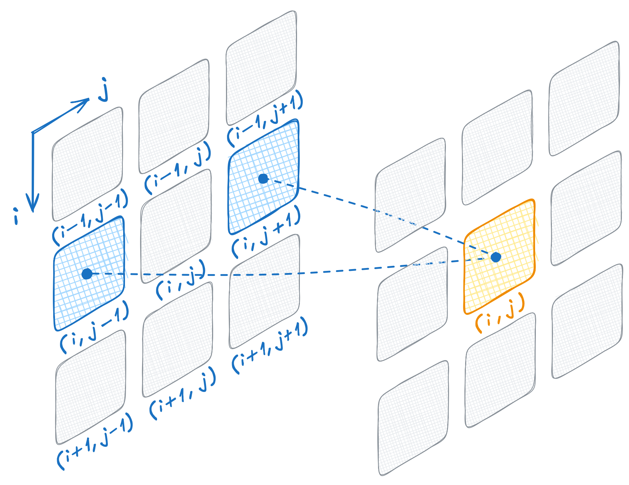
Implementing Stencil Pattern
float d2tdx2 = in_ptr[row * width + column - 1]
- in_ptr[row * width + column] * 2
+ in_ptr[row * width + column + 1];
float d2tdy2 = in_ptr[(row - 1) * width + column]
- in_ptr[row * width + column] * 2
+ in_ptr[(row + 1) * width + column];
return in_ptr[row * width + column] + 0.2f * (d2tdx2 + d2tdy2);
Don’t worry about the exact formula
Instead, consider access pattern
We need values from left and right
Notes:
First, we have to read temperatures of the left and right neighbors of a given cell.
A 2D array is typically laid out in row-major order, meaning each row is placed sequentially in memory.
To find a flattened 1D index of a 2D row / column index, we can multiply row index by the width of our grid and then add column index.
Here:
• row * width jumps us to the start of the correct row (because each row has width elements).
• column then offsets us within that row, taking us to the specific column
Using this same pattern, if we want the left neighbor of a given cell, we just subtract one from the column index.
For the right neighbor, we add one instead.

Slide 74
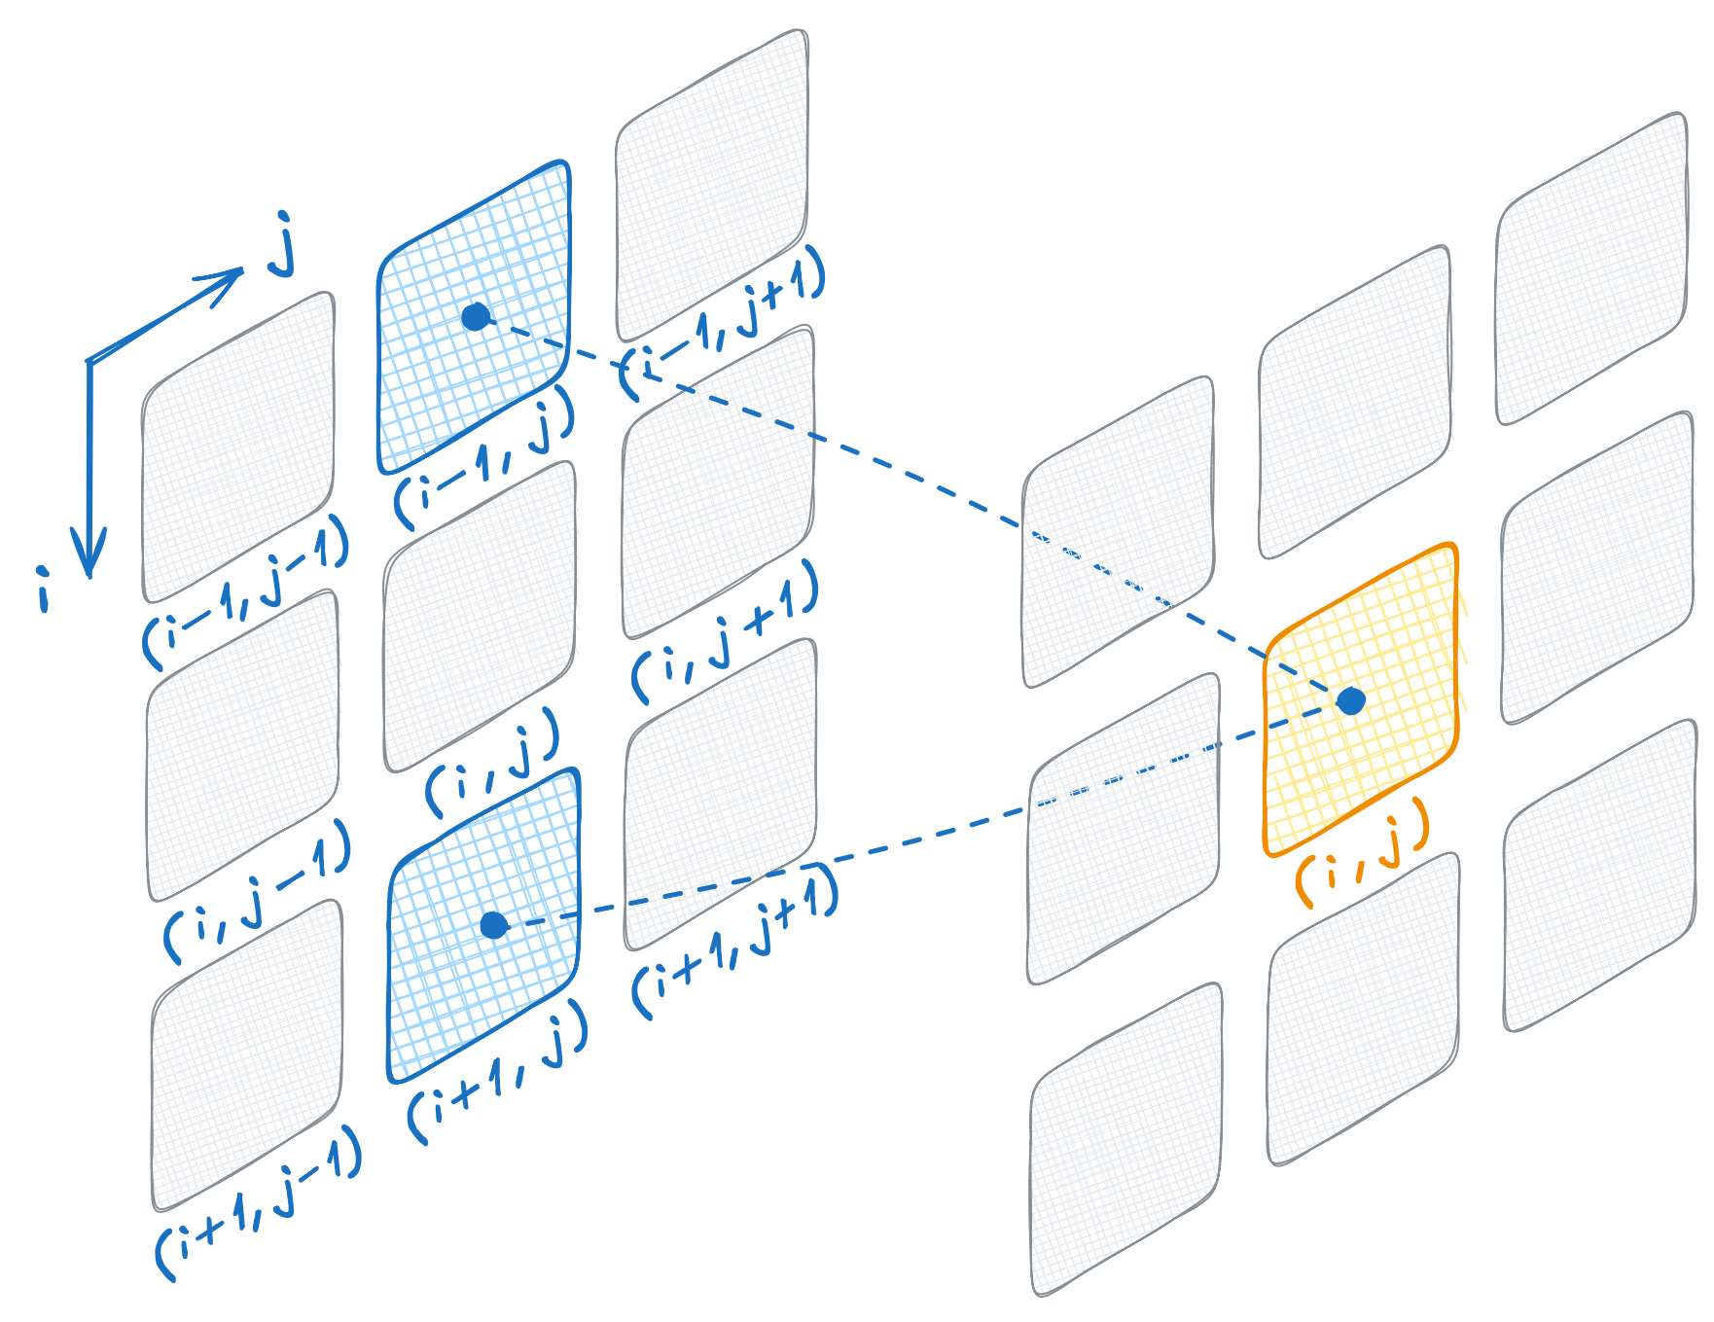
Implementing Stencil Pattern
float d2tdx2 = in_ptr[row * width + column - 1]
- in_ptr[row * width + column] * 2
+ in_ptr[row * width + column + 1];
float d2tdy2 = in_ptr[(row - 1) * width + column]
- in_ptr[row * width + column] * 2
+ in_ptr[(row + 1) * width + column];
return in_ptr[row * width + column] + 0.2f * (d2tdx2 + d2tdy2);
Don’t worry about the exact formula
Instead, consider access pattern
We need values from left and right
We need values from top and bottom
Notes:
Similarly, we compute index of top and bottom neighbors by subtracting and adding one to current row index.

Slide 75
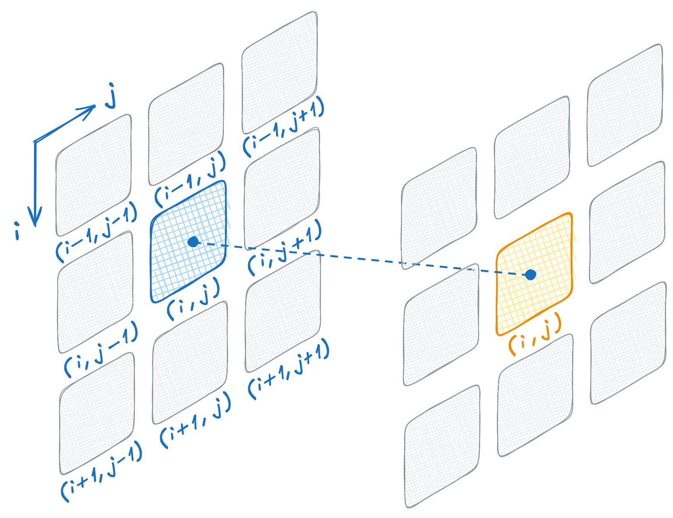
Implementing Stencil Pattern
float d2tdx2 = in_ptr[row * width + column - 1]
- in_ptr[row * width + column] * 2
+ in_ptr[row * width + column + 1];
float d2tdy2 = in_ptr[(row - 1) * width + column]
- in_ptr[row * width + column] * 2
+ in_ptr[(row + 1) * width + column];
return in_ptr[row * width + column] + 0.2f * (d2tdx2 + d2tdy2);
Don’t worry about the exact formula
Instead, consider access pattern
We need values from left and right
We need values from top and bottom
We need value of the current cell
Notes:
Besides that, we incorporate previous temperature of a given cell.
This code works fine in most of the cases, but there’s one issue.

Slide 76
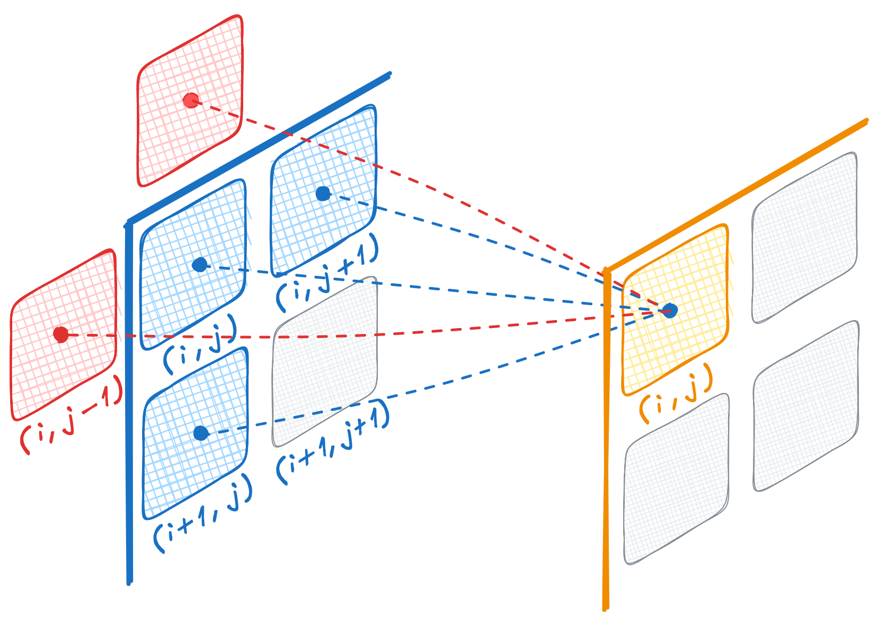
Boundary Conditions
if (row > 0 && column > 0 && row < height - 1 && column < width - 1) {
float d2tdx2 = in_ptr[row * width + column - 1]
- in_ptr[row * width + column] * 2
+ in_ptr[row * width + column + 1];
float d2tdy2 = in_ptr[(row - 1) * width + column]
- in_ptr[row * width + column] * 2
+ in_ptr[(row + 1) * width + column];
return in_ptr[row * width + column] + 0.2f * (d2tdx2 + d2tdy2);
} else {
return in_ptr[row * width + column];
}
Our grid is not infinite
Not all cells have neighbors
Let’s handle boundary conditions
Cells on boundary will be constant
Notes:
Real grids aren’t infinite, so cells along the edges don’t have all four neighbors.
If we tried to compute a left neighbor for the leftmost cell, for example, we’d go out of bounds.
To prevent that, we need to handle boundary conditions.
In this course, we’re using ‘constant’ boundary conditions.
This means that we don’t update the temperature for boundary cells - they keep their original values.
That’s why the code has an if statement checking whether row and column are strictly inside the grid.
If a cell is on the edge, we skip the update and return its current value.

Slide 77
Implementing Stencil Pattern
auto cell_indices = thrust::make_counting_iterator(0);
thrust::transform(
thrust::device, cell_indices, cell_indices + in.size(), out.begin(),
[in_ptr, height, width] __host__ __device__(int id) {
int column = id % width;
int row = id / width;
if (row > 0 && column > 0 && row < height - 1 && column < width - 1) {
float d2tdx2 = in_ptr[row * width + column - 1]
- in_ptr[row * width + column] * 2
+ in_ptr[row * width + column + 1];
float d2tdy2 = in_ptr[(row - 1) * width + column]
- in_ptr[row * width + column] * 2
+ in_ptr[(row + 1) * width + column];
return in_ptr[row * width + column] + 0.2f * (d2tdx2 + d2tdy2);
} else {
return in_ptr[row * width + column];
}
});
We can now:
capture pointer to previous temperatures,
and transform cell indices to new values
Convert the single, flattened cell index into 2D coordinates
Notes:
The next question is how we actually launch this computation on our 2D data.
If you think about it, each cell in our grid corresponds to a single ID in a flattened, one-dimensional space.
So, we can use a `thrust::make_counting_iterator` to generate all possible cell IDs - one for each cell - and then transform those IDs into updated temperature values.
But we still need to figure out which row and column these flat IDs corresponds to.
That’s where the modulo and division come in.
By dividing cell index by module of matrix width we get a column index,
and by dividing the cell index by the matrix width, we get the row index.
With this, we map each flat index to its correct 2D position.
After that, the rest of the code is the same boundary-check logic that we used before.
Essentially, we’re just transforming cell IDs into next-state temperatures, without needing an explicit loop over rows and columns.

Slide 78
Converting Thrust Pointers to Raw Pointers
void simulate(int height, int width,
const thrust::universal_vector<float> &in,
thrust::universal_vector<float> &out)
{
const float *in_ptr = thrust::raw_pointer_cast(in.data());
auto cell_indices = thrust::make_counting_iterator(0);
thrust::transform(
thrust::device, cell_indices, cell_indices + in.size(), out.begin(),
[in_ptr, height, width] __host__ __device__(int id) {
int column = id % width;
int row = id / width;
if (row > 0 && column > 0 && row < height - 1 && column < width - 1) {
float d2tdx2 = in_ptr[row * width + column - 1]
- in_ptr[row * width + column] * 2
+ in_ptr[row * width + column + 1];
float d2tdy2 = in_ptr[(row - 1) * width + column]
- in_ptr[row * width + column] * 2
+ in_ptr[(row + 1) * width + column];
return in_ptr[row * width + column] + 0.2f * (d2tdx2 + d2tdy2);
} else {
return in_ptr[row * width + column];
}
});
}
Get raw pointer from Thrust container
std::vector<int> vec(42);
int *data = vec.data();
thrust::universal_vector<int> vec(42);
thrust::cuda::universal_pointer<int> data = vec.data(); int *ptr = thrust::raw_pointer_cast(vec.data());
std::vector::data()
returns a raw pointer
Because some interfaces require raw pointers
thrust::universal_vector::data()
Returns a typed iterator
You can convert it to a raw pointer with thrust::raw_pointer_cast
Notes:
Notice that we’re capturing the pointer to our temperature data in a slightly unusual way.
In standard C++, calling .data() on a std::vector returns a raw pointer.
But with Thrust containers, .data() returns a typed iterator instead of a raw pointer.
Thrust needs that type information for various reasons, which we’ll explore later.
For now, the main point is that you can convert this typed iterator to a regular C++ pointer by using thrust::raw_pointer_cast.
This gives us the in_ptr we can capture in the lambda.

Slide 79
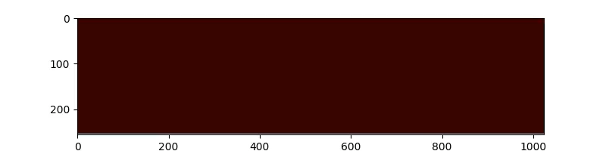
Implementing Stencil Pattern
Simulation results
Let’s simulate an empty oven:
Heating elements on top and bottom
Cold walls on left and right
Notes:
We can start by initializing the entire grid to a low, uniform temperature and then set some higher temperature values at the top and bottom boundaries.
If we run our heat-equation transformation with those initial conditions, we get results that look a bit like an empty oven, heating from the top and bottom.
Over time, you can see the heat spreading into the cooler regions, all according to the stencil computations we just set up.

Slide 80
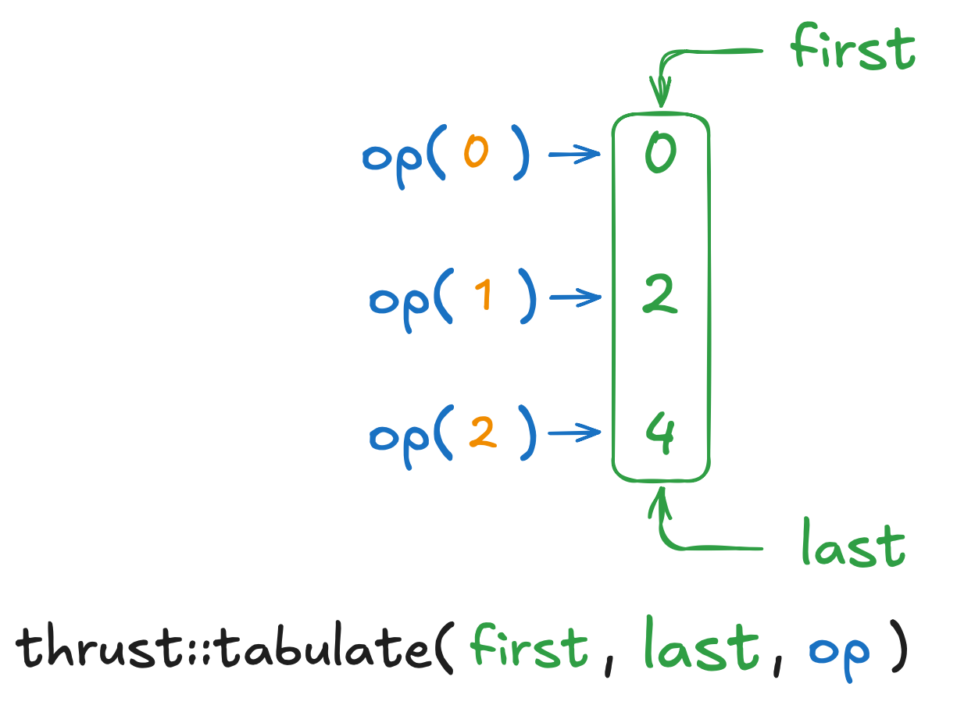
Tabulate
Thrust is not limited to standard algorithms
Tabulate applies operator to element indices and stores result at this index
This is essentially equivalent to transformation of counting iterator
When there’s a specialized algorithm, prefer it, since it’ll likely perform better
Notes:
An important thing to remember is that Thrust isn’t limited to algorithms that match the exact signatures of the C++ Standard Library.
If there’s a common pattern that can be accelerated on the GPU, Thrust often provides a specialized algorithm for it.
A good example is thrust::tabulate.
Under the hood, it’s really just transforming a counting iterator - something we’ve seen is quite common - so Thrust gives it a dedicated name and interface.
The call looks just like thrust::transform, except there’s no input range to pass in, because the input is implicitly generated by tabulation.
Besides being more convenient, specialized algorithms like this are often more optimized.
So, if you spot an algorithm whose name and purpose match what you need to do, it’s a good idea to use it.

Slide 81
Using Tabulate
void simulate(int height, int width,
const thrust::universal_vector<float> &in,
thrust::universal_vector<float> &out)
{
const float *in_ptr = thrust::raw_pointer_cast(in.data());
thrust::tabulate(
thrust::device, out.begin(), out.end(),
[in_ptr, height, width] __host__ __device__(int id) {
int column = id % width;
int row = id / width;
if (row > 0 && column > 0 && row < height - 1 && column < width - 1) {
float d2tdx2 = in_ptr[row * width + column - 1]
- in_ptr[row * width + column] * 2
+ in_ptr[row * width + column + 1];
float d2tdy2 = in_ptr[(row - 1) * width + column]
- in_ptr[row * width + column] * 2
+ in_ptr[(row + 1) * width + column];
return in_ptr[row * width + column] + 0.2f * (d2tdx2 + d2tdy2);
} else {
return in_ptr[row * width + column];
}
});
}
Tabulate is equivalent to transform of counting iterator
Notes:
So, let’s take the next step and replace thrust::transform with thrust::tabulate.
Notice we don’t need to create a counting iterator anymore - tabulate generates the indices internally.
Apart from that, the rest of the code stays exactly the same, so it’s a straightforward swap.
This makes our intent clearer and code easier to read.

Slide 82
Code Reuse
__host__ __device__
std::pair<int, int> row_col(int id, int width)
{
return std::make_pair(id / width, id % width);
}
thrust::tabulate(
thrust::device, out.begin(), out.end(),
[in_ptr, height, width] __host__ __device__(int id) {
auto [row, column] = row_col(id, width);
...
We’ll have to map flattened cell index into 2D coordinates more than once
This means it’s time to follow Don’t Repeat Yourself (DRY) principle and extract common code into function
To return both row and column from this function we could use std::make_pair
Notes:
We’ll likely need to convert from a flat 1D index to 2D coordinates in more than one place, so it’s best to follow the Don’t Repeat Yourself principle and put that logic in a separate function.
That’s what `row_col` function does: it returns a std::pair with the row and column calculated by dividing and taking a remainder against matrix width.
We’ve marked this function as __host__ __device__ so it can be called on both the CPU and GPU.
Then, in our lambda, we can use structured bindings to unpack the pair directly into row and column variables.
This keeps our code clean, makes it easier to maintain, and avoids scattering the same formula in multiple places.

Slide 83
Code Reuse Issue
__host__ __device__
std::pair<int, int> row_col(int id, int width)
{
return std::make_pair(id / width, id % width);
}
thrust::tabulate(
thrust::device, out.begin(), out.end(),
[in_ptr, height, width] __host__ __device__(int id) {
auto [row, column] = row_col(id, width);
...
We’ll have to map flattened cell index into 2D coordinates more than once
This means it’s time to follow Don’t Repeat Yourself (DRY) principle and extract common code into function
To return both row and column from this function we could use std::make_pair
But std::make_pair is a host function! Does this mean we have to re-implement every vocabulary type we might need for CUDA?
calling a __host__ function(" std::make_pair ") from a __host__ __device__ function(" row_col ") is not allowed.
Notes:
Unfortunately, the C++ Standard Library doesn’t know anything about CUDA, so functions like `std::make_pair` aren’t marked as __host__ __device__.
Calling them inside device code triggers a compilation error like the one you see on the screen: ‘calling host function from a host-device function.’
So, what are our options here?
Do we have to re-implement every standard library type just to make it device-friendly?

Slide 84
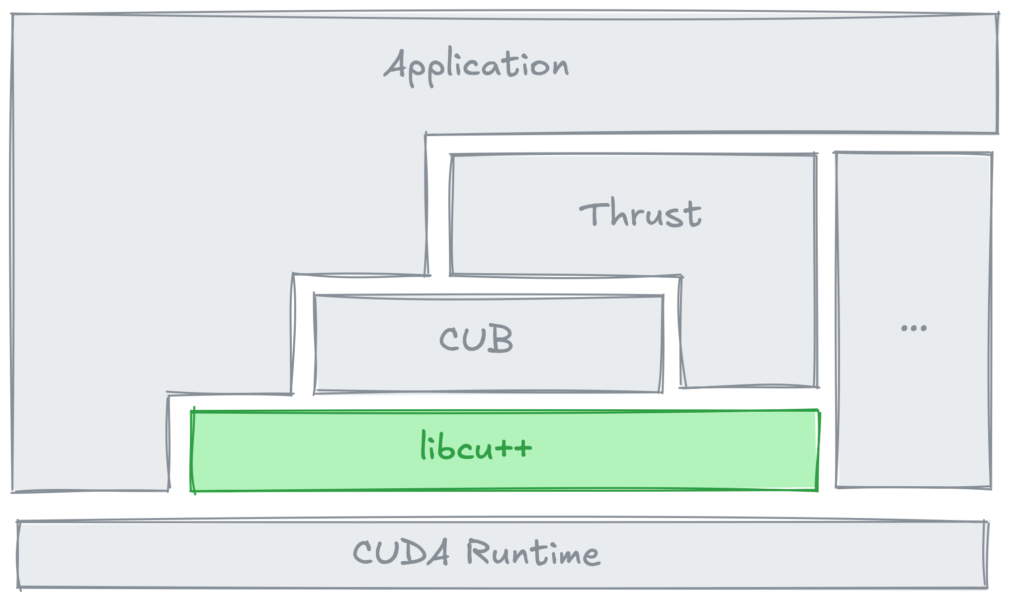
Vocabulary Types in libcu++
Compound Types
cuda::std::pair
cuda::std::tuple
...
Optional and Alternatives
cuda::std::optional
cuda::std::variant
...
Math
cuda::std::complex
cuda::std::mdspan
...
Synchronization
cuda::std::atomic
cuda::std::atomic_ref
cuda::std::atomic_flag
...
CUDA Extensions
cuda::atomic
cuda::atomic_ref
cuda::atomic_flag
...
https://nvidia.github.io/cccl/libcudacxx
Notes:
Fortunately, you don’t have to do that.
Recall from the stack diagram that Thrust is built on top of libcu++, a core library that provides host-device-friendly implementations of many standard C++ vocabulary types.
For instance, it provides such types as pair, tuple, optional, variant, complex, and atomic.
Not only do these types carry the proper __host__ __device__ annotations, but they’re also optimized for GPU usage.
That means you can treat them as drop-in replacements for the usual C++ types, and they’ll compile and run correctly on both the CPU and the GPU.
Let’s see how to swap out std::pair for the libcu++ equivalent.

Slide 85
Vocabulary Types
__host__ __device__
cuda::std::pair<int, int> row_col(int id, int width)
{
return cuda::std::make_pair(id / width, id % width);
}
thrust::tabulate(
thrust::device, out.begin(), out.end(),
[in_ptr, height, width] __host__ __device__(int id) {
auto [row, column] = row_col(id, width);
...
Instead of re-implementing vocabulary types
Just add cuda::in front of a standard type and you get a version that works on both CPU and GPU
Notes:
The actual change couldn’t be simpler: we just prefix `cuda::` to `std::pair`, making it `cuda::std::pair`, and now our code compiles and runs without issues.
The same pattern applies to other standard library types - just pull them in through `cuda::std` instead of std, and you’ll have GPU-friendly, optimized equivalents.

Slide 86
Vocabulary Types
Pair is not the only vocabulary type that can improve our simulator
Consider how we had to manually flatten 2D coordinates
This approach is:
error prone
not productive
float d2tdx2 = in_ptr[row * width + column - 1]
- in_ptr[row * width + column] * 2
+ in_ptr[row * width + column + 1];
float d2tdy2 = in_ptr[(row - 1) * width + column]
- in_ptr[row * width + column] * 2
+ in_ptr[(row + 1) * width + column];
Notes:
cuda::std::pair isn’t the only type that can clean up our code.
Right now, we’re still manually converting between 2D row/column coordinates and 1D indices.
That approach works, but it’s easy to make off-by-one mistakes and other indexing errors.
It’s also not very expressive - you have to remember the exact formula for flattening coordinates every time.

Slide 87
mdspan
Disadvantages of manual linearization become more apparent as number of dimensions increases
// inp[b][n][0][nh][d]
int inp_idx =
(b * N * 3 * NH * d)
+ (n * 3 * NH * d)
+ (0 * NH * d)
+ (nh * d)
+ d;
float q = inp[inp_idx]);
float q = inp(b, n, 0, nh, d)
There’s a standard type that can turn comment on the left into actual code at no performance cost
Notes:
It might not be too bad when we’re just flattening two dimensions, but as soon as you go beyond that, things can get ugly quickly.
Take a look at the snippet on the slide: it flattens a five-dimensional set of coordinates into a single index.
This is actual production code I’ve come across.
It’s easy to make a mistake in code like this - even the comment above has to remind you what the developer really intended to write!
What if I told you there’s a standard C++ type that can make this comment actually compile.

Slide 88
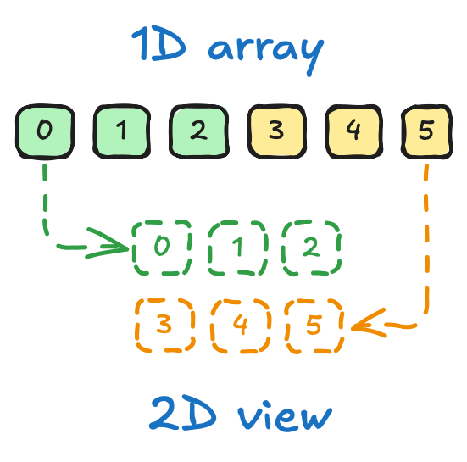
mdspan
cuda::std::mdspan
a multidimensional view of a sequence, that
helps write clean code, and
helps avoid bugs
in linearization of multidimensional indices
by coupling dimensions with the view itself
Notes:
cuda::std::mdspan is a non-owning, multi-dimensional view built on top of a flat data array.
Think of it like a lightweight wrapper around your memory: you give mdspan the dimensions (for example, height and width), and it automatically handles the offset calculations.
Because it’s just a view, there’s no extra memory usage or hidden overhead - it’s practically zero cost.
mdspan results is cleaner and. safer code, which in turn leads to fewer bugs.
Instead of scattering row-major index arithmetic everywhere, you can simply provide mdspan row and column for a 2D layout or extend that idea to higher dimensions.
The image on the slide shows how a 1D array of six elements can be treated as a 3 by 2 grid through mdspan.
Let’s take a look at the actual usage of this type.

Slide 89
mdspan
cuda::std::array<int, 6> sd{0, 1, 2, 3, 4, 5};
Let’s start with a 1D array that we’d like to view as 2D matrix
Notes:
Because mdspan doesn’t own memory, you need an underlying buffer that holds the actual data.
In this example, I’ve created a cuda::std::array<int, 6> containing six elements: 0, 1, 2, 3, 4, and 5.
mdspan will then view these values in whichever multi-dimensional shape we specify, but the data itself remains right here in our array.

Slide 90
mdspan
cuda::std::array<int, 6> sd{0, 1, 2, 3, 4, 5};
cuda::std::mdspan md(sd.data(), 2, 3);
Constructor cuda::std::mdspan of accepts:
raw pointer, (thrust::raw_pointer_cast will be handy)
height of the matrix
width of the matrix
*
* in the case of 2D matrix
Notes:
Let’s take a look at how you can construct an mdspan based on this array.
For this case, we have to pass mdspan three things.
First, we need a raw pointer to the data. Here we use array data() member function that returns a raw pointer.
But if you have to construct mdspan on top of Thrust container, remember to use raw pointer cast.
Besides the raw pointer, we’ll have to provide number of rows (2) and column (3).
That’s all mdspan needs to treat our 1D array as a 2-by-3 matrix.

Slide 91
mdspan
cuda::std::array<int, 6> sd{0, 1, 2, 3, 4, 5};
cuda::std::mdspan md(sd.data(), 2, 3);
std::printf("md(0, 0) = %d\n", md(0, 0)); // 0
std::printf("md(1, 2) = %d\n", md(1, 2)); // 5
You can then access the underlying sequence with operator() by providing:
Row index
Column index
*
* in the case of 2D matrix
Notes:
Once the mdspan is set up, you can access the underlying sequence using parenthesis.
Just supply the row and column indices.
For example, md(0, 0) accesses the very first element – 0.
The passing 1, 2 into parenthesis returns the element at the second row, third column, so 5 in our case.
This is a clean, intuitive way to treat a 1D buffer as a 2D array.

Slide 92
mdspan
cuda::std::mdspan::size()
Returns product of extents
cuda::std::array<int, 6> sd{0, 1, 2, 3, 4, 5};
cuda::std::mdspan md(sd.data(), 2, 3);
std::printf("md(0, 0) = %d\n", md(0, 0)); // 0
std::printf("md(1, 2) = %d\n", md(1, 2)); // 5
std::printf("size = %zu\n", md.size()); // 6
You can query total number of elements with .size()
Notes:
Besides the direct element access, mdspan also provides some handy helper functions.
For instance, calling md.size() returns the total number of elements in the view - in this example, that would be 6.

Slide 93
mdspan
cuda::std::mdspan::extent(r)
Returns extent at rank index r
cuda::std::array<int, 6> sd{0, 1, 2, 3, 4, 5};
cuda::std::mdspan md(sd.data(), 2, 3);
std::printf("md(0, 0) = %d\n", md(0, 0)); // 0
std::printf("md(1, 2) = %d\n", md(1, 2)); // 5
std::printf("size = %zu\n", md.size()); // 6
std::printf("height = %zu\n", md.extent(0)); // 2
std::printf("width = %zu\n", md.extent(1)); // 3
You can also query:
The height of the matrix with .extent(0)
The width of the matrix with.extent(1)
Notes:
Additionally, mdspan lets you query the size of each dimension using the extent method.
For a two-dimensional view, calling md.extent(0) gives you the height, and md.extent(1) gives you the width.
In this example, md.extent(0) will return 2 and md.extent(1) will return 3.
This is essentially the order at which we provided these values in the constructor.

Slide 94
Exercise: mdspan
6 minutes
Use cuda::std::mdspan instead of raw pointers
const float *in_ptr = thrust::raw_pointer_cast(in.data());
thrust::tabulate(
thrust::device, out.begin(), out.end(),
[in_ptr, height, width] __host__ __device__(int id) {
auto [row, column] = row_col(id, width);
if (row > 0 && column > 0 && row < height - 1 && column < width - 1) {
float d2tdx2 = in_ptr[(row) * width + column - 1]
- in_ptr[row * width + column] * 2
+ in_ptr[(row) * width + column + 1];
float d2tdy2 = in_ptr[(row - 1) * width + column]
- in_ptr[row * width + column] * 2
+ in_ptr[(row + 1) * width + column];
return in_ptr[row * width + column] + 0.2f * (d2tdx2 + d2tdy2);
} else {
return in_ptr[row * width + column];
}
});
}
01.04-Vocabulary-Types/01.04.02-Exercise-mdspan.ipynb
Notes:
Which brings us to our next exercise.
This time, instead of capturing a raw pointer in our lambda, we’ll capture an mdspan.
That way, we can use multi-dimensional indexing directly, without manually flattening the row and column into a single index.
It’ll make the code cleaner and less error-prone, while maintaining the same performance.

Slide 95
Exercise: mdspan
6 minutes
Use cuda::std::mdspan instead of raw pointers
cuda::std::mdspan::extent(r)
Returns extent at rank index r
cuda::std::array<int, 6> sd{0, 1, 2, 3, 4, 5};
cuda::std::mdspan md(sd.data(), 2, 3);
std::printf("md(0, 0) = %d\n", md(0, 0)); // 0
std::printf("md(1, 2) = %d\n", md(1, 2)); // 5
std::printf("size = %zu\n", md.size()); // 6
std::printf("height = %zu\n", md.extent(0)); // 2
std::printf("width = %zu\n", md.extent(1)); // 3
01.04-Vocabulary-Types/01.04.02-Exercise-mdspan.ipynb
Notes:
For this exercise, you have 6 minutes starting now.

Slide 96
Exercise: mdspan
Solution
cuda::std::mdspan temp_in(thrust::raw_pointer_cast(in.data()), height, width);
thrust::tabulate(
thrust::device, out.begin(), out.end(),
[temp_in] __host__ __device__(int id) {
int column = id % temp_in.extent(1);
int row = id / temp_in.extent(1);
if (row > 0 && column > 0 && row < temp_in.extent(0) - 1 && column < temp_in.extent(1) - 1) {
float d2tdx2 = temp_in(row, column - 1) - 2 * temp_in(row, column) + temp_in(row, column + 1);
float d2tdy2 = temp_in(row - 1, column) - 2 * temp_in(row, column) + temp_in(row + 1, column);
return temp_in(row, column) + 0.2f * (d2tdx2 + d2tdy2);
}
else {
return temp_in(row, column);
}
});
}
Notes:
Time’s up!
The key to this exercise was creating an mdspan using three parameters:
1. A raw pointer obtained from thrust::raw_pointer_cast.
2. The matrix’s height.
3. The matrix’s width.
Because mdspan keeps track of these dimensions, our lambda no longer needs to capture height and width separately - it can just call extents function to get them.
Even better, we can now write multi-dimensional indexing instead of multiplying row index by width and adding column index.
It makes the code much simpler to follow.

Slide 97
Best Practice: Give Domain-Specific Names
using temperature_grid_f = cuda::std::mdspan<float, cuda::std::dextents<int, 2>>;
using temperature_grid_d = cuda::std::mdspan<double, cuda::std::dextents<int, 2>>;
void simulate(int height, int width,
thrust::universal_vector<float> &in,
thrust::universal_vector<float> &out)
{
temperature_grid_f temp(thrust::raw_pointer_cast(in.data()), height, width);
thrust::tabulate(thrust::device, out.begin(), out.end(), [=] __host__ __device__(int
Actual cuda::std::mdspan type is more involving because it allows you to pass static information about some extents
It’s recommended to give your cuda::std::mdspan a domain-specific type aliases
Notes:
The type for cuda::std::mdspan can get pretty involved, because it lets you specify static as well as dynamic extents.
That’s why there exists a best practice on defining a domain-specific type alias instead of using mdspan type directly.
For instance, we can define a type alias called temperature grid f.
This alias hides the template complexity and makes your code easier to read and maintain.
It also makes it clear that this mdspan is meant to handle a 2D grid of floats.

Slide 98
Best Practice: DRY
__host__ __device__
float compute(int cell_id, temperature_grid_f temp)
{
int height = temp.extent(0);
int width = temp.extent(1);
int column = cell_id % width;
int row = cell_id / width;
if (row > 0 && column > 0 && row < height - 1 && column < width - 1)
{
float d2tdx2 = temp(row, column - 1) - 2 * temp(row, column) + temp(row, column + 1);
float d2tdy2 = temp(row - 1, column) - 2 * temp(row, column) + temp(row + 1, column);
return temp(row, column) + 0.2f * (d2tdx2 + d2tdy2);
}
else
{
return temp(row, column);
}
}
temperature_grid_f temp(thrust::raw_pointer_cast(in.data()), height, width);
thrust::tabulate(thrust::device, out.begin(), out.end(), [=]__host__ __device__(int id) {
return compute(id, in);
}
Extract commonly used functions, just like you would in standard C++
Notes:
Now that we have a domain-specific alias for our mdspan, we can use it in function signatures.
For example, in the code on the slide, the compute function takes a single cell index along with an mdspan.
Inside, it handles all the logic and returns the next temperature.
This keeps our code organized and reusable.
We’ll be using this pattern throughout the course.

Slide 99
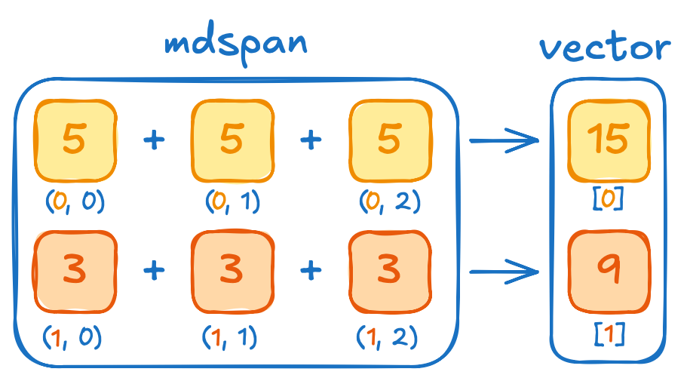
Serial vs Parallel
Let’s compute total temperature in each row
Notes:
At this point, our simulator is coming together nicely, but constantly writing out all the data to disk for visualization can be overkill.
Instead, we can track something simpler, like per-row total temperature.
This way, we can easily see how much heat accumulates at the boundaries over time without having to dump every cell’s temperature.
To visualize what I mean, imagine we take each row of our 2D grid, add up the temperatures of every cell in that row, and store the sum in a 1D vector.
In the example on the slide, the first row has three cells at 5 degrees each, so we store 15 in the first element of the vector.
The second row has three cells at 3 degrees each, so we store 9 in the second element, and so on.
The question is, how do we implement this row-wise aggregation in a clean and efficient way?

Slide 100
Serial vs Parallel
thrust::tabulate(
thrust::device, sums.begin(), sums.end(),
[=]__host__ __device__(int row_id) {
float sum = 0;
for (int col = 0; col < width; col++) {
sum += temp(row, col);
}
return sum;
});
We can use tabulate again, and iterate each row in the unary operator
But would that be a good solution?
Notes:
A straightforward approach is to reach for thrust::tabulate again, but this time we tabulate over row indices instead of cell indices.
Inside the lambda, we loop through each column in the row, accumulate the total temperature, and return that sum.
But is this the best way to do it?
Let’s think about the potential performance implications.

Slide 101

Serial vs Parallel
thrust::tabulate(
thrust::device, sums.begin(), sums.end(),
[=]__host__ __device__(int row_id) {
float sum = 0;
for (int col = 0; col < width; col++) {
sum += temp(row, col);
}
return sum;
});
Code on GPU does not magically become parallel
This means that the code in lambda function is serial
This prevents GPU from doing what it’s good at – massive parallelism
Notes:
When we write our code this way, it’s important to keep in mind that the GPU doesn’t automatically parallelize the loop inside our lambda.
Thrust only parallelizes at the level of rows because we’re calling thrust::tabulate on row indices.
If you have millions of columns but only a handful of rows, you end up with just a few threads each doing a massive amount of work.
That means you’re leaving most of the GPU’s parallel potential on the table - effectively using less than one percent of its capacity!
So, how do we fix this?
We need to somehow distribute the work across many threads.
In other words, we want each column in a row to be handled in parallel too.
Let’s explore how we can reorganize our code to achieve that.

Slide 102
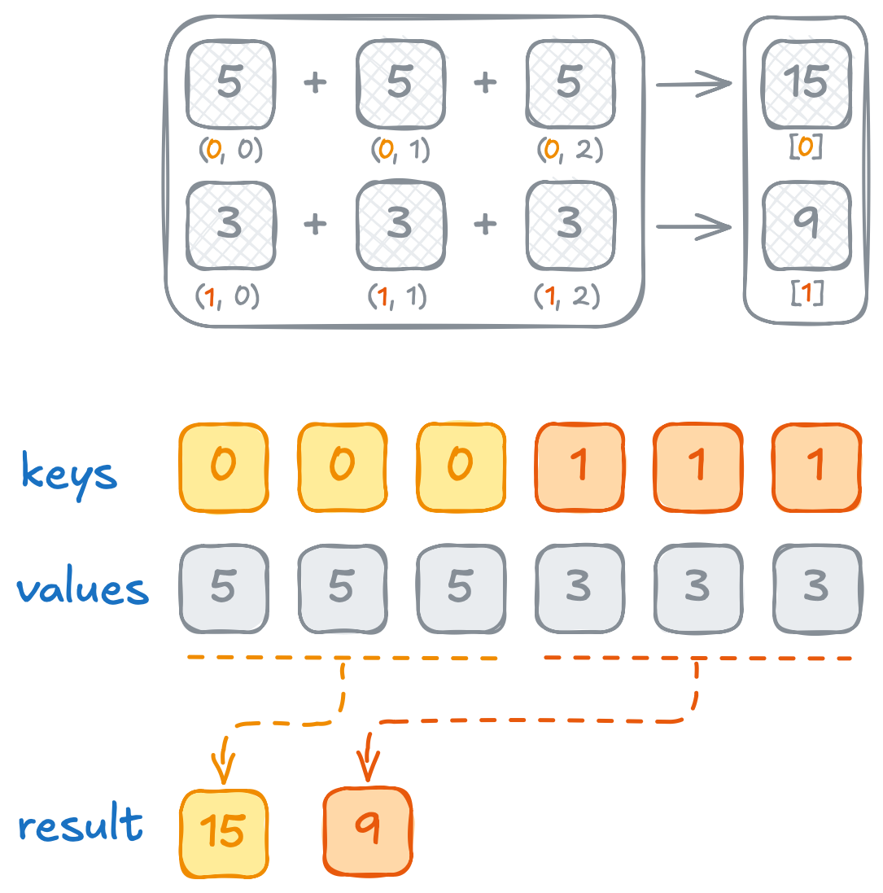
Serial vs Parallel
Observe how all values we want to reduce have common row
Another non-standard Thrust algorithm is a generalization of reduction called: thrust::reduce_by_key
It reduces values in groups of consecutive keys that are equal
This algorithm provides better parallelism than our solution, because it’d associate many threads with each row
Notes:
Just like before, we should begin by naming the operation we’re trying to perform.
If we ignore the fact that we have a row dimension, it basically looks like a standard reduction - except we’re grouping values by row.
That’s exactly where `thrust::reduce_by_key` comes in.
Unlike a plain reduce, reduce_by_key takes two input ranges: keys and values.
It then groups together values that share the same key and reduces each group independently.
So, in our case, the row index naturally becomes our key.
All the cells in a given row share the same key, and we can sum those cell values together.
This way, we spread the work across many threads while still ending up with one final sum per row.

Slide 103
Serial vs Parallel
thrust::universal_vector<float> row_ids(height * width);
thrust::tabulate(
row_ids.begin(), row_ids.end(),
[=]__host__ __device__(int i) { return i / width; });
We can materialize keys using tabulate
Key is essentially a cell index divided by the number of columns
Notes:
To use `reduce_by_key`, we need each cell in the grid to know its row key.
Straightforward way to set this up is to create a ‘row IDs’ array, where each entry corresponds to the row index for the cell at position `i`.
In the code snippet, we do that by calling `thrust::tabulate` on our `row_ids` vector, passing a lambda that returns `i` divided by the grid width.
That way, every cell in row 0 gets a key of 0, every cell in row 1 gets a key of 1, and so on.

Slide 104
Serial vs Parallel
thrust::universal_vector<float> row_ids(height * width);
thrust::tabulate(
row_ids.begin(), row_ids.end(),
[=]__host__ __device__(int i) { return i / width; });
thrust::universal_vector<float> sums(height);
thrust::reduce_by_key(
thrust::device,
row_ids.begin(), row_ids.end(), // input keys
temp.begin(), // input values
thrust::make_discard_iterator(), // output keys
sums.begin()); // output values
Apart from aggregates, reduce by key provides keys as output
We are not interested in them
We can save bandwidth using discard iterator
Notes:
Once we have our row IDs array, we can call thrust::reduce_by_key.
We pass:
• row_ids.begin(), row_ids.end() as the input keys, where each entry corresponds to the row of that cell
• temp.begin() as the input values—these are the temperatures in our 2D grid, flattened into one dimension.
• thrust::make_discard_iterator() as the output keys, which we’ll return in a moment, next we pass
• sums.begin() as the output values, where the final per-row sums will be written.
This way, all cells with the same row key get added together, and we end up with one sum per row in the sums vector.

Slide 105
Serial vs Parallel
thrust::universal_vector<float> row_ids(height * width);
thrust::tabulate(
row_ids.begin(), row_ids.end(),
[=]__host__ __device__(int i) { return i / width; });
thrust::universal_vector<float> sums(height);
thrust::reduce_by_key(
thrust::device,
row_ids.begin(), row_ids.end(), // input keys
temp.begin(), // input values
thrust::make_discard_iterator(), // output keys
sums.begin()); // output values
Apart from aggregates, reduce by key provides keys as output
We are not interested in them
We can save bandwidth using discard iterator
📖 | ✏️
2N | 2N
Notes:
By default, `reduce_by_key` writes both keys and values into output iterators.
But in our case, we already know each row corresponds to a unique key in order - so writing out those row IDs would be redundant.
To save memory bandwidth, we use` thrust::make_discard_iterator()` for the key output.
A discard iterator simply ignores any values written to it, so we skip storing that integer sequence and keep only the per-row sums in sums.

Slide 106
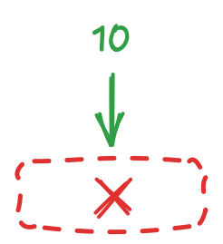
Discard Iterator
struct wrapper
{
void operator=(int value)
{
// discard value
}
};
struct discard_iterator
{
wrapper operator[](int i) { return {}; }
};
int main()
{
discard_iterator it{};
it[0] = 10;
it[1] = 20;
}
thrust::make_discard_iterator()
We can even discard the value
This iterator is helpful when you don’t need some of the algorithm’s outputs
✏️
0
Notes:
[optional – if time permits]
This snippet shows a simplified mental model of how a discard iterator operates.
We have a wrapper struct whose assignment operator simply ignores the value you try to write.
Our `discard_iterator` then returns one of these wrappers whenever you index into it, so any assignment ends up being discarded.
For example, calling it[0] = 10; never stores 10 anywhere - operator=() just quietly throws the value away.
That’s exactly what Thrust’s discard iterator does behind the scenes, letting you skip writing out data you don’t actually need.

Slide 107
tabulate vs reduce_by_key
Reduce by key is 100x faster
Notes:
These changes translate into roughly a hundredfold speedup compared to our initial approach, which relied on tabulate with a loop in the lambda.
It’s a striking reminder that GPUs don’t magically parallelize your code - you need to design your data processing so all those GPU threads can share the workload.
Whenever you see a loop inside a device lambda, ask yourself if there’s a more parallel way to do it.

Slide 108
Exercise: Segmented Sum Optimization
10 minutes
Use counting and transform iterators to generate row indices without materializing them in memory
auto row_ids_begin = // ... ;
auto row_ids_end = row_ids_begin + temp.size();
thrust::universal_vector<float> sums(height);
thrust::reduce_by_key(thrust::device,
row_ids_begin, row_ids_end,
temp.begin(), thrust::make_discard_iterator(),
sums.begin());
📖 | ✏️
2N | 2N
01.05-Serial-vs-Parallel/01.05.02-Exercise-Segmented-Sum-Optimization.ipynb
Notes:
We’ve eliminated most sources of inefficiency, but there’s still one more issue.
Right now, our algorithm makes two passes through memory - one for the temperature values, and another for the row indices.
We don’t actually need to store those row IDs in memory at all!
Think about how we generated the row indices by transforming cell indices (0, 1, 2, …) into row IDs (i / width).
Instead of storing that result in a row_ids array, we can use fancy iterators.
A counting iterator for the cells, plus a transform iterator that converts each cell index into a row index on the fly.
That way, we never write the row IDs out to memory.
Your exercise is to replace the explicit row_ids vector with these iterators, so we have only one real set of data reads and writes.
For this, you’ll have 10 minutes starting now.

Slide 109
Exercise: Segmented Sum Optimization
Solution
auto row_ids_begin = thrust::make_transform_iterator(
thrust::make_counting_iterator(0),
[=]__host__ __device__(int i) {
return i / width;
});
auto row_ids_end = row_ids_begin + temp.size();
thrust::universal_vector<float> sums(height);
thrust::reduce_by_key(thrust::device,
row_ids_begin, row_ids_end,
temp.begin(), thrust::make_discard_iterator(),
sums.begin());
📖 | ✏️
N | N
Notes:
The final solution uses a transform iterator of a counting iterator, so we never actually store row IDs in memory.
That means reduce-by-key only reads the temperature data and writes the aggregated sums, eliminating the extra pass through memory.
Practically speaking, you can’t do better than that.
Let’s see how your change impacts performance numbers.

Slide 110
Serial vs Parallel
Reduce by key is 100x faster
Fancy iterators + reduce by keys is 300x faster
Notes:
In this chart, we’re looking at speedups rather than normalized elapsed times, because the difference is so large it would barely fit on the previous scale.
You can see that using fancy iterators gets us around a 300x speedup compared to our initial, more naive tabulate approach.
By cutting out the extra memory reads for row indices, we’re making much better use of the GPU’s high bandwidth.
Now that we’ve seen how powerful fancy iterators can be, let’s explore what else we can do with them.

Slide 111
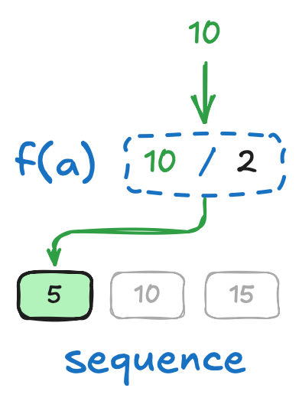
Transform Output Iterator
struct wrapper {
int *ptr;
void operator=(int value) { *ptr = value / 2; }
};
struct transform_output_iterator {
int *a;
wrapper operator[](int i) { return {a + i}; }
};
thrust::make_transform_output_iterator(
a.begin(),
[]__host__ __device__(int a) {
return a / 2;
})
std::array<int, 3> a{ 0, 1, 2 };
transform_output_iterator it{a.data()};
it[0] = 10;
it[1] = 20;
std::printf("a[0]: %d\n", a[0]); // prints 5
std::printf("a[1]: %d\n", a[1]); // prints 10
Concept of iterators is not limited to input
With another level of indirection, we can transform values that are written into transform output iterator
✏️
N
Notes:
[optional – if time permits]
So far, we’ve been transforming values as we read them from an iterator.
But you can also transform values as you write them, by adding another level of indirection on the output side.
In the example on the slide, we return a tiny wrapper object from the iterator’s subscript operator.
When we assign a value to that wrapper, its assignment operator applies a transformation.
In our case, it divides the incoming value by two before storing it in the underlying array.
This leads to an interesting behavior.
So, if you assign it at index 0 a value of 10, 10 is divided by two, and the array element actually ends up storing 5.
In many ways, a transform output iterator is symmetrical to the transform iterator we’ve used before.
Except this time, the transformation happens when writing instead of reading.
So instead of taking raw data and returning modified values, it takes the values you assign and writes a transformed version back to memory.

Slide 112
Exercise: Segmented Mean
10 minutes
Use transform output iterator to compute row mean
struct mean_functor {
__host__ __device__ float operator()(float x) const {
return x / width;
}
};
thrust::universal_vector<float> means(height);
auto means_output = ...
thrust::reduce_by_key(thrust::device, row_ids_begin, row_ids_end,
temp.begin(), thrust::make_discard_iterator(),
means_output);
📖 | ✏️
2N | 2N
01.05-Serial-vs-Parallel/01.05.03-Exercise-Segmented-Mean.ipynb
Notes:
[optional – if time permits]
This transform output iterator idea is really handy in our row-temperature scenario.
Right now, each row sum can be a very large number, which isn’t always meaningful in practice - we’re more interested in the average temperature per row.
Of course, we could do another pass to divide those sums by the row width, but that would mean extra reads and writes, which we’d prefer to avoid.
Instead, we can use a transform output iterator to convert the totals into means on the fly as we write them out.
So, in this exercise, I’d like you to replace the final output iterator in the reduce-by-key call with a transform output iterator that divides each row sum by the grid width.
For this, you’ll have 10 minutes starting now.

Slide 113
Exercise: Segmented Mean
Solution
struct mean_functor {
__host__ __device__ float operator()(float x) const {
return x / width;
}
};
thrust::universal_vector<float> means(height);
auto means_output =
thrust::make_transform_output_iterator(means.begin(), mean_functor{});
thrust::reduce_by_key(thrust::device, row_ids_begin, row_ids_end,
temp.begin(), thrust::make_discard_iterator(),
means_output);
📖 | ✏️
N | N
Notes:
[optional – if time permits]
Time’s up!
Let’s take a look at the solution.
We start by creating a transform output iterator pointing to our means vector and give it a mean_functor that divides each incoming sum by the row width.
That way, when reduce-by-key writes a total into this iterator, it immediately transforms it into an average before storing.
There’s no extra pass over the data - just one write operation that handles both the summation and the final calculation in a single step.

Slide 114
Memory Spaces
Problem statement
...
simulate 0.00016 s
store
simulate 0.03123 s
simulate 0.00018 s
simulate 0.00018 s
store
simulate 0.02954 s
simulate 0.00016 s
simulate 0.00016 s
...
thrust::universal_vector<float> prev = dli::init(height, width);
thrust::universal_vector<float> next(height * width);
for (int write_step = 0; write_step < 3; write_step++)
{
dli::store(write_step, height, width, prev);
for (int compute_step = 0; compute_step < 3; compute_step++) {
dli::simulate(height, width, prev, next);
prev.swap(next);
}
}
Why does computation step take 100x longer after storing?
Notes:
Up to this point, we’ve focused on optimizing our temperature simulation by cutting out unnecessary reads and writes, ultimately harnessing the GPU’s massive parallelism.
Now, let’s take a quick look at the overall structure of our simulator.
On the slide, you can see how we initialize a ‘prev’ buffer and a ‘next’ buffer, store data on disk, and then perform several simulation steps in a loop.
Everything seems straightforward … except for one puzzling detail.
Each time we store the data our next computations slows down - sometimes by a factor of a hundred!
That’s a massive performance drop, and it suggests something else is at play besides our fancy iterators or algorithm design.
In fact, this hints at a deeper concern related to memory spaces.

Slide 115
Memory Spaces
GPU has dedicated memory optimized for higher bandwidth
Notes:
Remember that slide showing the bandwidth differences between CPUs and GPUs?
GPUs can handle much higher data throughput because they have their own dedicated memory, that was specifically architected for massive bandwidth.
Previously, we distinguished host and device execution spaces, to know where actual code runs.
To get better performance, we also have to distinguish device and host memory spaces, in other words, where bytes live.
But that raises a question: how did our simulator run on the GPU in the first place?
We haven’t done anything special to allocate device memory, haven’t we?

Slide 116
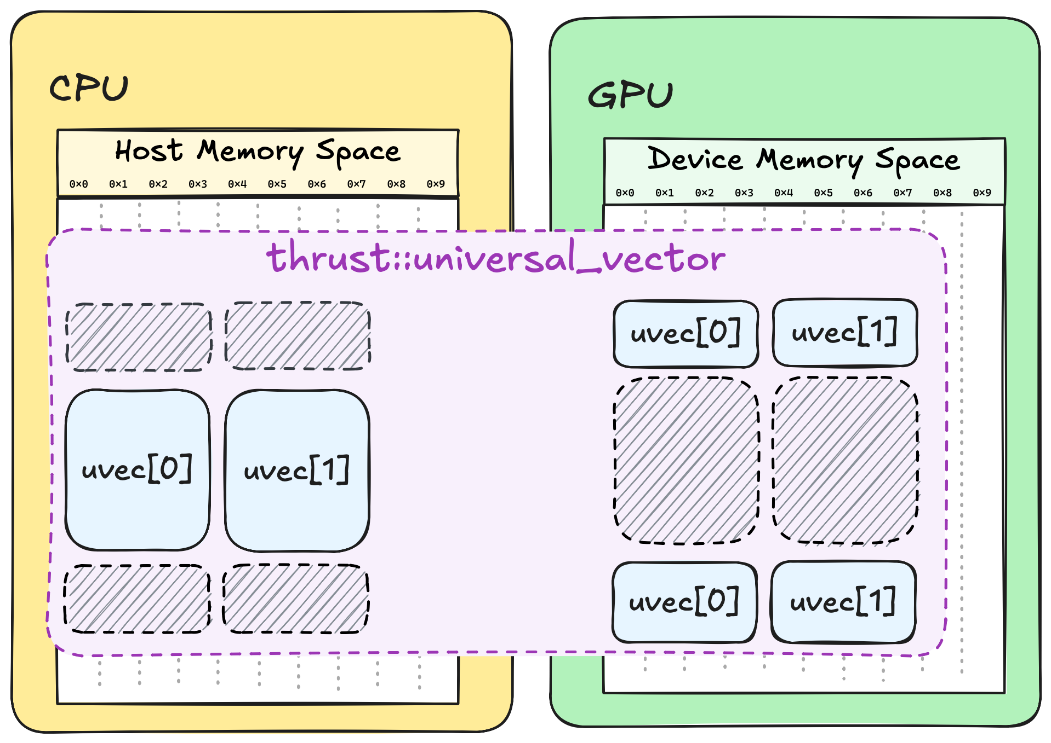
Memory Spaces
Universal vector relies on managed memory
Managed memory abstracts away the fact that GPU and CPU have distinct memory spaces
Implicit memory transfer between memory spaces happens upon accessing memory
Notes:
Well, not exactly.
Earlier, we switched from std::vector to thrust::universal_vector.
This container uses managed memory, a technology that makes the CPU and GPU seem to share the same memory.
Under the hood, though, the CPU and GPU still have separate memory spaces.
Whenever the CPU or GPU accesses data, CUDA silently transfers that data to the location where it’s needed.
In effect, a universal vector keeps two copies of the same data: one for the CPU and one for the GPU.
If the CPU reads or writes to the vector, CUDA invalidates the GPU copy, and vice versa.
This saves us from writing explicit copy calls, but it also has a performance cost.
Let’s go back to our sudden slowdown and see how these hidden data transfers explain perf regression.

Slide 117
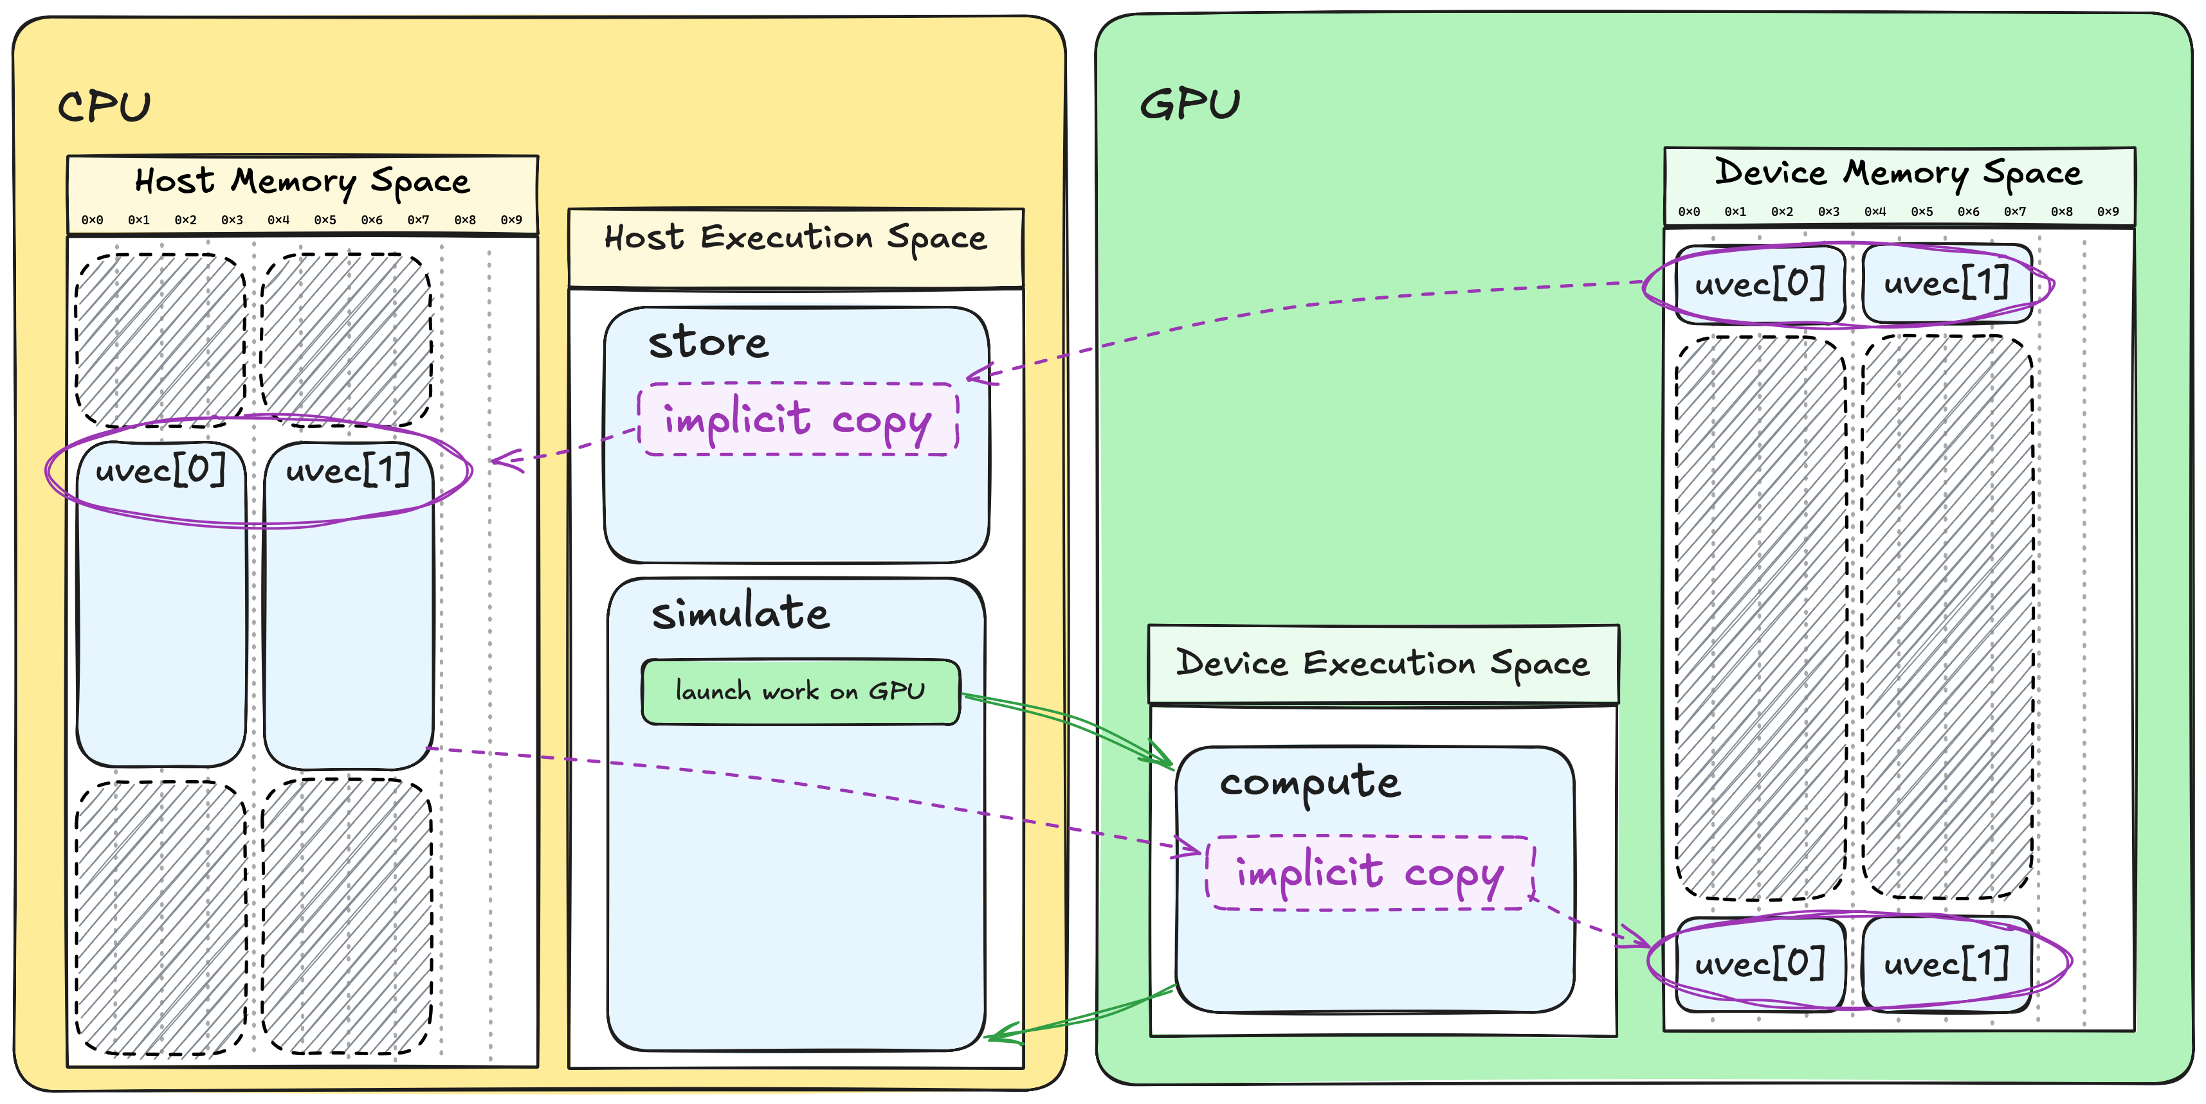
Memory Spaces
Notes:
Imagine the data is in the device memory when we call store on the CPU.
Because the CPU needs that data, CUDA first copies it from the device to host memory.
Once store finishes, we launch the next GPU computation step.
But now the host copy is valid, while the GPU copy is out of date, so CUDA has to copy the data back to the device.
That’s why the first simulation step after storing takes so long - it includes the hidden cost of moving data back onto the GPU.

Slide 118


Memory Spaces
Different containers allow you to be explicit in where you want memory
Host vector:
constructed on host
allocates memory in host space
device cannot access it
Device vector:
constructed on host
allocates memory in device space
host cannot access it
Notes:
To solve our performance problem, we can make the GPU and CPU transfers explicit.
Thrust offers different containers so you can decide where your data should live:
thrust::host_vector allocates memory in host memory, so it’s only accessible in the host execution space.
thrust::device_vector allocates memory in the device memory space, so it’s only accessible in the device execution space.
It’s important to note, that both vectors have to be constructed on the host.
Anyways, by choosing the right container, we avoid the hidden back-and-forth transfers of managed memory.
That way, we only move data across the CPU-GPU boundary when we decide it’s necessary, which helps keep performance more predictable.

Slide 119
Memory Spaces
You can use copy algorithm to explicitly copy between memory spaces
Notes:
We can handle data transfers ourselves by using thrust::copy, which has the same interface as the standard library’s std::copy.
This way, we know exactly when data is crossing the CPU–GPU boundary, and we can control it for optimal performance.

Slide 120
Exercise: Use Explicit Memory Spaces
12 minutes
Use thrust::host_vector and thrust::device_vector instead of thrust::universal_vector
...
simulate 0.00016 s
store
simulate 0.03123 s
simulate 0.00018 s
simulate 0.00018 s
store
simulate 0.02954 s
simulate 0.00016 s
simulate 0.00016 s
...
thrust::universal_vector<float> prev = dli::init(height, width);
thrust::universal_vector<float> next(height * width);
for (int write_step = 0; write_step < 3; write_step++)
{
dli::store(write_step, height, width, prev);
for (int compute_step = 0; compute_step < 3; compute_step++) {
dli::simulate(height, width, prev, next);
prev.swap(next);
}
}
01.06-Memory-Spaces/01.06.02-Exercise-Copy.ipynb
Notes:
Now we come to our final exercise in this section.
This time, we’ll move away from universal vector and instead use separate device host containers.
You’ll have to allocate a host vector to hold the copy of data in CPU space, and use thrust::copy to transfer that between the device and host as needed.
For this, you’ll have 12 minutes starting now.

Slide 121
Exercise: Use Explicit Memory Spaces
Solution
All compute steps now take the same time to run
...
simulate 0.00019 s
store
simulate 0.00018 s
simulate 0.00017 s
simulate 0.00017 s
store
simulate 0.00024 s
simulate 0.00016 s
simulate 0.00016 s
...
thrust::device_vector<float> d_prev = dli::init(height, width);
thrust::device_vector<float> d_next(height * width);
thrust::host_vector<float> h_prev(height * width);
for (int write_step = 0; write_step < 3; write_step++)
{
thrust::copy(d_prev.begin(), d_prev.end(), h_prev.begin());
dli::store(write_step, height, width, h_prev);
for (int compute_step = 0; compute_step < 3; compute_step++)
{
dli::simulate(height, width, d_prev, d_next);
d_prev.swap(d_next);
}
}
Notes:
Time’s up!
Let’s walk through the solution step by step:
We replaced universal vector with separate device and host vectors.
The device vectors (d_prev and d_next) re allocated in GPU memory, while host vector h_prev lives in CPU memory.
The `d_`, and `h_` prefix is quite common to denote the difference in memory spaces.
Then, each time we need to store results to disk we first explicitly copy from d_prev to h_prev using thrust::copy.
We then pass h_prev to the store function, which records the data on the CPU side.
Now, there’s no hidden transfer since both d_prev and d_next live entirely on the GPU.
With this change, data only crosses the CPU–GPU boundary at times we explicitly choose, eliminating the surprising 100x slowdown.

Slide 122
Takeaways
Use NVCC compiler
Notes:
Before we take a break, here’s a quick recap of the main takeaways.
Use NVCC to compile your code for NVIDIA GPUs.

Slide 123
Takeaways
Use NVCC compiler
Use accelerated libraries as much as possible:
Thrust for general-purpose parallel algorithms
cuSPARSE for linear algebra
MatX for array-based numerical computing
etc.
Notes:
Leverage accelerated libraries whenever you can.
Existing libraries are already tuned to make the most of GPU hardware.
For example, use Thrust for general-purpose parallel algorithms and container management.
Use cuSPARSE when you need GPU-accelerated sparse linear algebra functions.
Use MatX for array-based numerical computing, etc.

Slide 124
Takeaways
Use NVCC compiler
Use accelerated libraries as much as possible:
Thrust for general-purpose parallel algorithms
cuSPARSE for linear algebra
MatX for array-based numerical computing
etc.
Use __host__ __device__ execution space specifiers:
to specify where given function could be executed
Use thrust::host and thrust::device execution policies:
to specify where given thrust algorithm will be executed
Notes:
When writing your CUDA code, remember the difference between execution specifiers and policies:
Use __host__ __device__ execution space specifiers to specify where given function could be executed.
Use thrust::host and thrust::device execution policies to specify where given thrust algorithm will be executed.

Slide 125
Takeaways
Use NVCC compiler
Use accelerated libraries as much as possible:
Thrust for general-purpose parallel algorithms
cuSPARSE for linear algebra
MatX for array-based numerical computing
etc.
Use __host__ __device__ execution space specifiers:
to specify where given function could be executed
Use thrust::host and thrust::device execution policies:
to specify where given thrust algorithm will be executed
Avoid serialization as much as possible
Notes:
Avoid serialization as much as possible.

Slide 126
Takeaways
Use NVCC compiler
Use accelerated libraries as much as possible:
Thrust for general-purpose parallel algorithms
cuSPARSE for linear algebra
MatX for array-based numerical computing
etc.
Use __host__ __device__ execution space specifiers:
to specify where given function could be executed
Use thrust::host and thrust::device execution policies:
to specify where given thrust algorithm will be executed
Avoid serialization as much as possible
Use explicit memory spaces
Notes:
Where possible, use explicit memory spaces to avoid unexpected slowdowns.
Rather than relying on implicit managed memory transfers, define separate host and device vectors and manage data movement yourself.
This way, you’re always in control of when and how data travels between the CPU and GPU.

Slide 127
Takeaways
Use NVCC compiler
Use accelerated libraries as much as possible:
Thrust for general-purpose parallel algorithms
cuSPARSE for linear algebra
MatX for array-based numerical computing
etc.
Use __host__ __device__ execution space specifiers:
to specify where given function could be executed
Use thrust::host and thrust::device execution policies:
to specify where given thrust algorithm will be executed
Avoid serialization as much as possible
Use explicit memory spaces
When existing libraries do not cover your use cases
Use fancy iterators to extend them
Notes:
And lastly, fancy iterators give you a powerful way to extend existing parallel algorithms to your unique use cases.
By encapsulating custom logic, you can reuse Thrust’s highly optimized building blocks without having to rewrite entire algorithms from scratch.

Slide 128
Break
35 minutes
Notes:
With that, let’s pause for lunch break.
Enjoy your meal, and we’ll continue in 35 minutes.

